Slide 1
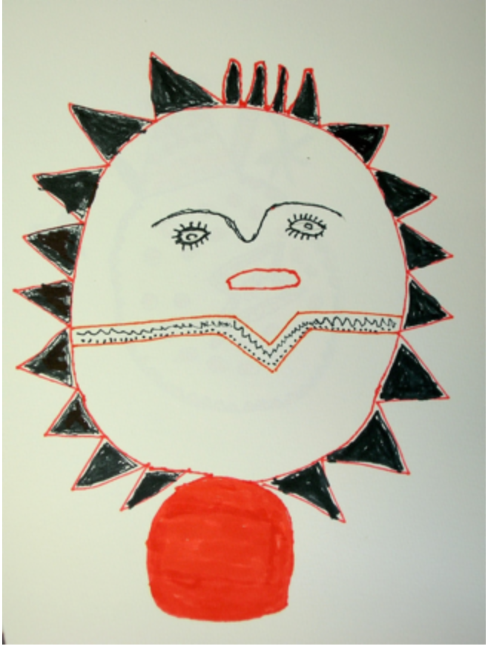
“Looking at the Sun as an Act of Memory: An Analysis of Two Quichua Sun Songs.”
Tod Swanson
In this essay I present two Pastaza Quichua sun songs that mutually interpret each other. Both songs are expressions of a particular type of filial piety called “ayllura iyariina” (remembering relatives). The Kichwa verb iyarina which means both “remembering” and “thinking,” consists of looking at the local land or some aspect of the local landscape and remembering the family history that occurred there. This memory then orients future action.
Song 1: When the sun comes up each morning Eulodia Dahua sings this song which addresses her departed mother and the sun.
This sun, This sun
My dear mother
My dear mother
You saw, You saw
My mother you saw
This sun
When from inside your womb,
When from inside your womb
You were bringing me out
You were bringing me out
You saw this same sun
My dear mother, my mother
My dear mother, my mother
Now when you go away leaving me
When you go away leaving me
The likeness of your face
The likeness of your face
Every day I will see
Every day I will see
The likeness of your face
When I look at the sun
I will be here remembering
My dear mother, my mother
My dear mother, my mother

Slide 2
Kai indita chu-yan// Ñuca mamitagaya// Ricupangui,rikupan ya Kai indita chu-ya Ñuca mamitagaya ricuparangui Kan iksaukumanda// Llukshisha llukshisha, Kai indita chu-ya Rikuparangui mari Mamitalla, mamita//
Kan ichusha rikpi// Kamba ñawita shina// Tukui punzhalla-mi-ya// Kamba nawita shina Indita rikusha Yuyarisha tiyani Mamitalla mamita//

Slide 3
-2-
How does the sun serve as a tie or a bond between the singer and her departed mother? The singer’s mother is said to have looked at this sun at the moment she was giving birth to the singer. Because of this her mother’s face, captured at that intimate moment, is there recorded in the sun. After the mother dies the daughter remembers her mother’s face every day when she sees the sun. The sun can function as a mother for her because it contains that motherly memory of the singer’s birth. The memory of that moment is so etched into the sun that the sun remembers the singer’s birth with the same intensity and intimacy that her mother would would have remembered it.
The song has a depth of generational memory because the singer’s Achuar great grandmother Nunguli is said to have sung the same song remembering her own mother. By singing this song habitually the singer becomes an “Indi Warmi” or a “Sun Woman” because she is the daughter, granddaughter, and great-granddaughter of other Indi Warmiuna (sun women) who have similarly sung their family identities into the sun. The song illustrates the way in which Quichua/Shuar/Andoan culture linked the memory of relatives and family history (Quichua: yuyarina/iyarina) to objects in nature (in this case the sun, but frequently manioc fields, or plant and animals species). The local earth or natural world served as pneumonic device for remembering relatives because it is believed to contain the local past.

Slide 4
-3-
Song 2 “I am a Sun Woman” (Quichua transcription; Indi Warmi Marani);
Singer: Eulodia Dagua. Recorded by Tod Swanson, June 2009
In this second song, which is a form of love medicine or love magic, the same singer uses this nature-embedded quality of memory to fix her own face in the sun so that a man who seeks to leave her will be haunted by her memory every time he sees a sunrise or a sunset. Once the song is sung each sunrise and sunset will flood the man’s heart with longing causing him to return to the woman he left.
I am a Sun Woman
I am a Sun Woman
I am not a human woman
I am a Sun Woman
If you say you want to leave me
If you say you want to leave me
It is not like before
I am not a human woman
I am a Sun Woman, I am a Woman of the Sun
(If ) you (say) I will go leaving her
If you say I want to go leaving her.
Every morning.
I will rise taking your little eyes out.
I will dawn taking them out
Sun Woman, Sun Woman
She was in the Sun, Sun
She was in the Sun, Sun
Don’t turn around to look back
Your heart, Your heart
I will take, I will take
When the sun is going down
Don’t turn around
Don’t look at me
I will go taking your heart away
The power of this second song is dependent of the first. The woman can identify herself as a “sun woman” and so use the sun to her advantage as love medicine only because the sun has been associated with her family, her mother, and her birth through the habitual looking at the sun and remembering her mother expressed in the first song.

Slide 5
Indi warmi marani// Mana runa warmichu arani Ñucaga indi warmi marani Kan ichuni nijpi// Mana ñaupa yagari Mana runa warmichu garani Ñucaga indi warmi marani, Indi warmi marani Kan ichusha rini Kan ichusha rini nisha nijpi Karan tutamandami Camba nawillatami llujshisha pagariuni, Llujshisha pagariuni Indi warmiga yari// Indi indi ashkaimi//
Ama vultarishaga washama ricunguichu Kamba shunguta gaya// Apangawarauni ya// Indi ikushcaiviga Ama vultarishaga Ama ricuwanguichu Kamba shungutagaya apasha ringarauni

Slide 6
-4-
The second song was given to Eulodia by her Father when she was a young girl so that she could use it in the future if a man should threaten to leave her. In using the song the singer takes on the identity of the sun and uses it to influence the emotions of a man who threatens to leave her. The singer’s identity as a sun woman is hidden to her lover. Although he has lived with her all this time he thinks she is just a human woman whom he can easily leave. But she turns out to have been a sun woman. After she sings this song he will be unable to forget her anymore than he can forget the sun because the singer has intertwined her own family history and identity with that of the sun. When he sees the sun each morning, the image of the woman he seeks to leave will come back with a painful clarity burning his memory like the blazing sunrise burns his eyes. Every time he sees the sunset her memory will take away his heart like the setting sun takes the light from the world.
In both sun songs the sun works as a aspect of nature that holds the memory of relatives. In the first song, “My Mother in this Sun,” it is a positive memory that makes the singers departed mother present in her life. In the second “I am a Sun Woman” it causes the memory of an abandoned woman to haunt the husband who wants to leave her so that he will come back. The singer is only able to use the sun to haunt the memory of the man because she is a Sun Woman. She is because she comes from a line of women who have understood their family history as recorded in the Sun.

