Slide 1
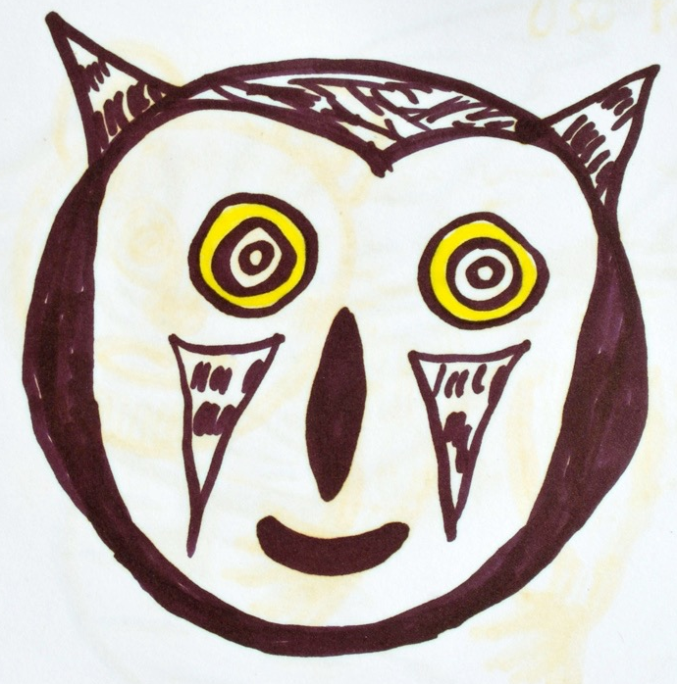
Angallami Kaparinga
Ñuka rishka washapi
pani-situ pani-kulla
waka-sha-lla tiya-ju-ngui
panisitu panikulla
ñuka rishka washapi
anga-lla-mi kaparin
angallami kaparinga
angallami kaparinga
ñuka rishka washapi
Illangami kai-manda
Illangami kaimanda
ñuka rishka washapi
angallami kaparin
angallami kaparinga
angallami kaparinga
panisitu panikulla
karan tutamanda-ga
kandaga-lla uya-chi-uni,
ñukaga tiyaushallami
karan tuta uya-chi-uni,
panisitu panikulla
ñuka chingari-kpi-ga
angallami kaparinga
kanba rinrii sapiga kaparinga

Slide 2
Translated from Kichwa by Tod Swanson
From Alessandra Foletti-Castegnaro
Cantos de Amor y de Guerra, Abya-Yala, 1987.
Ñuka rishka washapi After I am gone
panisitu panikulla Little sister, dear sister
wakashalla tiyajungui You will just be crying
panisitu panikulla Little sister, dear sister
ñuka rishka washapi After I am gone
angallami kaparin Only an owl calls
angallami kaparinga Only an owl will call
angallami kaparinga Only an owl will call
ñuka rishka washapi After I am gone
Illangami kaimanda He will be absent from here
Illangami kaimanda He will be absent from here
ñuka rishka washapi After I have left
angallami kaparin Only an owl calls

Slide 3
angallami kaparinga Only an owl will call
angallami kaparinga Only an owl will call
panisitu panikulla Little sister, dear sister
karan tutamandaga Every morning
kandagalla uyachiuni, You are the only one I will make hear it
ñukaga tiyaushallami I will just be there
karan tuta uyachiuni, Every night I will make you hear it
panisitu panikulla Little sister, dear sister
ñuka chingarijpiga When I disappear
angallami kaparinga Only an owl will call
kanba ringri sapiga In the root of your ear
kaparinga It will call.

Slide 4
Vocabulary for Angallami Kaparinga
rina
washa-pi
wakana to cry
Illana to be absent
tiyana to be present
kai here or this
tutamanda morning
kan you
ñuka I
karan every
tuta night
uyachina to cause to hear
pani sister of a male
chingarina to disappear, to die
anga bird of prey
rinri ear
sapi root
kaparina to cry out
-lla only, just
-mi affirmative
-shka more distant past marker
-nga future 3rd person singular marker
-manda from
-pi locative marker in, at

