Slide 1
Kichwa uses many of the same words for human and animal body parts. This may seem strange to speakers of European languages who take it for granted that their bodies differ qualitatively from those of plants and animals. The reasons for this are complex, but may be understood as, in part, related to the European split between culture and nature. Human bodies are different because they are believed to express a moral and cultural personality which is traditionally understood in Judeo-Christianity as made in the image of God. By contrast plants and animals are pure nature.

Slide 2
Consider, for example, how the following expressions and usages create a different set of associations for human vs nonhuman bodies: hands pray and create art while paws and claws carry out instinctive acts; humans speak but animals bark, howl, or chirp; humans kiss, caress, and make love while animals mate; humans shed tears while trees drip sap. In English the attribution of animal bodies to humans is most commonly in the form of insult such as: ‘He fell into her claws’ or ‘Don’t put your paws on me.’

Slide 3
By contrast Quichua culture does not make a split between culture and nature, and comparing human and animal bodies is common in compliments. Therefore, unlike English or Spanish, Quichua often uses the same terms for the human body as it does for the bodies of plants or animals. For example the roots of a tree are its angu (tendons or veins). The stem is its tullu or bones. The smaller stem of a leaf is its “hand” or maki. The nodes of its stem are its knuckles or muku. The base of a tree is its siki (buttocks). If its kara (skin/bark) is cut, the sap that it sheds is its wiki or tears.
This interchangeability of terms reflects differences in the way Quichua people speak about plants and animals. In Quichua the human body is frequently used to speak analogically about plant and animal experience.

Slide 4
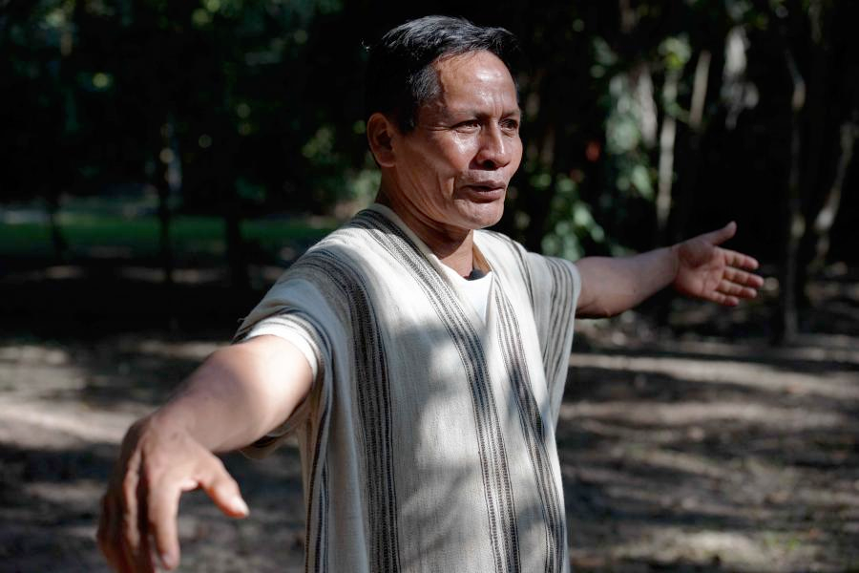
rigra
rigra

Slide 5
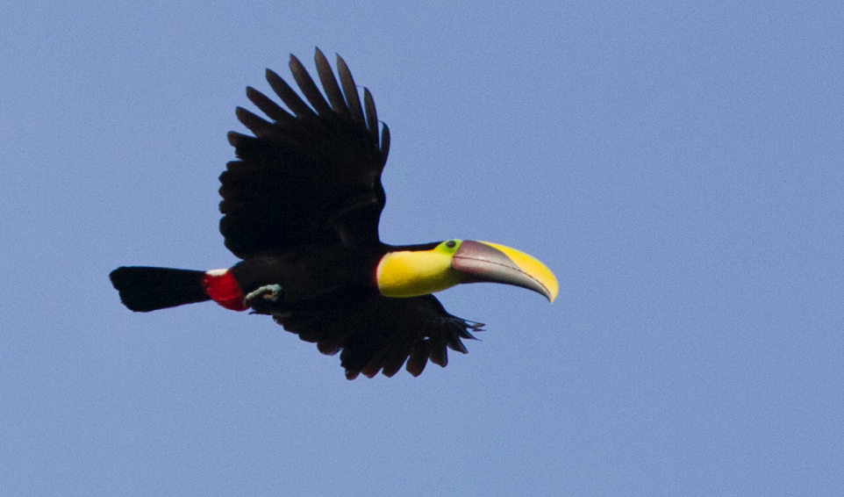
rigra
rigra

Slide 6
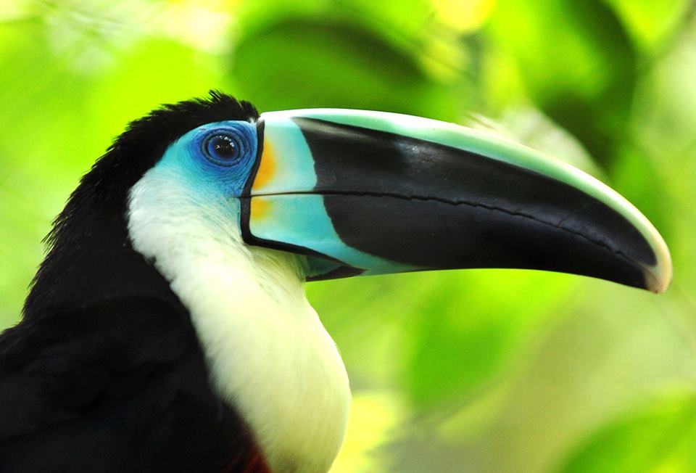
kiru
ilma

Slide 7
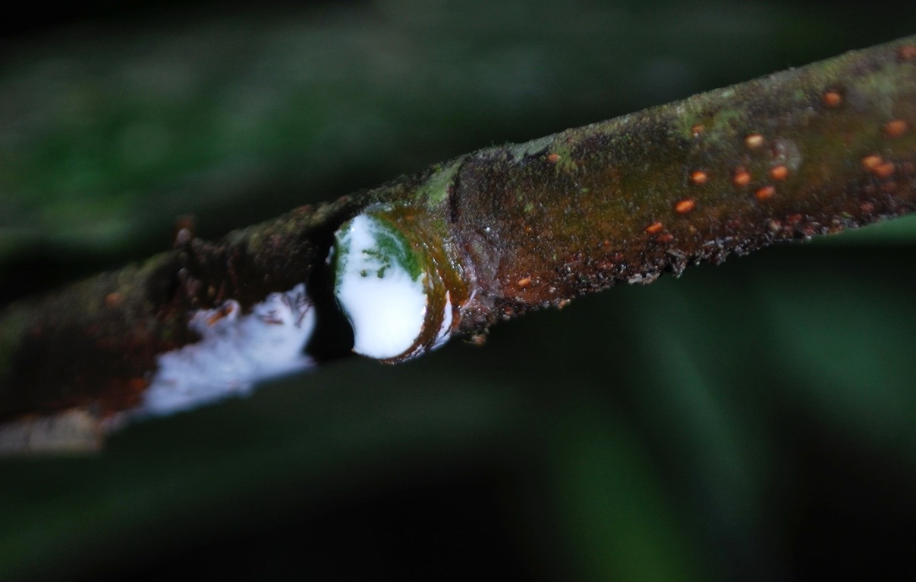
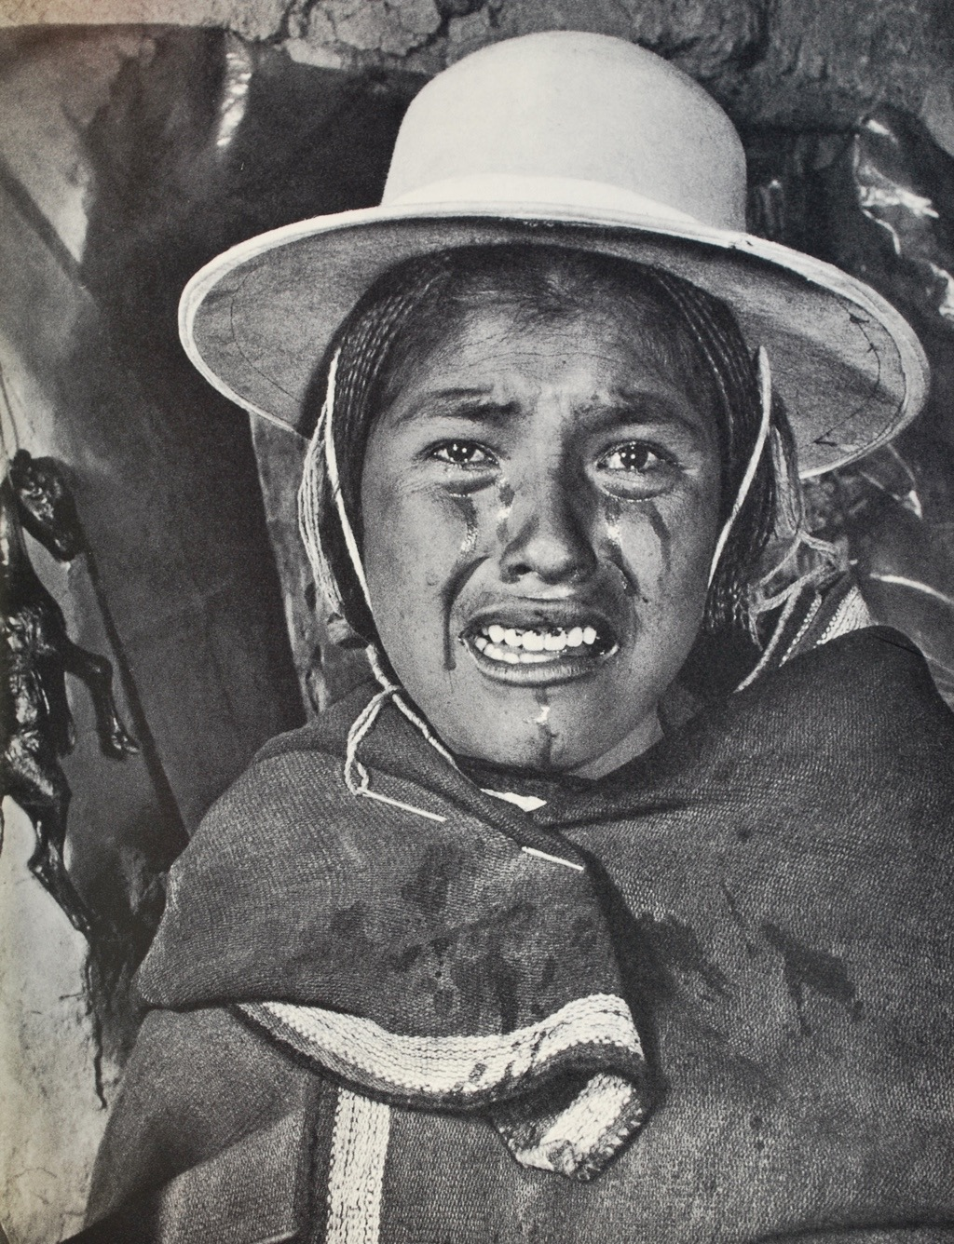
iki means both sap and tears
iki = sap
iki = tears

Slide 8
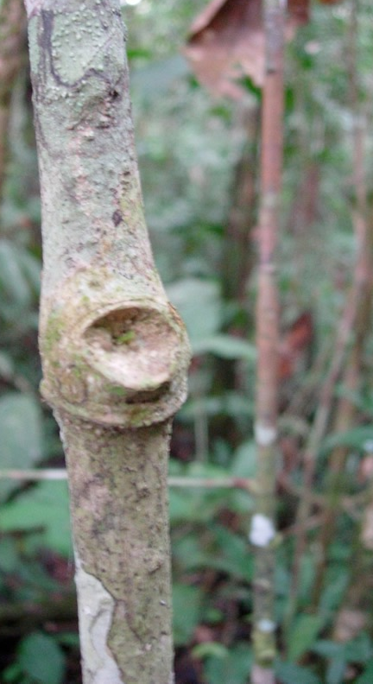
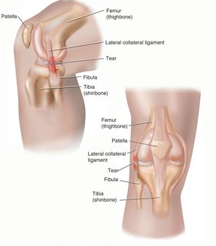
English has words for the joints of the body that are used exclusively for human anatomy: knee, ankle, elbow, hip, shoulder, knuckles. Kichwa uses a single word mucu for the joint of humans, other animals and plants.
mucu joint or knuckle.
tullu (bone or stem)

Slide 9
tullu
tullu (stem or bone)

Slide 10
In beginning times the chichiku was a human woman. When she chewed manioc to make chicha her mouth was stained white.
White mouthed chichiku
White mouthed chichiku
She made manioc chicha
She made manioc chicha
From that time until now
White mouthed chichiku

Slide 11
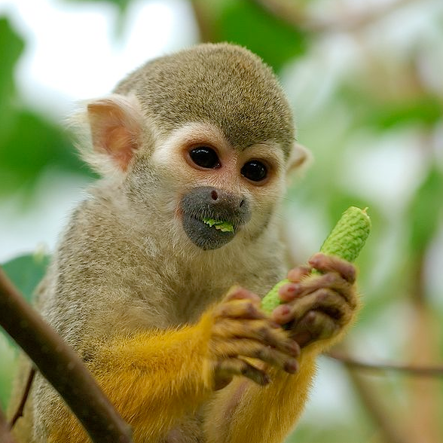
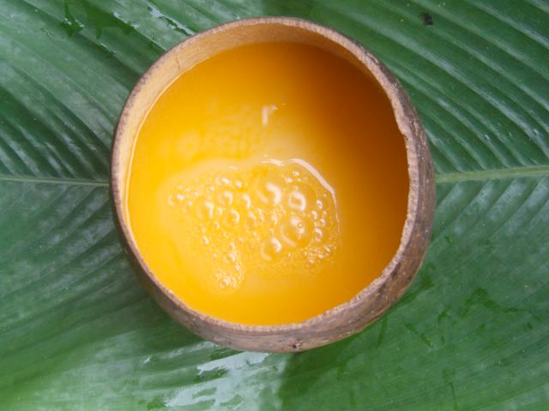
The distinctive features of plant and animal bodies come from a previously human history
In beginning times the squirrel monkey was also a human woman. When she kneaded yellow chonta fruit to make chant chicha her her hands were stained yellow.
Yellow handed squirrel monkey
She made chonta chicha
She made chonta chicha
From that time until now
Yellow handed squirrel monkey
Yellow handed squirrel monkey
She stands at the chicha jug
With her hands dripping
The yellow handed squirrel
she mixes (chicha) and serve drinks

Slide 12
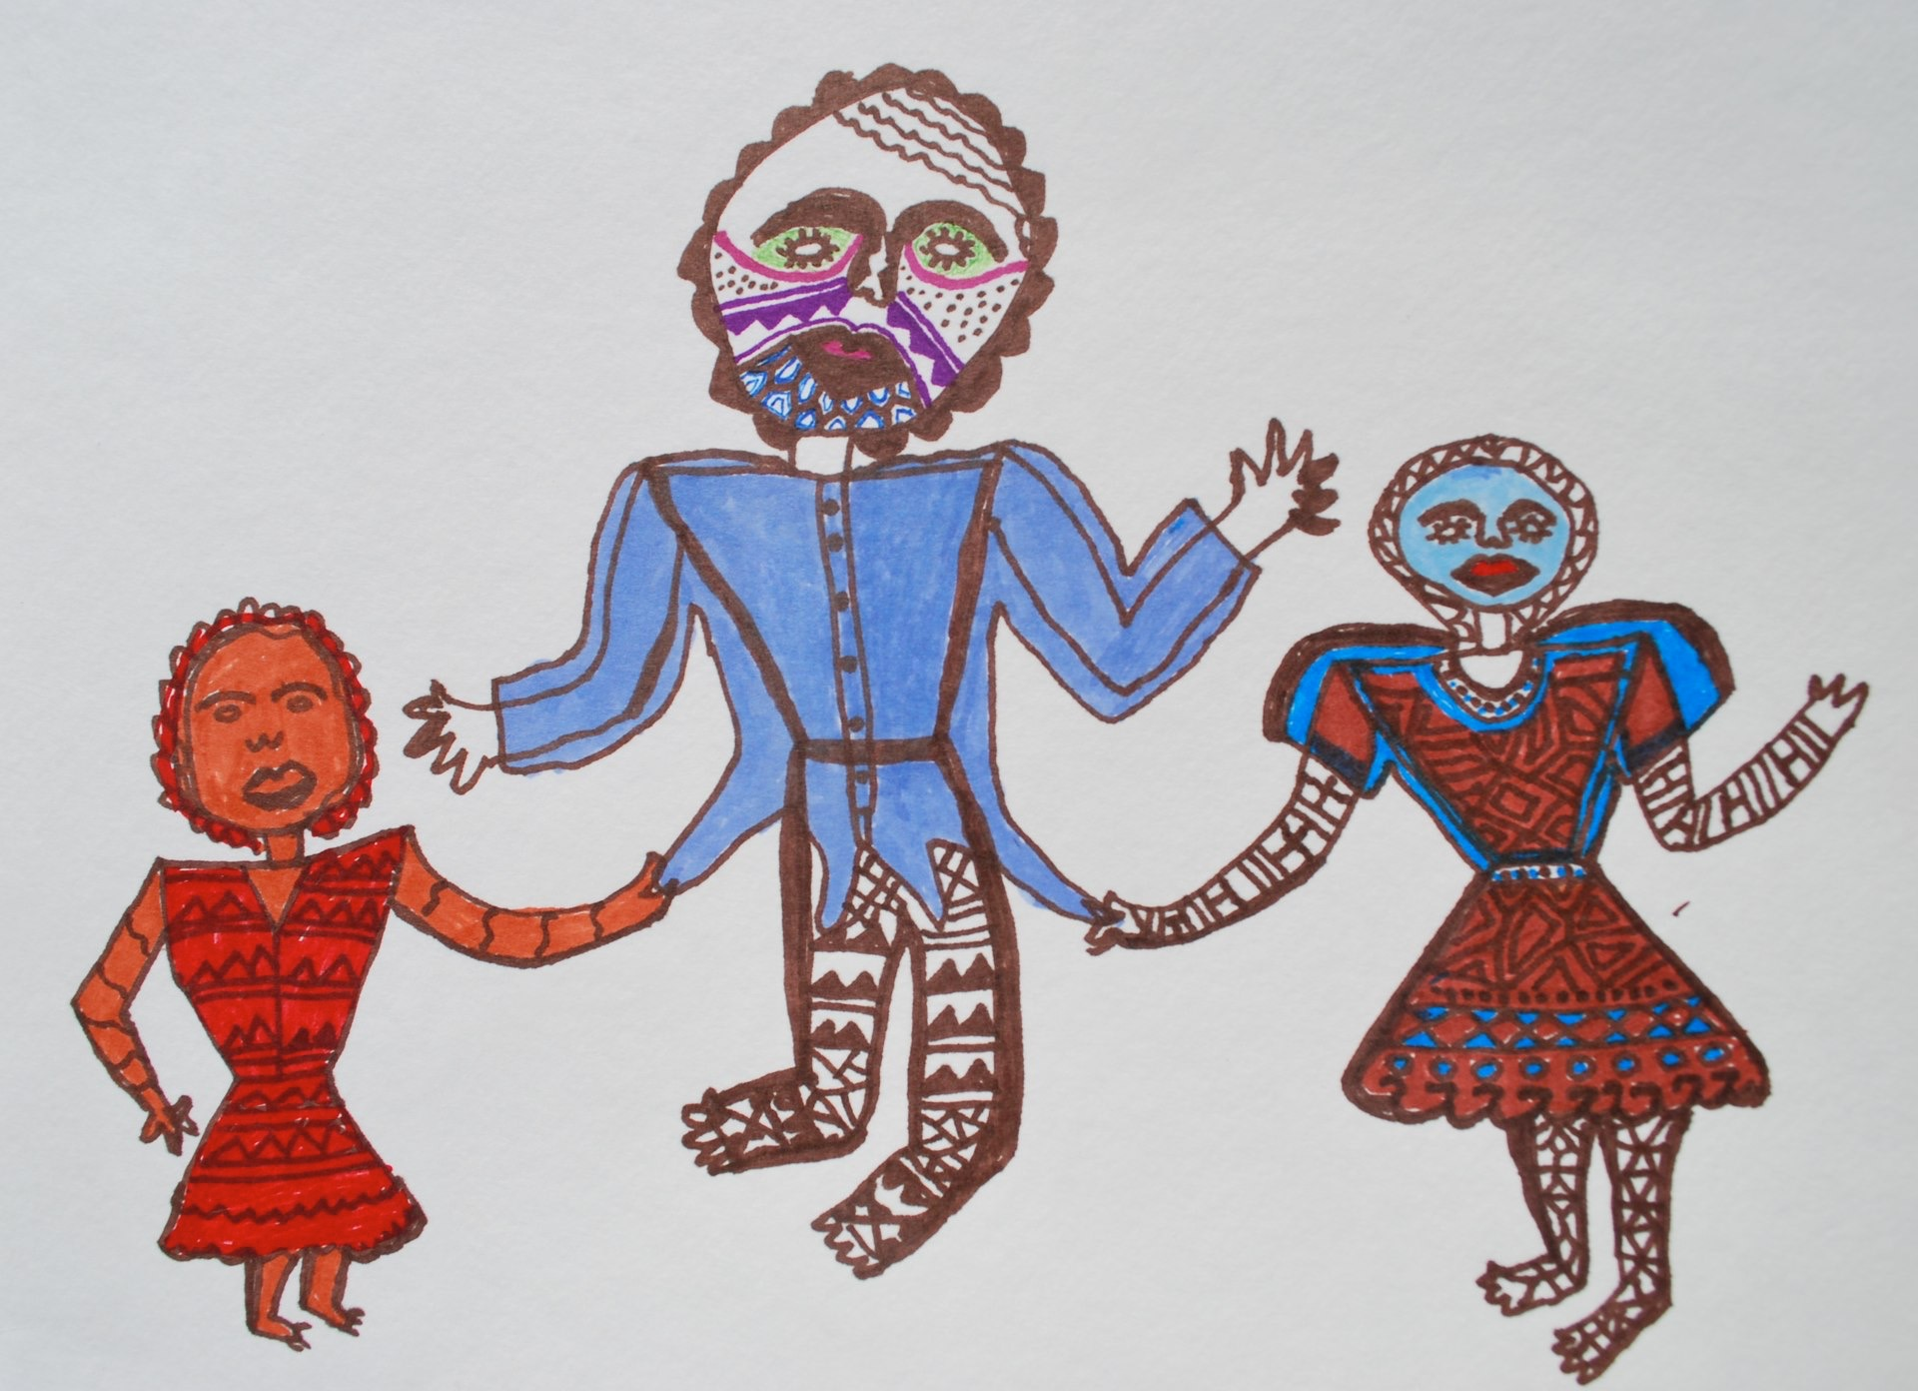
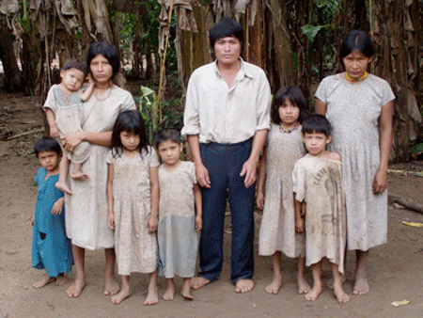
Kichwa thinking plants are as similar to humans as are animals because they too result from the transformation of human bodies.
In Jivaroan cultures the normal marriage was two sisters married to one man.

Slide 13
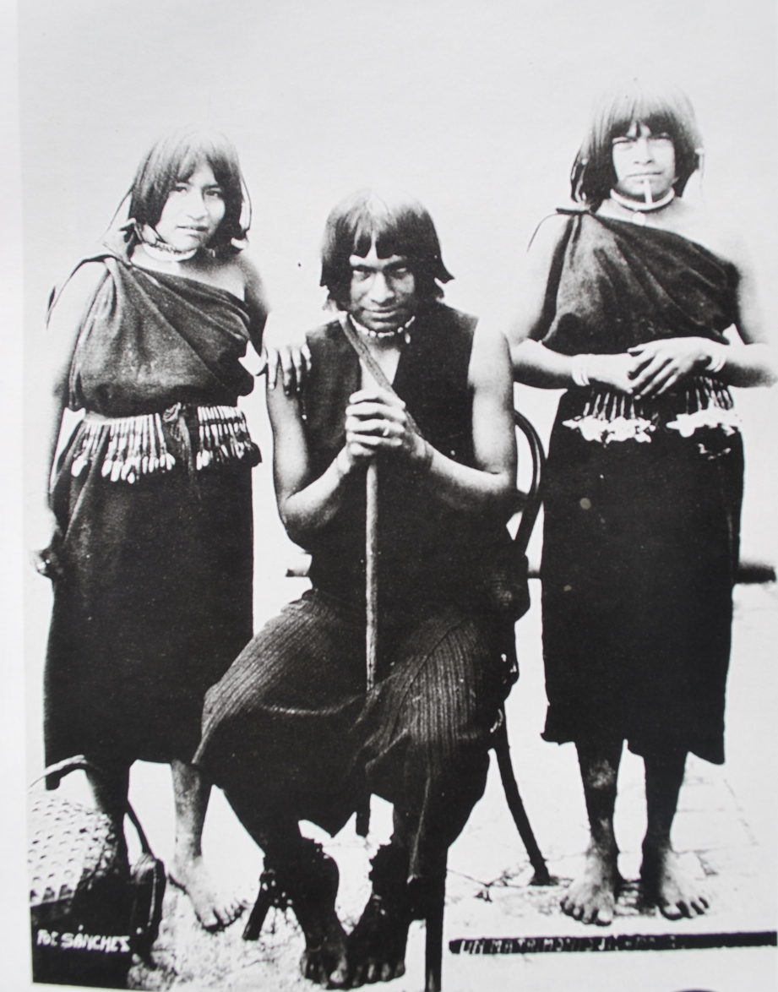
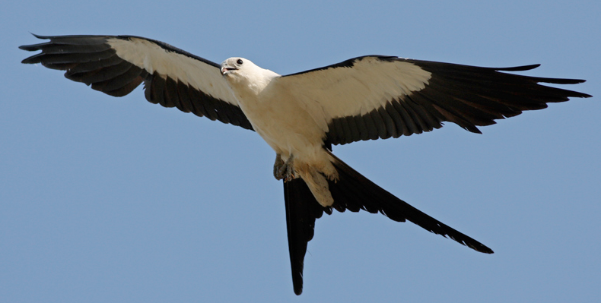
Manduru and Wituk were two sisters who pulled their husband in two different directions. Because life under these conditions was unbearable he flew off in the form of Nayapi the swallow tailed kite his tail forked by how the women had pulled him in different directions.

Slide 14
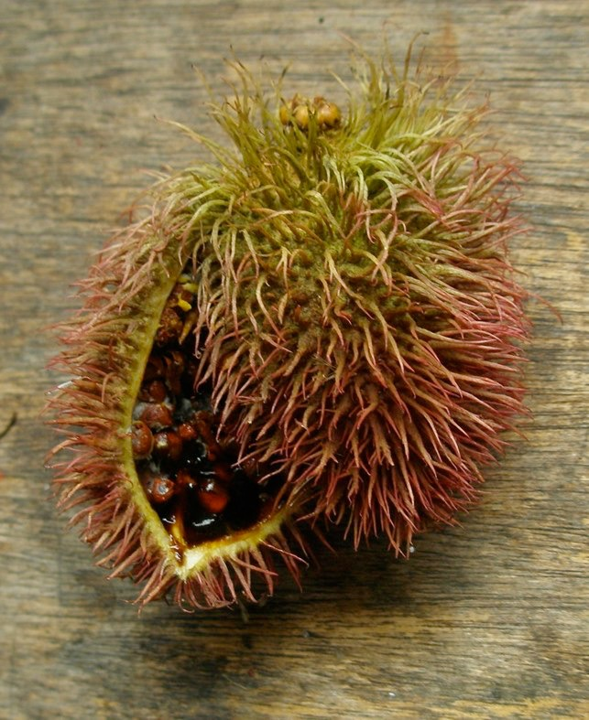
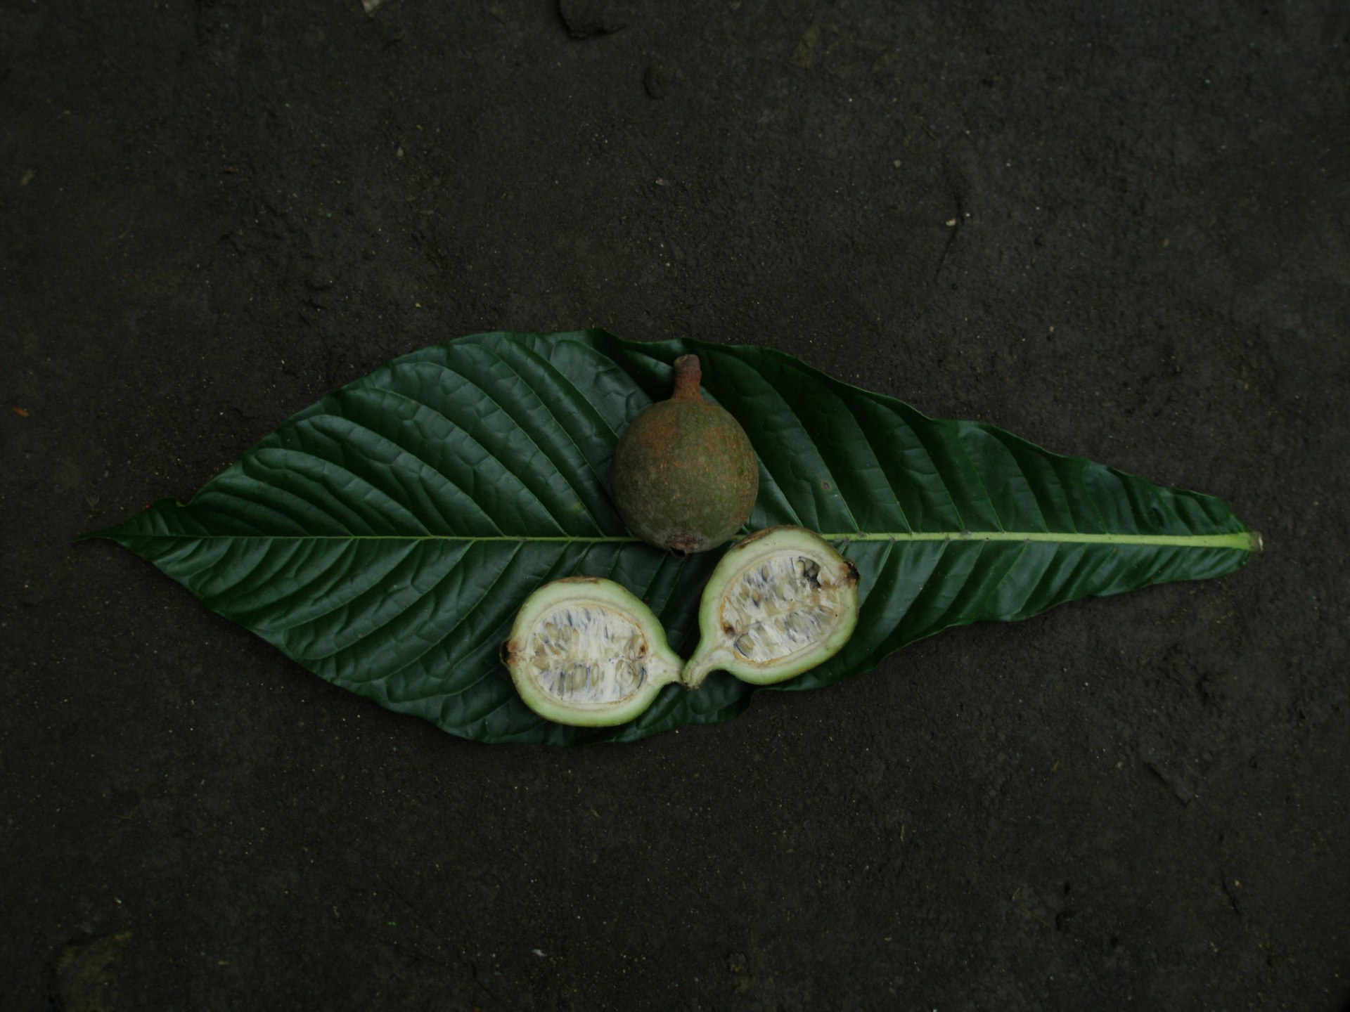
Since the bird and the two tree species are all transformations of human bodies it is not possible to say that the swallow tailed kite is more closely related to humans than are trees.

Slide 15
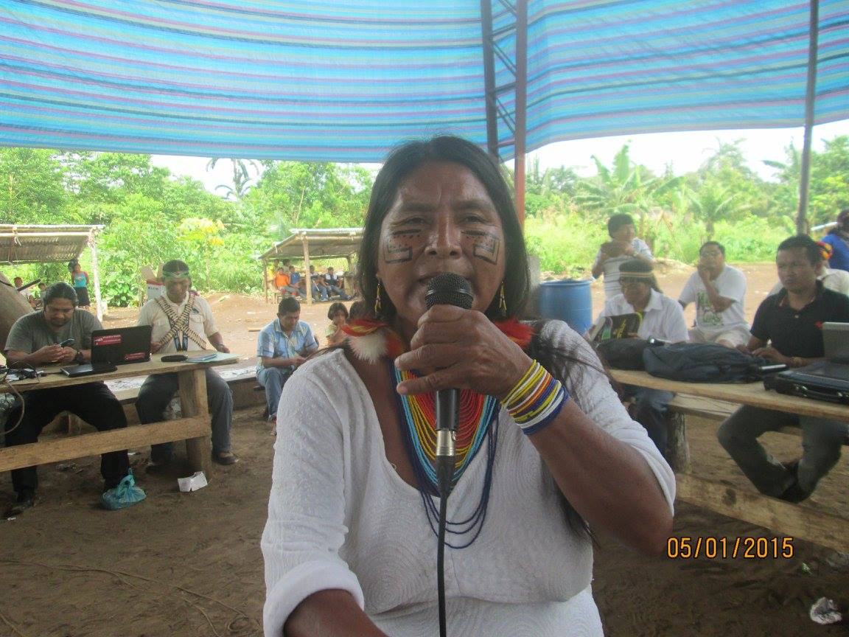
In the Spring of 2015 when the Amazonian Indian movement is deeply divided over oil extraction a female leader recalled what happened with Manduru and and Wituk. Lets not allow ourselves to be divided she said. Remember what happened with Nayapi.

Slide 18
With the red paint of her body Manduru painted the fur of the red squirrel and many other animals.

Slide 19
With the black paint of her body Wituk painted the shiny feathers of the toucan and many other animals.

Slide 20
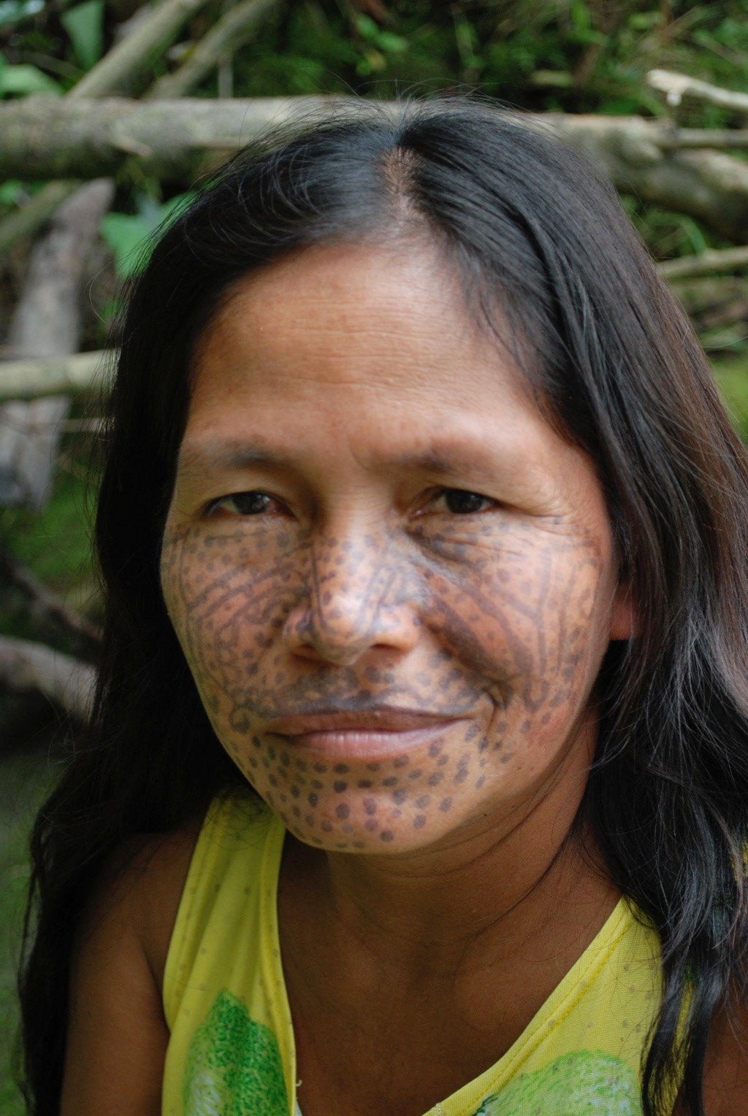
The patterns that bind each body to plants and animals in beauty are differently mediated by the fluids of of the two tree women. The attractive of this macaw and this woman are linked by their common share in the body of wituk.

Slide 21
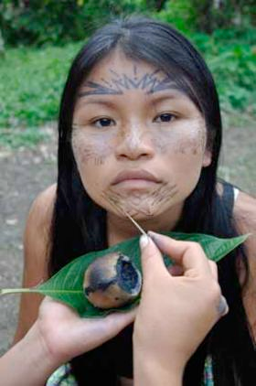
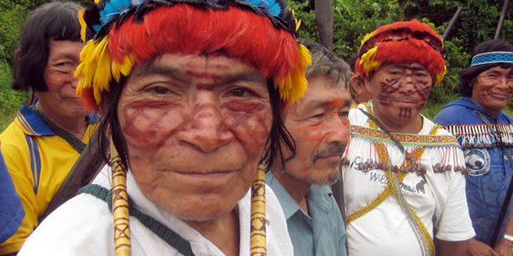
While runa paint their bodies with wituk the Achuar paint theirs with manduru. This close relation to wituk vs. manduru marks the difference between the two human groups.
This complicates the attempt to contrast human and plant bodies. After all, the beauty of a Runa woman is the beauty of Wituk while the beauty of an Achuar woman is the beauty of Wituk’s sister Manduru.

Slide 22
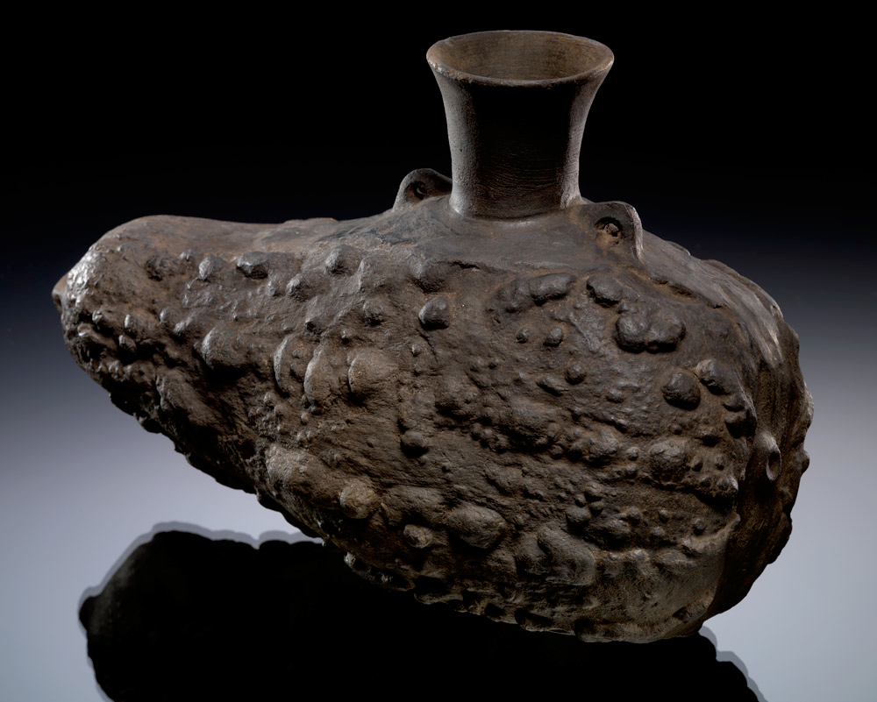
Runa art is a way of expressing empathy with the beauty of the plants and animals.

Slide 23
Hence art is a way of unifying the shared body by evoking a mutual or shared response of increase empathy with the referent of the art. In this case the referent is the squash. By heightening empathy with the squash the squash become the squash people.

Slide 24
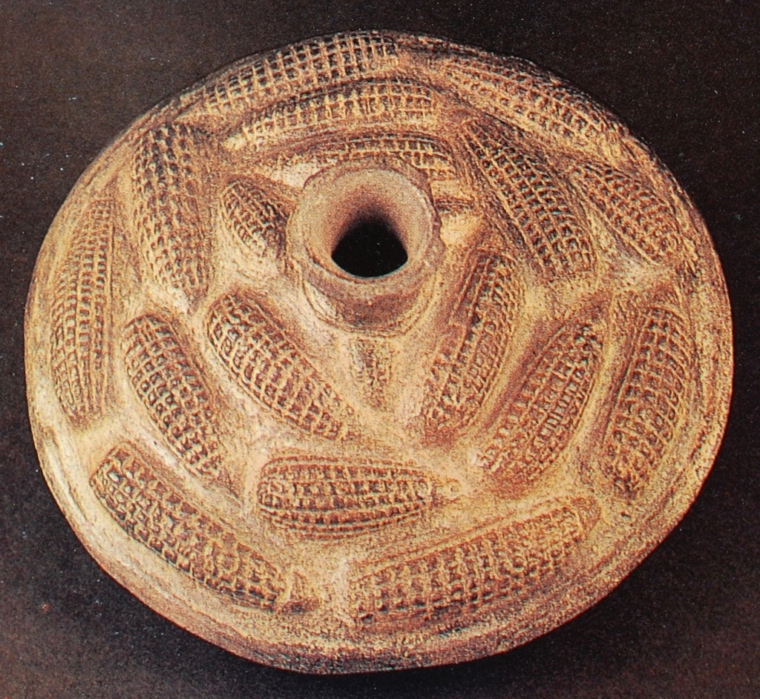
Maize (Sara) from Chimu
No two ears of corn are the same. The pattern does repeat

Slide 25
Chimú,
Museum of the American Indian

Slide 26
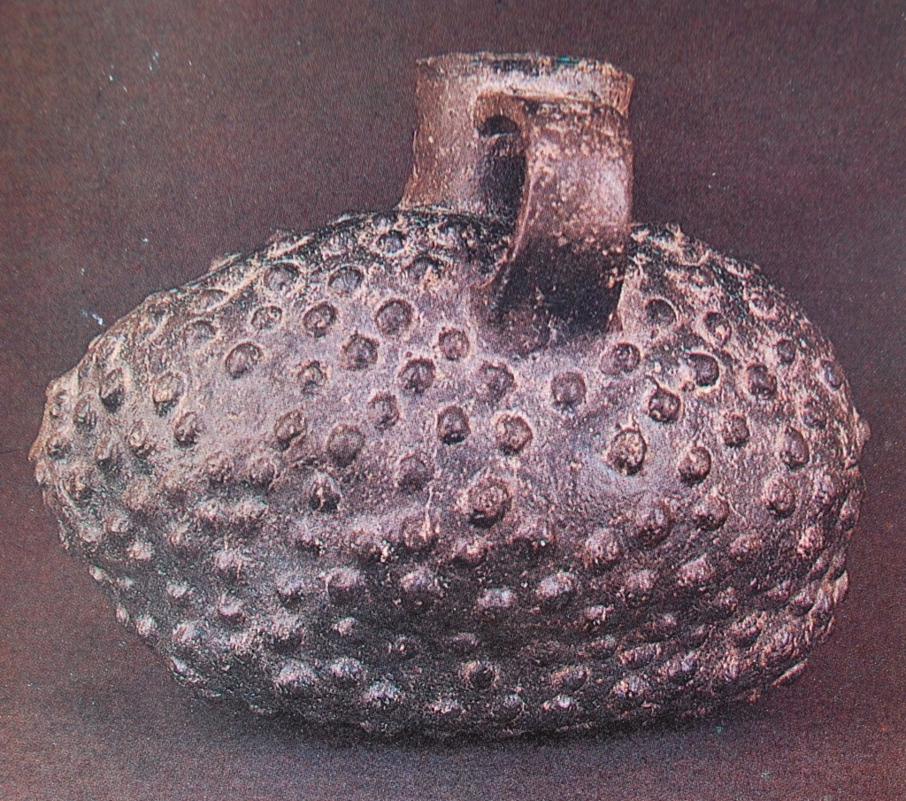

Slide 27
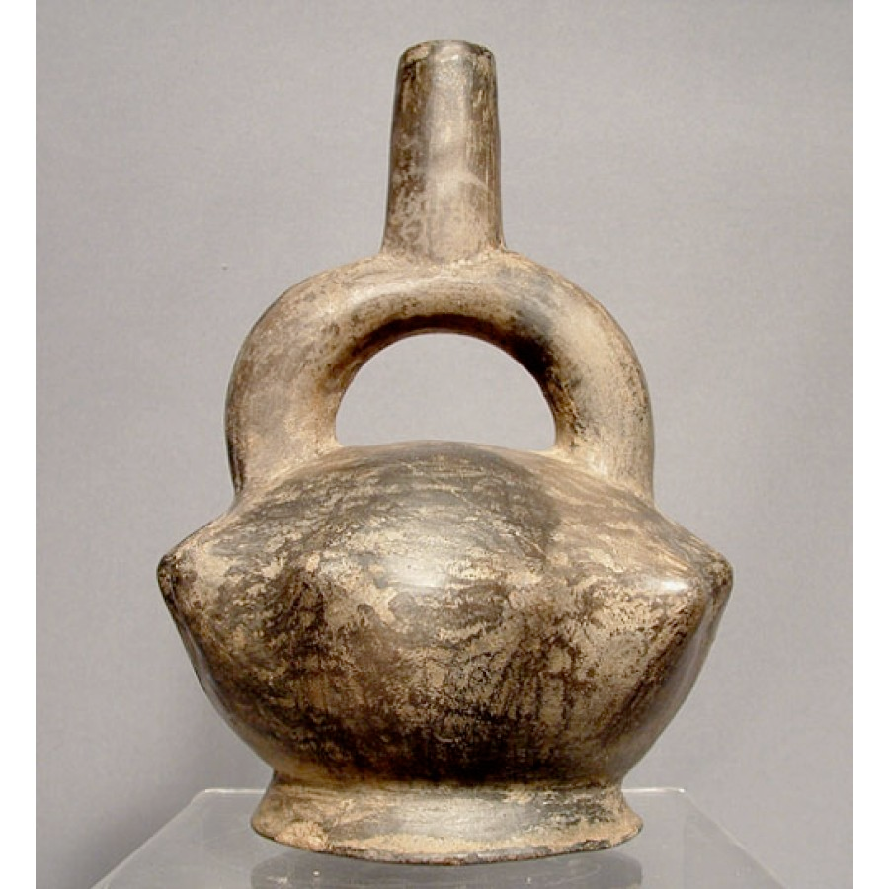
Chimu

Slide 28
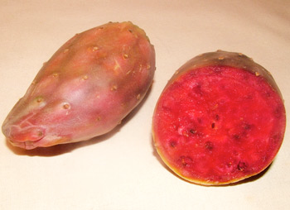
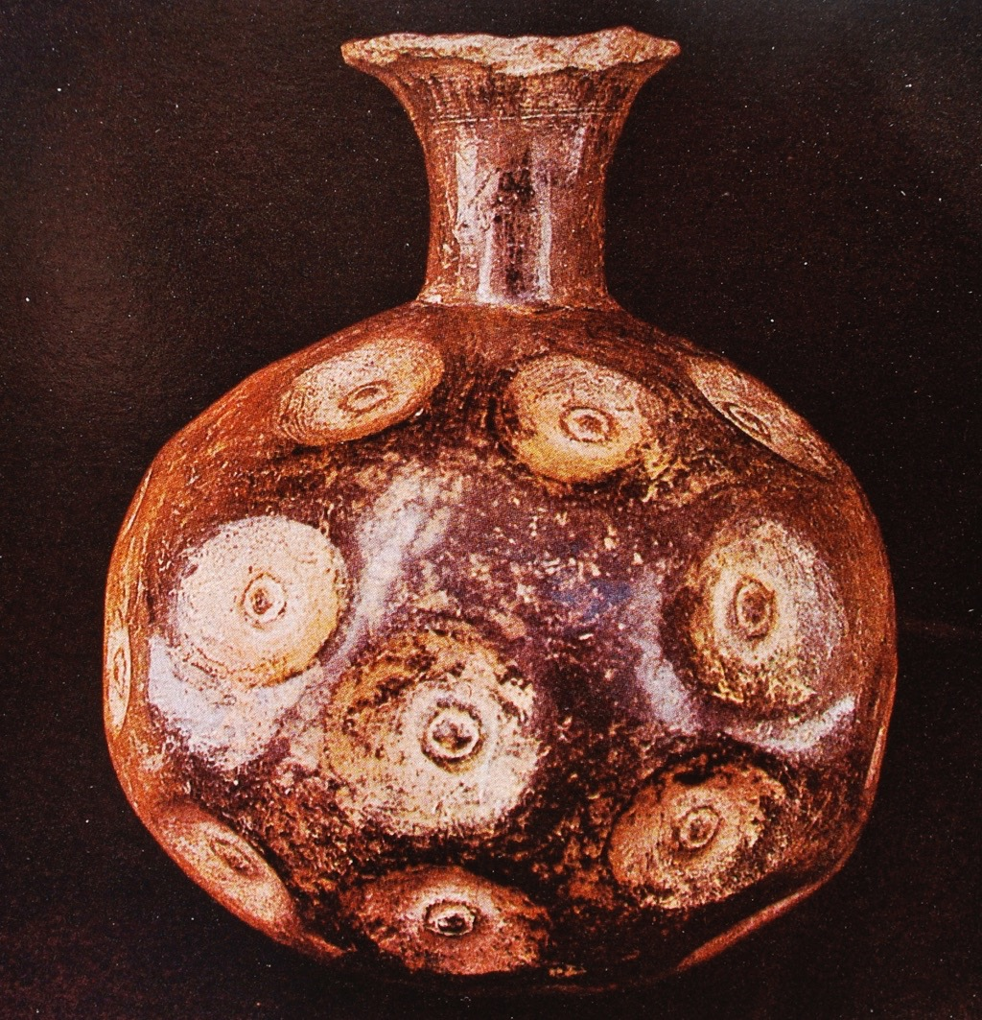
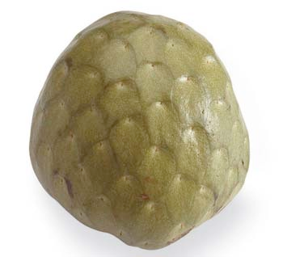
Plant from Chimu

Slide 29
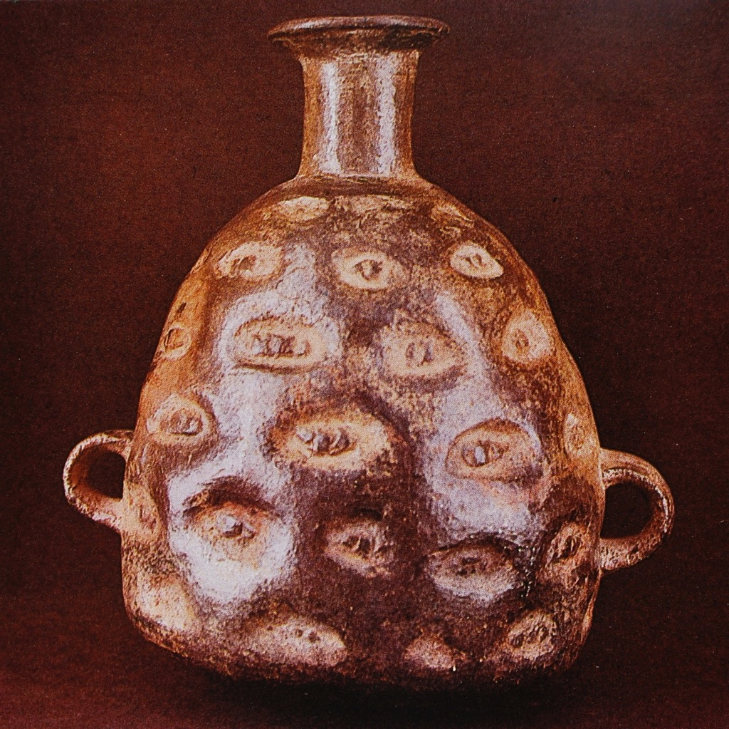
Plant tuber from Chimu

Slide 30
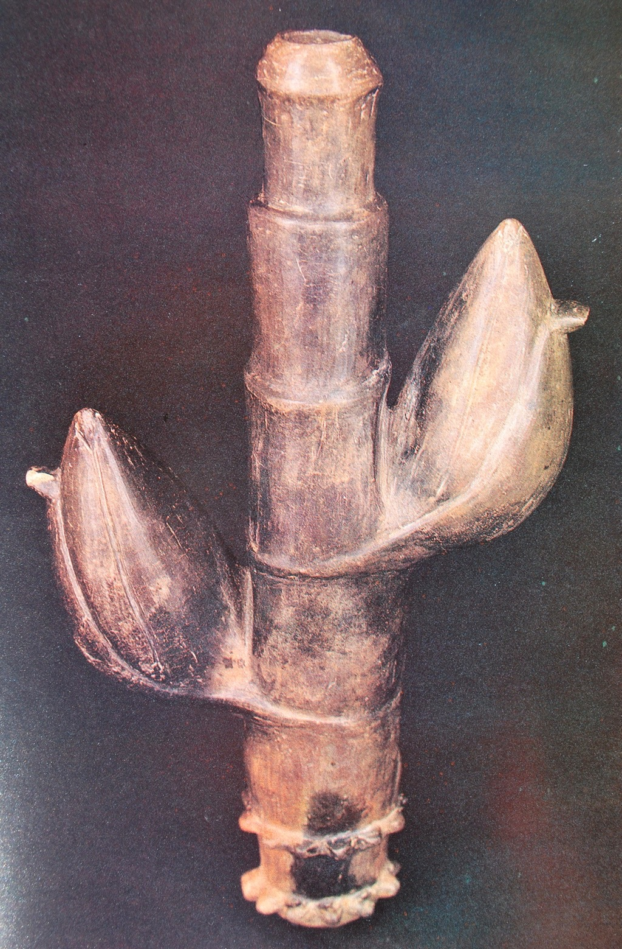
Maize (Sara) from Chimu

Slide 32
Kallari huras chichiku runa warmi ashka. Runa warmi ashkai mari lumura mukushka aswangawa. Lumu mukushkamandami paiwa shimi shina yuraj sakirishka. Chimanda chichiku tukushka.
Yuraj shimi chichiku
Yuraj shimi chichiku
Lumu aswara rurashka (kuti)
Chimandami kunagama
Yuraj Shimi Chichiku. (kuti)

Slide 33
The distinctive features of plant and animal bodies come from a previously human history
Barisas kallari huras runa warmi ashka. Pai chunda asuara randi rurashka. Chunda asuara llapishkamanda paiwa maki killu sakirishka. Chimandami killu maki tukushka pai.
Killu maki barisa
Chunda aswara rurashka (kutin)
Chimandami kunagama
killu maki barisa (kutin)
Asuamanga tinajpi
Aswamanga tinajpi
Shiuta shiuta shayaurin
Shiuta shiuta shayaurin
Killu maki barisami
llapishami upiachiun

Slide 34
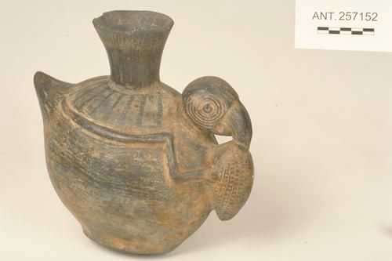
A shared body is comprised of shared food. Sharing food is not simply a shared material component like fuel. Rather it is a social and aesthetic bond. A shared llaki.
Parrot eating corn. Chimu, Peru. Yale Peabody Museum

Slide 35
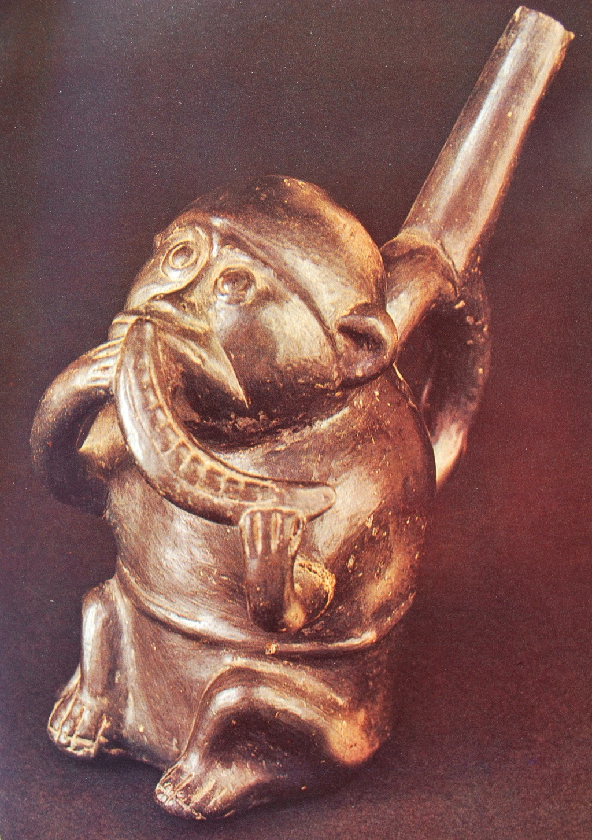
Monkey enjoying pacai from Chimu
Many ceramic pieces evoke the emotions of the animals such as fright or delight in food. The evoking triggers a memory which elicits a laughter of recognition

Slide 36
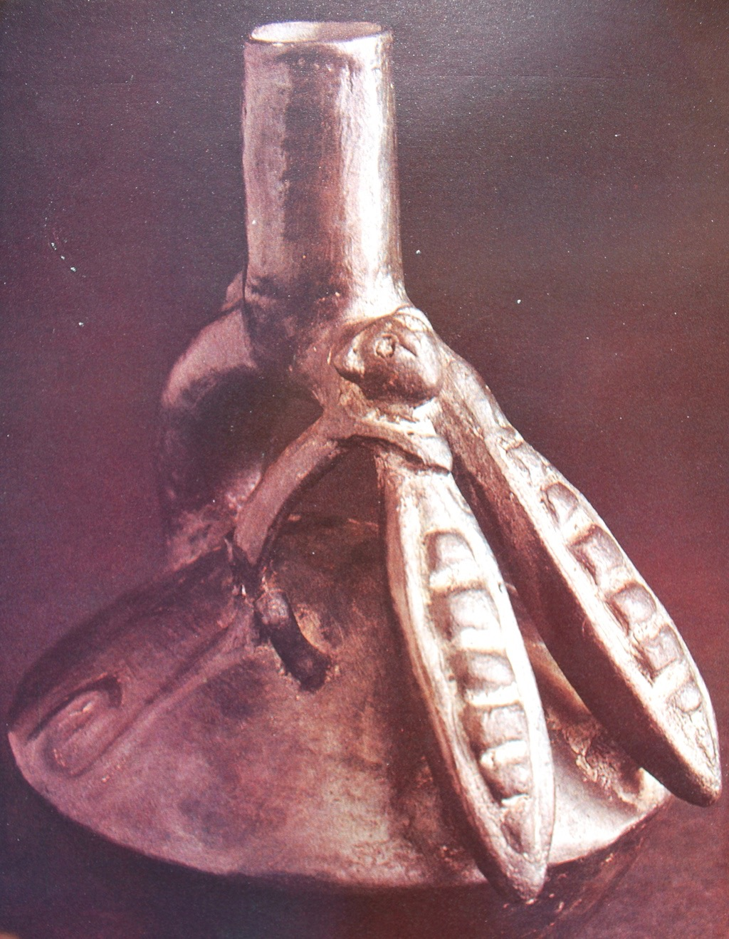
Pacai from Chimu

Slide 37
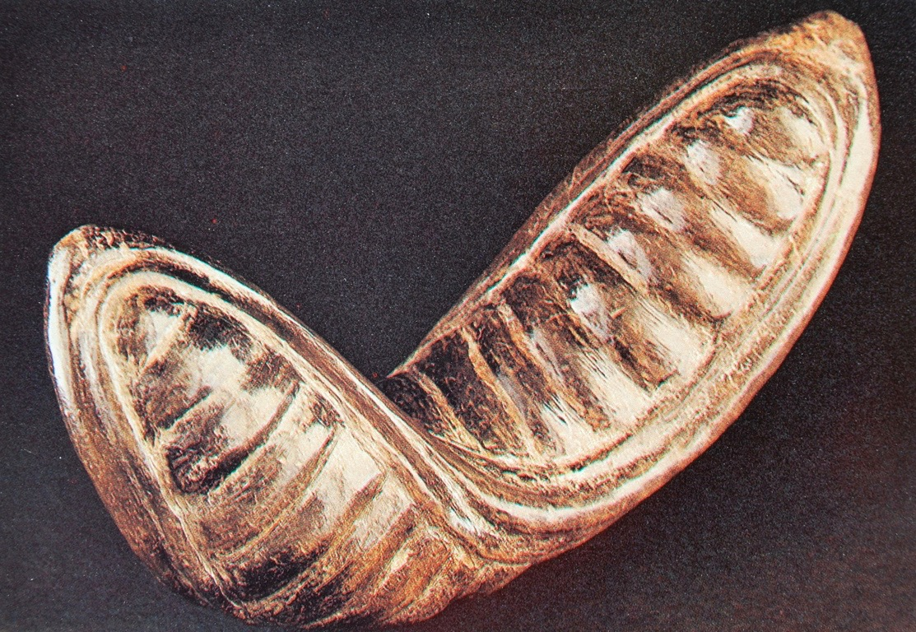
Pacai from Chimu

Slide 38
Maize (Sara) from Chimu

Slide 39
Maize (Sara) from Chimu

