Slide 1
The Morpheme -wa has the following meanings:
1. -wa apended to a noun means “with.”
2. -wa diminutive; often indicating intimacy (one’s own)
3. -wa apended to a non ending in a vowel may be a possessive. Examples: paiwa (his, hers, its); yayawa (fathers); Mariawa (Maria’s).
4. -wa as a verbal suffix increases transitivity directing the action of the verb toward the speaker. In so doing it often causes the action to appear more intense, either as a more personal favor or as a more personal offense.

Slide 2
As a verbal suffix -wa directs the action of the speaker. In so doing in enhances transitivity so that the action done to the speaker often appears more intense either as a more personal favor or as a more personal offense.

Slide 3
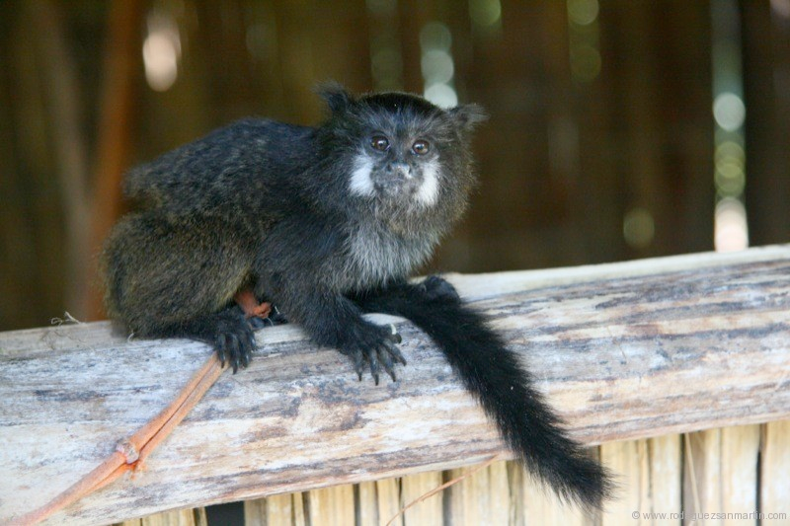
Feed me.

Slide 4
Kara-wa-i.

Slide 5
Don’t eat me.

Slide 6
Ama miku-wa-ngui.

Slide 7
When I eat wild fruit my stomach hurts me.

Slide 8
Sacha muyura mikukpi iksa nanawan.

Slide 9
My mother told me about it.

Slide 10
Ñuka mama kwintawaka.

Slide 11
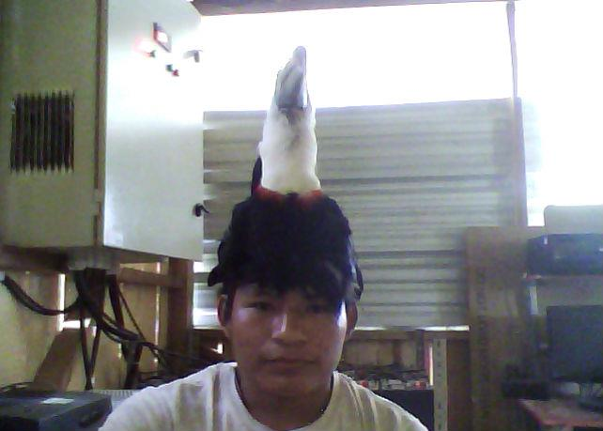
The shot me when I was not paying attention.

Slide 12
Ñuka mana riparashkai illapawaka.

Slide 13
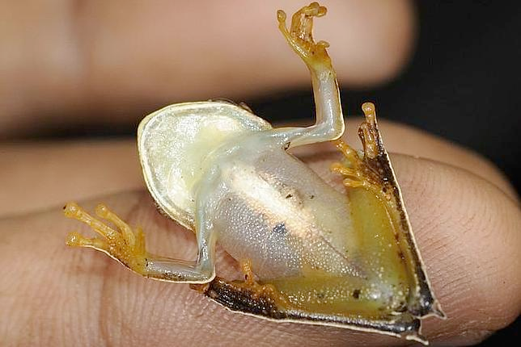
Let me go!

Slide 14
Kachariwai!

Slide 15
Ñukara mana tapuwaka.

Slide 16
They didn’t even ask me.

Slide 17
Ñukara Itsingama vultiachiwaka.

Slide 18
They turned me upside down.

