Slide 1
Urku supai wañushkamanda Estefania Aguinda
Recorded by Tod Swanson
July, 1998
Ñuka mama, chi manda ñukanchi yayawa wawki, wawkiwa warmi Mariaga, Maria shina kwintaka. Shina rasha shina tukyamuj nisha yaku, yaku tukyamusha shina supaygunara supayra shina apamujmi nisha kwintaj aka. Ima kwinta uyarjmi nin umama shina yaku taparimusha mazhanaita uyarimujmi. Tuta manzharisha tuta urkura kalpaj ashka chaima llushti urkuma. Chi urku tularishka mari. Wañushkami nin. Pay tiyashka urkumi tularishka nishami ninunmi nin. Yaku uma-manda shamushka (Maibi wañushka?) Kai Warmi Latas nishka arkarijmi ninun chindai sirij nin.... Kuri ima kwinta siririjmi ninga. Chiga kurindimi chi supai shamushka nin nijuna aka. (Chi supai kuri dueño aca?) Shinai. Kurindi aj urku tullarishka aka. Supai tiyaushka urku. Shina shamujmi ninun yaku tukyajpi.
Shina rasha kayandi tutamanda yaku aisarishkai kurira maillangaj shamusha shamuj rukuunara kurira maillarianushka. Maltaunara chinda ahuara chi imas wañunushka anga nisha maskarianushka. Chimari chi supaira tupanushka nin. Supaindi shamushka kurida shina siririshka nin. Shina runa kwinta rikurij ñaibi ashallaramari intiroga ilmajuj ashka nin, intiro maki tukui, tukui, ilmajuj. Paywa ñabiga kai runa kwinta ñabiyuj llushtinai ashka nin.
Shinara rikusha manzharisha kalpaj rukugunama rimai rijunami nin. Ñukanchi chi uraspi ñukanchi illashkanchi. Ñuka mama shina kuintaj aka, ñuka yaya shina kwintakunaka chimanda Maria shina kwintaj aka. Shina rukuna kwintashkara uyaj anchi.
Kuri ima kwinta sirishka nika. Kasna maki undawara apasha bateai churasha maillasha rikujpi ima kwinta kai tupu, kai tupu sikachiskai batia siki shina tiyarin nin kuri. Shinara maillaj anchi. Shina nisha kwintakuna-ka ñawpa rukuna payguna yaku tukyashkara rikusha kawsajkuna.
Kuna horas mana shina, mana chi tupus mana undan umamas mana uyarin. Mana shina uyarisha. Shina uyarisha pacha kuna huras shina uyarisha shamusha pacha tukuchingaj kaita pamba sikira tiajtapacha.
Urkumanda, urkui aj supai mari.

Slide 2
Translation. Tod Swanson
My mother, (I heard it) from her, and also from our father’s brother’s wife Maria, Maria [also] told it like this. She said the river exploded like that and when the river overflowed its banks she said it washed down a supay. They say a tremendous sound could be heard toward the headwaters. When the water covered over everything they say it sounded frightening. During the night they got scared and ran to the mountain. Way over there to that treeless mountain. Tiin! The river exploded like that, she said. Then again like earlier “Tiin” it sounded like nothing they had ever heard. Thinking they would die in the water they escaped to way over there to the head of the mountain where their grandfather lived. On the morning of the next day, when the water had gone down the old people went to wash gold. While they were washing gold the kids spotted something dead on top of a driftwood pile and the old people went to look for it. There yes! There they found a supai, they say. Together with that supai gold had washed down just lying there like that. It had a very human looking face. But she said its whole body was covered with fur, its entire hand, everything, everything, hairy. Its face was bare like this human face they say. Seeing something like this they ran away frightened, they went to talk with the old people, she said. We, at that time, we were not born yet. My mother used to tell it that way, My dad used to tell it like that, and Maria (my uncle’s wife) used to tell it like that. We heard about it from the talk of the old people. They say gold was lying there like you wouldn’t believe. They would take just a handful of sand, put it in the batea, wash it, take a look, and there would be a whole lot. Like this much! Like this! Climbing up the side of the batea (gold washing pan) from the bottom the gold would be just sitting there they say. That is how we washed the gold. That is how the old people used to talk about the early days how they used to live watching the river explode its banks. These days its not like that, not that way, it doesn’t flood in the headwaters, we don’t hear anything. It was from the mountains, it was a mountain dwelling spirit. They say it died when that mountain came washing down. They say the mountain where it lived came tumbling down. It came from the headwaters. This Warmi Latas (Female whirlpool) carried it. It was lying on a pile of driftwood. The gold was lying there like how! They say that with the gold that spirit came. It lived with that gold. That mountain came down, the mountain where the spirit lived. It really came like that they say, when the water exploded.

Slide 3
One distinctive characteristic of this narrative is the frequent use of the attributive suffix -j/k.
tukllamuk
apamukmi
uyarimukmi
Practice the form N + loc +ak The ____ who was in or who lives in
urkui ak supay
wasii ak
sachay ak
chinday sirik
How does the repeated use of this form contribute to the meaning of the narrative?
Note the use of pacha to express an extreme degree of something:
Mana shina uyarisha shina uyarisha pacha
kuna uras shina uyarisha shamusha pacha tukuchingaj kaita
pamba sikira tiakta pacha.
kan pacha
pay pacha
Note the form with “kwinta”: kai runa kwinta ñabiyuj “A face like this human face.”
Practice creating other comparative descriptions using this form:
Allku kwinta suni ririyuk One who has long ears like a dog
Upi siki runa kwinta puka singuyuk One who has a red nose like an alcoholic
Warmi kwinta ñañu kungayuk. One who has a high voice like a woman.
Pillan kwinta suni kalluyuk. One who has a long tongue like an ant eater.
The opening line tells us from whose perspective the story is narrated. In doing so it gives us a chain of relations.
Ñuka mama, chi manda nukanchi yayawa wawki wawkiwa warmi Mariaga, Maria shina kwintaka.
Practice making similar chains of relations:
My mother’s sister husband Antonio.
My sister’s daughter’s child

Slide 4
Note the repeated use of the suffix -ndi
kurindisupaindikayandi1. Shina rasha kayandi tutamanda yaku aisarishkai kurira maillangaj shamusha shamuj rukuunara kurira maillarianushka.
2. Supaindi shamushka kurida shina siririshka nin.
3. Chiga kurindimi chi supai shamushka nin nijuna aka (Chi supai kuri dueñomi aca?) Shinai. Kurindi aj urku tullarishka aka. Supai tiyaushka urku.
What suffix is closest in meaning to -indi? -wa What is the difference between -ndi and -wa? -ndi indicates an organic pairing of two things. Practice exchanging -ndi and -wa.
How does the repeated use of -ndi contribute to the meaning of the narrative?

Slide 5
Cuentomanda tapuna:
Imara tupanushca chinda awai?Pita tuparica supaira?Rukuguna imara nisha shamunauca yaku patama?Imarasha chi tucui kuri sirishca playai?Kurira tupanukachu?
Ansawarachu?
Urcu supaiga imasnara rikurica?
Vocabulary:
Llushtinai sort of naked
uyarimuna the sound of something coming
tularina to cave in derrumbar
tukllana to explode
aisarina to recede (liquid
sirina (to lie down)
tukuchina (to finish)
taparimuna (to close back up)
yaku uma headwaters of a river
yaku pata river bank
yaku pungu mouth of a river
kayandi on the morrow
maskana to look for
arkarina to get hung up
maillana to wash
pacha

Slide 6
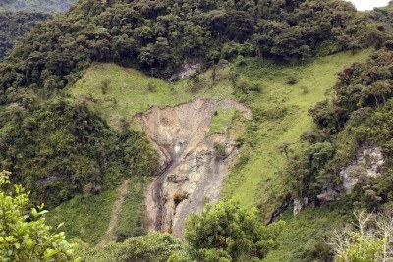
Urku tularishca.

Slide 7
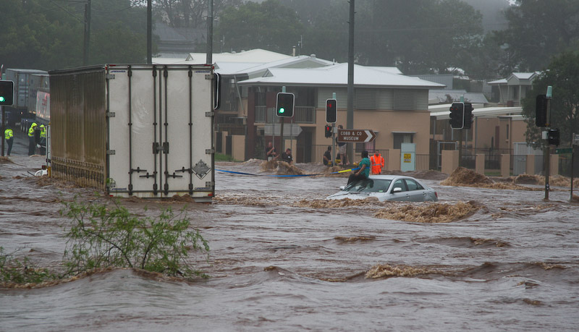
Yaku tukyan

Slide 8
