Slide 1
The Imperative
Perhaps more than anywhere else this politeness of Quichua can be seen in the use of the imperative.
To form a command the imperative ending -i is added to the verb stem. (Note that the infinitive ending -na must be dropped before the imperative -i is added).
-i = imperative ending in the singular. Implies that one person is being asked to do something.
–ichi = imperative ending plural. Implies that the more than one person is being asked to do something
Examples
Rimana
Rimai! Speak! Kaya rimangui
Rimai-chi Speak (plural) Kaya rimanguichi
Tapuna to ask
Tapui! Ask! Kaya tapungui
Tapuichi! Ask! (plural) Kaya tapunguichi
pichana pichai patara pichangui
Upi!
tiarishunchi hortative Pedrowa librura mañashun
atarishun mikushun

Slide 2
The Imperative
Perhaps more
Examples
Rimana
Rimai! Speak! Kaya rimangui
Rimai-chi Speak (plural) Kaya rimanguichi
Tapuna to ask
Tapui! Ask! Kaya tapungui
Tapuichi! Ask! (plural) Kaya tapunguichi
pichana pichai patara pichangui
Upi!
tiarishunchi hortative Pedrowa librura mañashun
atarishun mikushun

Slide 3
When the infinitive ending is removed from some verbs the verb stem ends in “i”. In these cases
adding another -i to create the imperative is redundant and the -i is not doubled.
Examples
Sirina To lie down
Siri Lie down!
Sirichi You all lie down!
likcharina to wake up
Likchari! Wake up!
Likcharichi! Wake up (plural)
(j)atarina jatari!
tiarina
upina To drink
Upi! Drink!
Upichi! Drink (plural)

Slide 4
Negative commands
To form a negative command place the word “ama” (don’t) before the verb denoting the action
and add the suffix “-chu” to the verb after the imperative ending.
Examples
Kaita ama upichu! Don’t drink this!
Ama rimai -chu! Don’t speak
Ama rimai-chi -chu!
Ama tapui-chu! Don’t ask!
Ama mikuichu! Don’t eat!
Ama puñuichu! Don’t sleep!
Amazonian song: Pricila
Imarasha wakangui Pricila? Why do you cry Pricila?
Kanda munasha shamuni Pricila. I come because I love you.
Ama yapa wakanguichu Pricila.6 Don’t cry too much Pricila
Kanda nishami shamuni Pricila.

Slide 5
Polite imperative:
The simple present tense conjugated in the second person is used as a polite form of the imperative. The polite imperative is used in two settings:
1) When the action requested does not need to be carried out immediately.
2) When the action is something that the person addressed may not want to do and the requester wishes to be delicate or diplomatic in the request even though the task may need to be done urgently.

Slide 6
In runa shimi the most common form of making a polite request is to conjugate the verb with the dependent verb marker -sha followed by the word kuwai or “give me” ( “give me the favor of____” as in English “Do me the favor of____).
verb stem + -sha kuwai (From kuna to give ku-wa-i)
Examples:
Llachapara taxasha ku-wa-i.
Do (Give) me the favor of washing the clothes
Kai mangara maillasha kuwai.
Do (Give) me the favor of washing this pot
Lumura yanusha kuwai.
Do (Give) me the favor of cooking the manioc.
Wasira pichasha kuwai
Do (Give) me the favor of sweeping the house.

Slide 7
Expression of Obligation
Kichwa expresses the sense of obligation by combining the infinitive of a verb with “ana” in the appropriate verbal tense and person ending: Infinitive + “ana” = person/tense
Examples:
Mikuna angui
Purina angui
Kichwara rimana angui
Rina anchi
Sachai yanuna ani
Yakuy llachapara taksana an

Slide 8
Expression that something needs doing in an impersonal way without specifying who should carry out the action)
Verb (infinitive) + direct object marker + nin
i

Slide 9
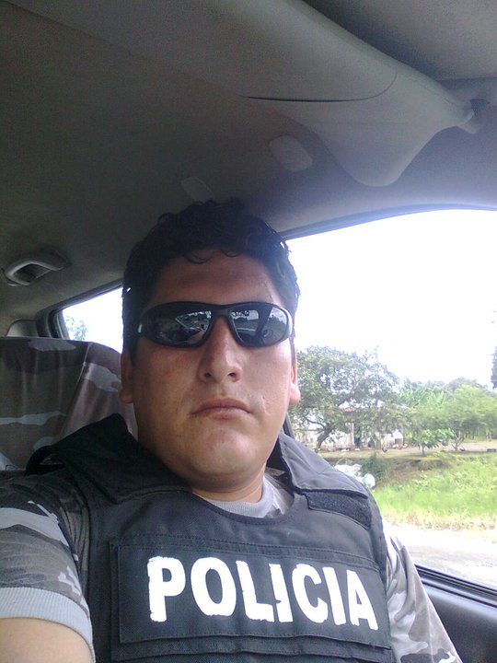
You all look for the robber! shuak maskasha kuwai

Slide 10
Shuajta maskaychi.

Slide 11
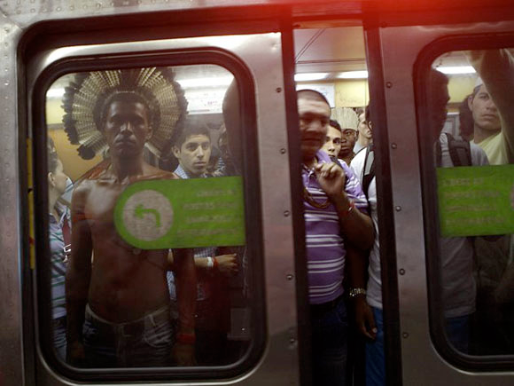
Trenda apingui chima ringaj.

Slide 12
Shuajta maskashun.

Slide 13
Kaya maskanguichi.

Slide 14
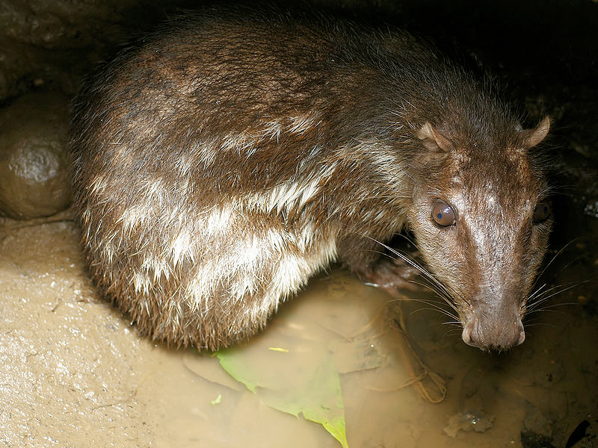
Basurara pakalla ichun yakuma.
Kill the lights!.

Slide 15
Basurara pakalla ichun yakuma.
Luzda wañuchi!

Slide 16
Breathe.

Slide 17
Samay Samangui

Slide 18
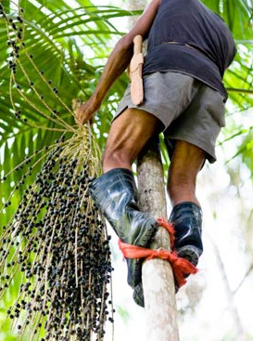
Climb the tree.

Slide 19
Yurara sikai.

Slide 20
Tie your feet!

Slide 21
Chakira watay.

Slide 22
Muyura piti

Slide 23
Cut the fruit!

Slide 24
Climb with your feet tied. chaki watana sikana

Slide 25
Chakira watasha sikai

Slide 26
Climb up and cut the fruit.

Slide 27
Sikasha muyura piti.

Slide 28
Kaya sikasha muyura piti.

Slide 29
Cut the siona cluster (racimu).

Slide 30
Siuna racimura piti.

Slide 31
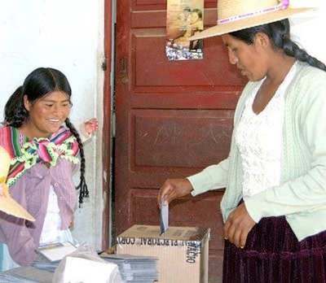
Vote for Alianza Pais! shitay

Slide 32
Alianza Pais-ma shitai. shitana

Slide 33
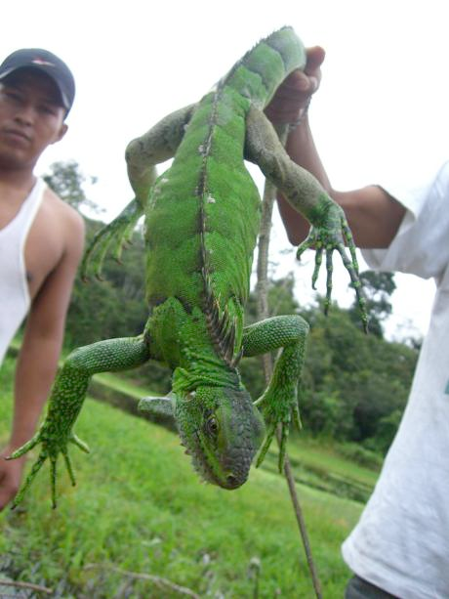
Let him loose (kacharina)

Slide 34
kachari

Slide 35
You all let him go.

Slide 36
Kacharichi

Slide 37
You all don’t let him go!

Slide 38
Don’t let him go!

Slide 39
Ama kacharichi-chu!

Slide 40
Ama kacharinguichi-chu!
Kacharinguichu? Mana kacharini -chu

Slide 41
kachari-wa-i

Slide 42
Open your mouth. shimira páskai pungura paskai

Slide 43
Shimira paskai

Slide 44
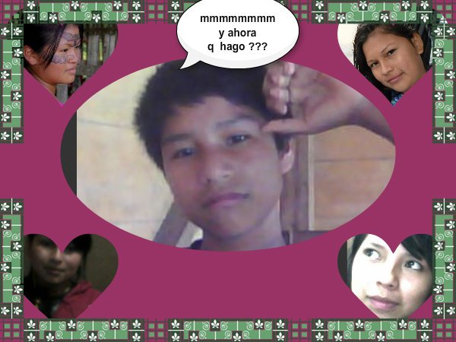
Choose!
Akllana = to choose.
Pitara akllasha.

Slide 45
Ajllai!
Ajllana = to choose.
Pitara ajllasha.

Slide 46
Ajllana = to choose.
Choose the woman you love!
Pitara ajllasha.

Slide 47
Ajllana = to choose.
Kan munashka warmira ajllai!
Pitara ajllasha.

Slide 48
Choose me.
Ajllana = to choose.
Pitara ajllasha.

Slide 49
Ajllana = to choose.
Ñukara ajllangui.
Pitara ajllasha.

Slide 50
Ajllana = to choose.
Ajlla-wa-ngui.
Ñukara ajllawangui.
Pitara ajllasha.

Slide 51
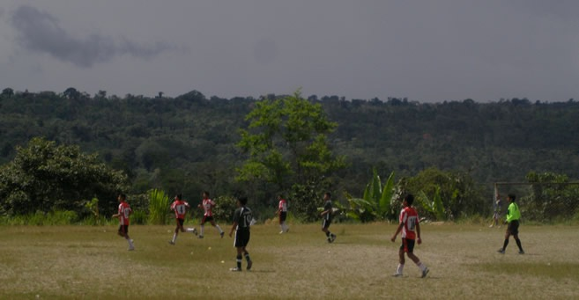
Imara ranun?
to see + direct object marker + nin
Will they play again tomorrow?
It remains to be seen.
mikuna
puñuna
wakana
kallpana
pugllana
upina
armana
purina
makana
pitina
kuchuna
tarpuna

Slide 52
Imara ranun?
Kaya kuti pugllangachu?
Ummm Hmmm. Rikunara nin.
mikuna
puñuna
wakana
kallpana
pugllana
upina
armana
purina
makana
pitina
kuchuna
tarpuna

Slide 53
Basurara pakalla ichun yakuma.
Luzda wanchinara nin!

Slide 54
Basurara pakalla ichun yakuma.
The lights need to be turned out!

Slide 55
A choice needs to be made.
Ajllana = to choose.
Pitara ajllasha.

Slide 56
Ajllana-ra nin.
Ajllana = to choose.
Pitara ajllasha.

Slide 57
Ajllana angui.
Ajllana = to choose.
Pitara ajllasha.

Slide 58
to cut + direct object marker + nin
The fruit needs cutting.

Slide 59
to cut + direct object marker + nin
Muyura pitinara nin.

Slide 60
to cut + direct object marker + nin
Muyura pitina angui.

Slide 61
to climb + direct object marker + nin
Yurara sicanara nin.

Slide 62
to climb + direct object marker + nin
The tree has to be climbed.

Slide 63
to tie + direct object marker + nin
The feet need to be tied.

Slide 64
to tie + direct object marker + nin
Chakira watanara nin.

Slide 65
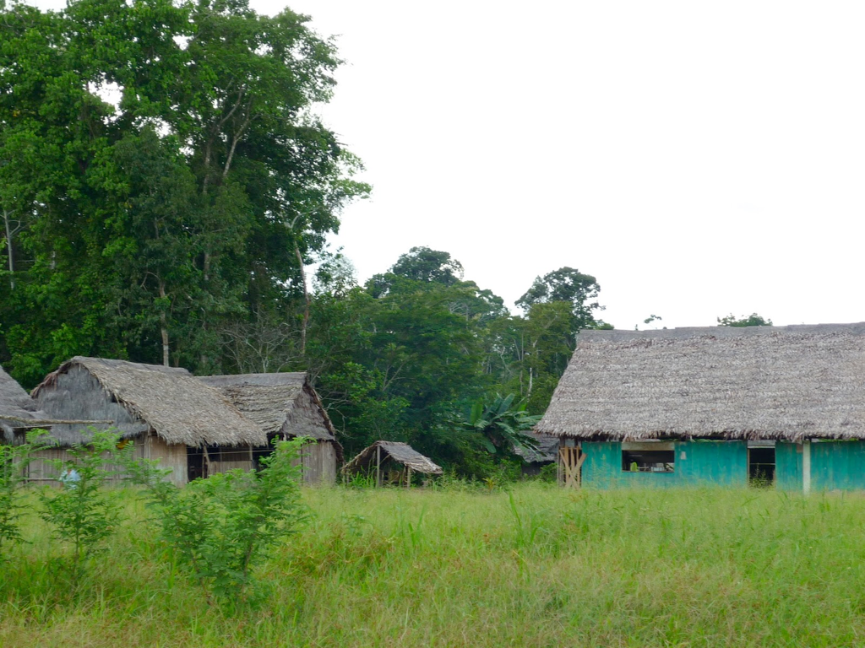
Kiwasha kuwai.
Kiwara kaya kiwanguichi
Ama kiwara kiwanguichichu.
Ama kiwaichichu
The grass needs cutting.

Slide 66
Kiwasha kuwai.
Kiwara kaya kiwanguichi
Ama kiwara kiwanguichichu.
Ama kiwaichichu
Kiwanara nin.

Slide 67
Kiwasha kuwai.
Kiwara kaya kiwanguichi
Ama kiwara kiwanguichichu.
Ama kiwaichichu
Cut the grass tomorrow.

Slide 68
Kiwasha kuwai.
Kiwara kaya kiwanguichi
Ama kiwara kiwanguichichu.
Ama kiwaichichu
Kaya kiwangui.

Slide 69
Kiwasha kuwai.
Kiwara kaya kiwanguichi
Ama kiwara kiwanguichichu.
Ama kiwaichichu
Kiwasha kuwai.

Slide 70
The robber needs looking for.

Slide 71
Shuajta maskanara nin.

Slide 72
Shuajta maskauni.

Slide 73
You all look for the robber!

Slide 74
Shuajta maskaichi.

Slide 75
Look for the robber!

Slide 76
Shuajta maskai!

Slide 77
Take your time looking for the robber next week!

Slide 78
Shuajta allimanda maskangui shamuj semanai!

Slide 79
We ought to look for the robber.

Slide 80
Shuajta maskana anchi.

Slide 81
Do me the favor of looking for the robber.

Slide 82
Shuajta maskasha kuwai.

Slide 83
Don’t look for the robber..

Slide 84
Shuajta ama maskaichu.

Slide 85
Shuajta ama maskaichichu.

Slide 86
You all don’t look for the robber.

Slide 87
Shuajta ama maskanguichi-chu.

Slide 88
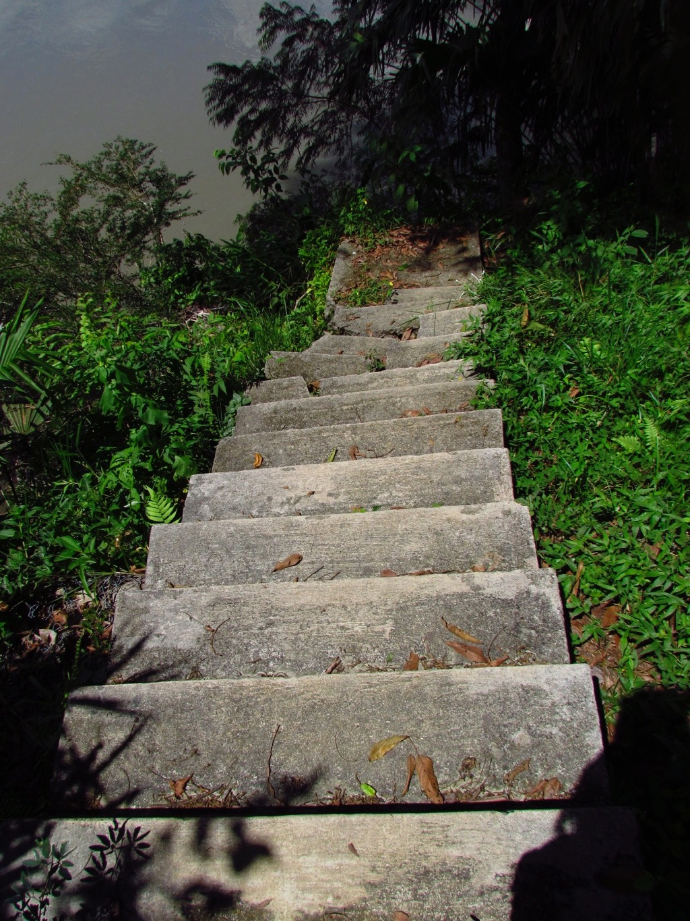
Climb on up!
Sikana = to climb.

Slide 89
Sikan-guichi awa-ma.

Slide 90
Awa-ma sikaichi!

Slide 91
Awa-ma sikai!

Slide 92
You (plural) climb (up) from the river bank!

Slide 93
Yaku pata-manda sikan-guichi.

Slide 94
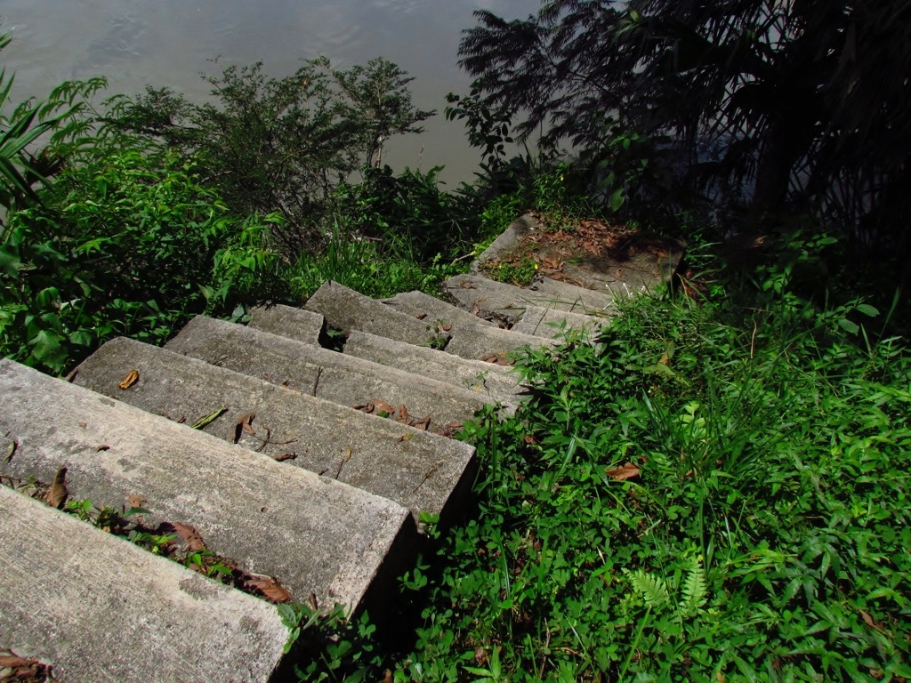
Go down to the river bank!

Slide 95
Yaku pata-ma irgui!
Irguna = to go down.

Slide 96
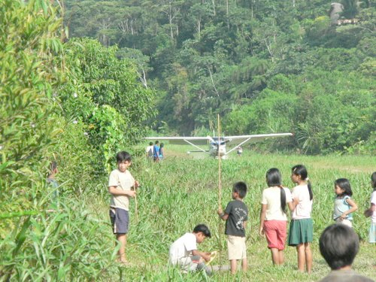
Avionetara chapanun.
Ñuka tigranagama chapanguichi.
Ñukara ama chapaichu!
Pilotora chapana anchi
chapana to wait
Ari. Indijpi. Alli punzha tukujpi ringarauni.
Mana rijpi kiwa supai tukunga.

Slide 97
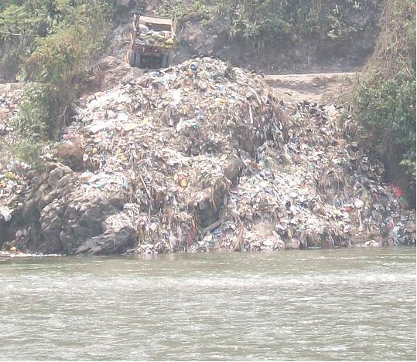
Basura yakuma mana ichuna anchi.
Aichara mana mikuna anchi.
Mormonguna cervezara mana upina anun.

Slide 98
Kiwasha kuwai.
Kiwara kaya kiwanguichi
Ama kiwara kiwanguichichu.
Ama kiwaichichu

Slide 99
Kiwanara nin.

Slide 100
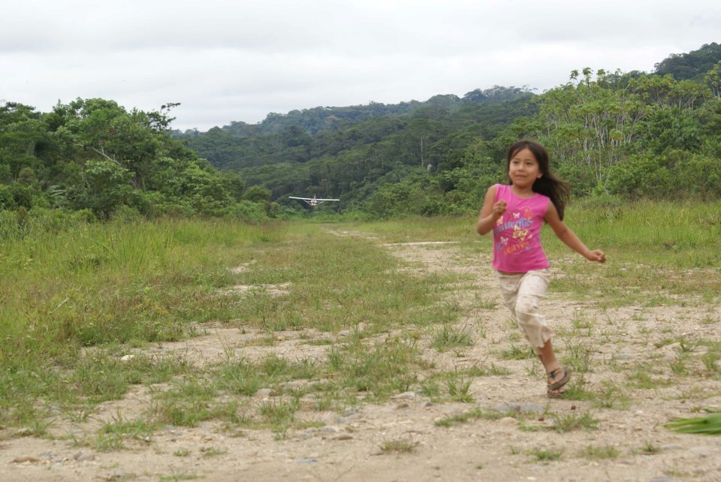
kallpana = to run

Slide 101
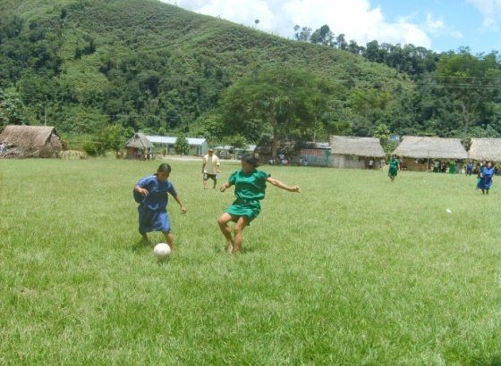
Nijtan. Nijtana = to kick
Ñukara ama nijtaichu!
Ñukara ama nijtanguichu!
Iksa punguirin.

Slide 102
Kolchonda katujuna. katuna
Kolchonda katunguichi

Slide 103
Kolchonda katujuna. katuna
Sell me the mattress.

Slide 104
Kolchonda katujuna. katuna
Kolchonda katu-wa-i

Slide 105
Hamacara kuyuchin.

Slide 106
Hurry! Rock the baby!.

Slide 107
Ukta! Wawara kuyuchi.

Slide 108
We should rock the baby.

Slide 109
Wawara kuyuchina anchi.

Slide 110
If the baby wakes up move the hammock.

Slide 111
Wawa likcharijpi hamakara kuyuchingui.

Slide 112
Do me the favor of rocking the baby.

Slide 113
Wawara kuyuchisha kuwai.

Slide 114
Don’t rock the hammock!

Slide 115
Hamakara ama kuyuchichu!

Slide 116
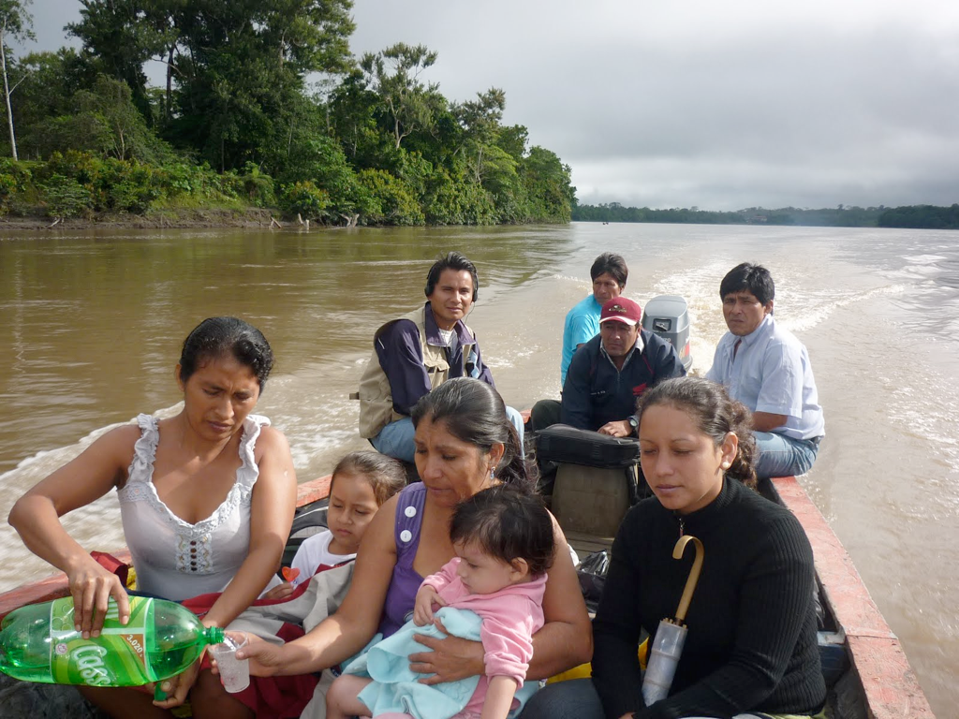
Drink some cola comadre.

Slide 117
Colara upi comadre.

Slide 118
Yangami nin! Ama upichu!
Ambira charin. Kanda wañuchisha nin.

Slide 119
She is just saying that! Don’t drink it!
It has poison in it.She wants to kill you.

Slide 120
We should drink drinks that don’t have sugar.

Slide 121
Azucar illaj upinara upina anchi.

Slide 122
paiwa votora shitan. She casts her vote.

Slide 123
Kay salonbi akchara pitichina angui.

Slide 124
Aichawara aisasha karara allira aspina anguichi.

Slide 125
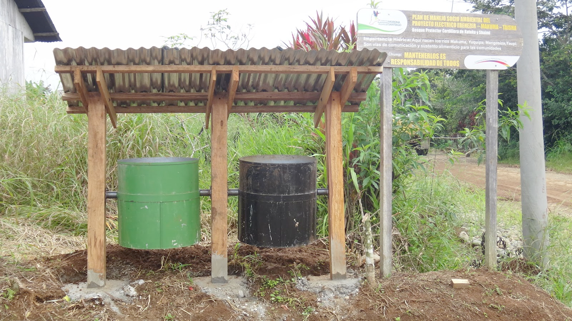
Throw the plastic garbage in the black container.

Slide 126
Plastico basura yana purui ichunguichi.

Slide 127
Do mi the favor of filling the jug.

Slide 128
Purura undachisha kuwai.

Slide 129
Ok. Show me the jug so I can fill it.

Slide 130
Allimi. Purura rikuchiwai undachingaj.

Slide 131
Basurara pakalla ichun yakuma.
Kill the lights!.

Slide 132
kamana to try something
Kamai! Try it!
Kamaichi (You plural as in “ y’all”) Try it!
In runa shimi the most common form of making a polite request is to conjugate the verb with the dependent verb marker -sha followed by the word kuwai or “give me” ( “give me the favor of____” as in English “Do me the favor of____). For example. Wasira pichai! = Sweep the house. Wasira pichasha kuwai. Give me the favor of sweeping the house.
verb stem + -sha kuwai
Examples
Llachapara taksasha kuwai. Do (Give) me the favor of washing the clothes
Kai mangara maillasha kuwai. Do (Give) me the favor of washing this pot
Lumura yanusha kuwai. Do (Give) me the favor of cooking the manioc.
Wasira pichasha kuwai Do (Give) me the favor of sweeping the house.
Exercise:
Translate:
Chi mangara llukchisha kuwai
Chi mangara shayachisha kuwai
Chi wawara armachisha kuwai
Chi palandara kuchusha kuwai
Chi chiwillara llushtisha kuway
When the infinitive ending is removed from some verbs the verb stem ends in “i”. In these cases
adding another -i to create the imperative is redundant and the -i is not doubled.
Examples
Sirina To lie down
Siri Lie down!
Sirichi You all lie down!
likcharina to wake up
Likchari! Wake up!
Likcharichi! Wake up (plural)
upina To drink
Upi! Drink!
Upichi! Drink (plural)
Negative commands
To form a negative command place the word “ama” (don’t) before the verb denoting the action
and add the suffix “-chu” to the verb after the imperative ending.
Examples
Kaita ama upichu! Don’t drink this!
Ama rimaichu! Don’t speak
Ama tapuichu! Don’t ask!
Ama mikuichu! Don’t eat!
Ama puñuichu! Don’t sleep!

Slide 133
“Ama ichusha puringuichu kai wawara.” Kasna rimasha kamachika Nunguli chi warmira.

Slide 135
Exercises: Kai iyaigunara rukusha katinguichi:
Kaya imara rurana anchi?
Kaya tutamanda atarina anguichi. Chi washa armana anguichi. Chi manda mikunas anguichi. Chi manda yachaungaj awama sikana anguichi. Washa chagrama sachara pichangaj, lumura tarpungaj rina anguichi. Puchukaibi yakuma armangaj rina anguichi. Chi washa wasima mikungaj, samangaj tigrana anguichi.

