Slide 1
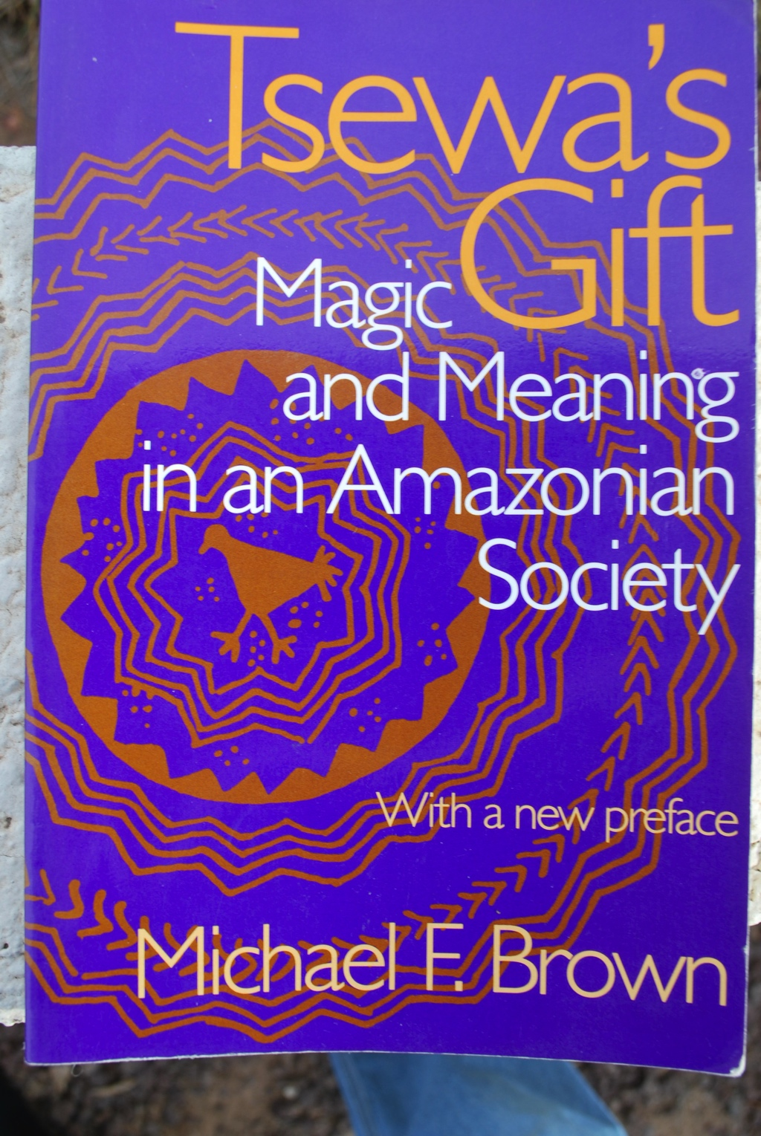
Michael Brown, Tsewa’s Gift: Magic and Meaning in an Amazonian Society
Like most indigenous cultures of the Americas the Amazonian Aguaruna sing ritual songs to plants and animals. Michael Brown’s book Tsewa’s Gift provides an important explanation for how these songs are believed to work. His explanation is likely valid for indigenous ritual across the Americas.
Brown calls these songs a magical technology for hunting and gardening.
Why does he call these songs a “technique?”
Why does he call them “magical?”
The songs are like a “technology” because they are believed to be practices necessary to ensure a successful outcome in the hunting and gardening carried out to produce food. They are magical because they do not follow the rules of cause and effect that are accepted by science.
Although the songs do not follow the western cannon of cause and effect they do follow an internally coherent indigenous logic which the book lays out.

Slide 2
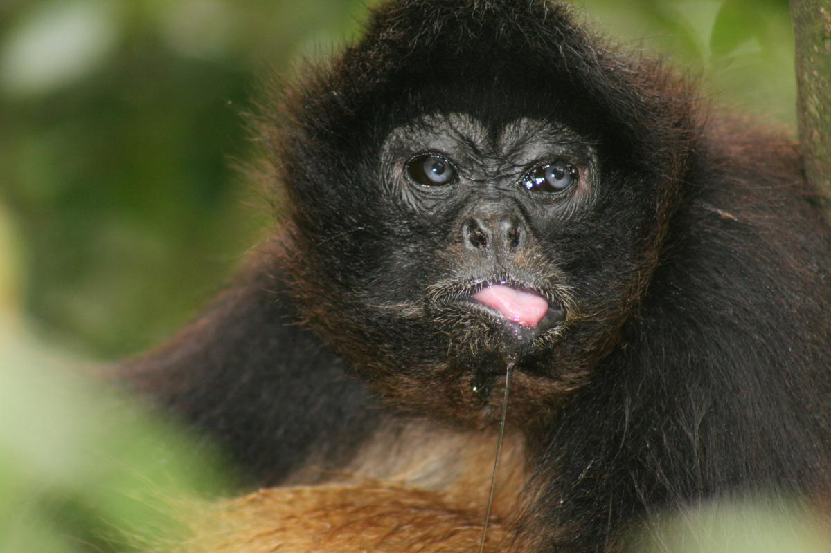
Western science would think techniques of marksmanship and scientifically calculating animal behavior are sufficient to lead to results. However, Aguaruna are skilled hunters. Nevertheless they are convinced that: “good marksmanship and a knowledge of animal behavior are not enough to ensure hunting success, 67.”
Instead:
“Many of the Aguaruna child rearing practices of the past were intended to make the heart strong, the thoughts “straight” or correct. One important aspect of developed thought is the ability to accomplish the practical activities by which the Aguaruna define themselves as human beings. In the course of completing these tasks, people employ many procedures that are not easily accommodated within the category “technology”: they perform songs to attract game and help their gardens grow; they alter their diet so that the foods they eat will not interfere with the project at hand; they attempt to manipulate the emotions of loved ones through the power of special animal, vegetable and mineral substances. Because the efficacy of these procedures is not explained by reference to cause and effect relationships that are acceptable in Western scientific terms, we usually classify them as “magical.” pp. 19-20.

Slide 3
What is the indigenous understanding of cause an effect that leads Aguaruna to think that singing is a necessary part of hunting and gardening technology?
Assumption: The reason is that Aguaruna (like indigenous cultures throughout the Americas) have a very different understanding of plants and animals. According to the Aguaruna plants and animals are estranged humans. As such they cannot be “managed.” Instead, they have to be made friendly. They have to be attracted. They must be persuaded to feel sufficient sympathy for the human hunter or gardener to make them willing to give themselves as food.

Slide 4
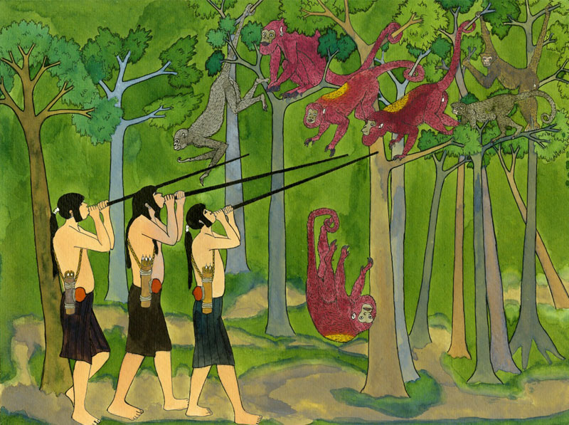
Who the animals are: The example of Tsewa
In beginning times spider monkeys were a separate group of humans. Their leader was Tsewa. These people had their own love songs by which they attracted each other. An ancestor of the Aguaruna made friends with Tsewa who taught him their songs and gave him the first blowgun.
“Finally, though, the (Aguaruna) man used his new-found knowledge to hunt members of Tsewa’s own household. In a rage, Tsewa rammed the blowgun up into the man’s anus. The man himself became a spider monkey and the blowgun his long tail. But it was too late for Tsewa to take back the hunting songs, for they had already been learned by (Aguaruna) human beings.” Brown 75 (from Chumap Lucia and Garcia-Rendueles 1979:227).
Thus modern spider monkeys are descended from this Aguaruna man and Tsewa’s family.
They are humans estranged by painful the events of the Aguaruna man’s betrayal.
The anen songs Aguaruna hunters use to attract them are the spider monkeys’ own songs.
Spider monkeys are not frightened by blowguns because they invented them.
Indigenous cultures of the Americas all have stories of how estrangement between humans leads to the rise of new plants and animal species. The Aguaruna story of Tsewa is just one example of a broad pattern.

Slide 5
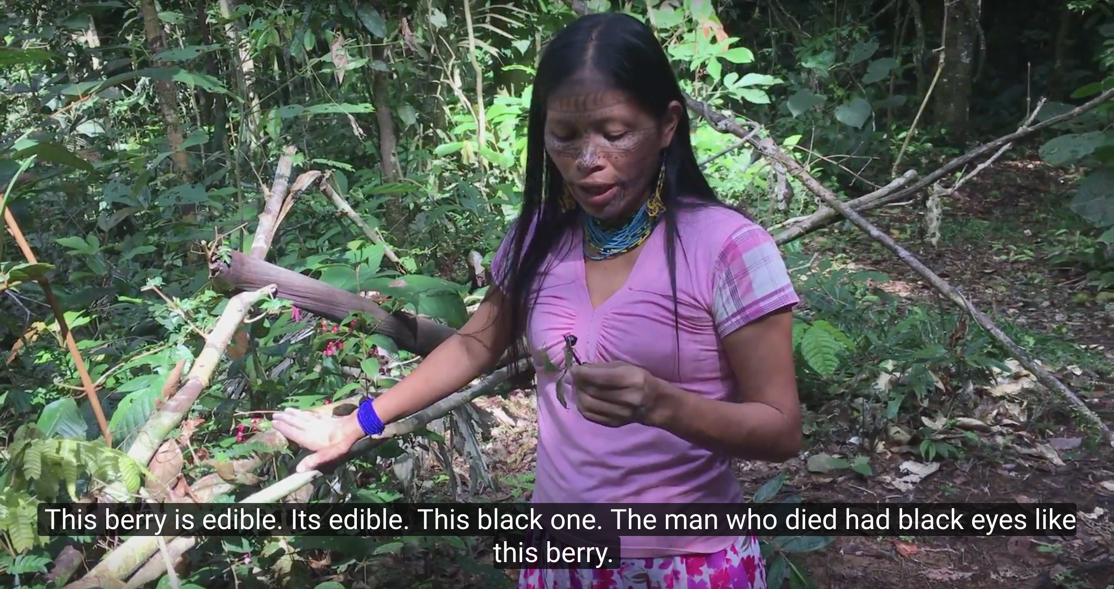
Plants too are estranged humans: Example of the Spirit Eye Tree
There are also many stories telling how estranged humans become plants. In this story a boy follows a girl to her gardens trying to get her to fall in love with him. He has beautiful black eyes and she likes him well enough but does not want to be his girlfriend. He keeps bothering though so she pokes his eye out with a stick. As he dies he says “now I will become a berry tree growing on the edge of your garden. You will eat my berries and enjoy them. He dies but the poked out eye sprouts and grows into a tree with beautiful black eyelike berries. The girl enjoys their beauty and their taste because as a plant the man is more distant and cannot pester her.

Slide 6
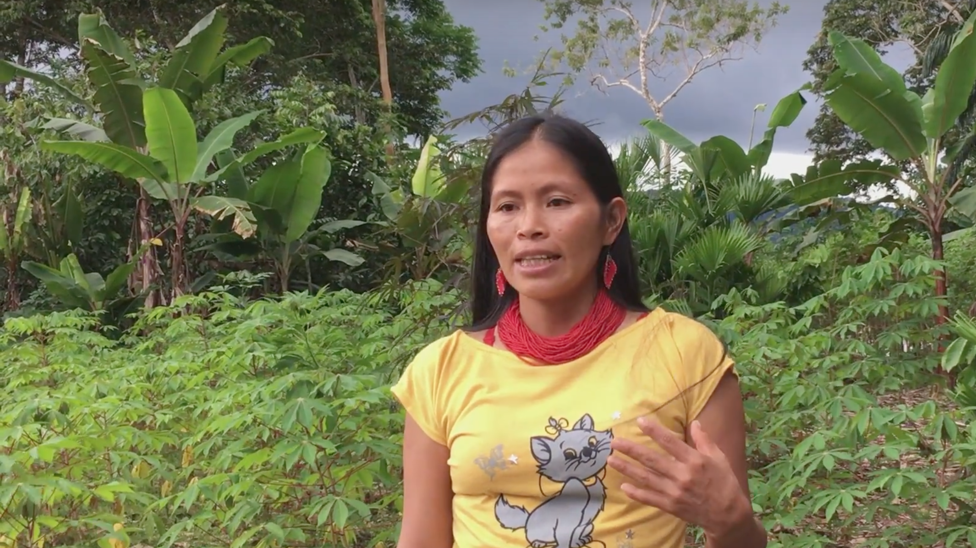
In order to make the plants and animals “friendlier” the Aguaruna sing “love songs” or “friend songs” to them. These songs are called anen. Hunting songs are called spider monkey anen because they come from the spider monkeys. They are Tsewa’s Gift (referred to in the title).
In order to understand how the songs work it will be helpful to examine the semantic range of the term anen.
anen - a genre of songs with the power to act directly upon the natural and social worlds. The category anen encompasses songs used in hunting, horticulture, and courtship....
anentái, a noun that means “heart.”
anentáimat, verb “to think.”
The relationship between anent “ritual song” and anentái suggests that the the singing of the song causes and emotional change of heart anentái.
The verb anentáimat, “to think” is similar to the noun anentái. Some informants told Brown that this is because we think with our hearts.
Brown asked an Aguaruna on whether people think with their heads or their hearts. He answered:
“The people who say that we think with our heads are wrong because we think with our hearts. The heart is connected to the veins, which carry the thoughts in the blood through the entire body. The brain is only connected to the spinal column, isn’t it? So if we thought with our brains, we would only be able to move our thought as far as our anus!” p. 19
This would be consistent with other west Amazonian languages. For example Kichwa say that anent style songs are agents of llakichina (causing love and empathy) which then leads to iyarina (Kichua word for remembering/thinking.) Anentáimat, would thus be an Aguaruna synonym to Kichwa iyarina or Piro nshinikanchi.

Slide 7
According to Brown the purpose of singing (and other hunting and gardening rituals) is to increase affinity between humans and the animals or plants.
Deffinition of Affinity: noun
1. a spontaneous or natural liking or sympathy for someone or something. 2. empathy for, rapport with, sympathy for, accord with, harmony with, relationship with, bond with, fellow feeling for, closeness with/to, understanding of/for; a similarity or resemblance suggesting a relationship.

Slide 8
Differences between western and native thinking on human relations to animals
Western thinking:
starts from the perspective of human exceptionalism.
God gave Adam dominion over nature as crop and livestock manager
humans manage nature through rational techniques they control.
Nothing depends on nature’s emotional willingness to cooperate.
Aguaruna and Indigenous American Thinking
Nature cannot be managed because plants and animals are estranged people not things.
They must be persuaded to cooperate.
This means courting a more intimate relation to the plants and animals that makes them feel sympathy for human needs.

Slide 9
Empathy with animals is intensified in order to increase the effectiveness of hunting.
Brown views the anen that intensify this empathy as tools or technology for hunting. According to the men of the Alto Mayo, the principle function of hunting songs is to attract game to the vicinity of the hunter.
A secondary purpose is to make the animals “friendly” and therefore more likely to reveal their presence by emitting some sound. As one man says “When a man knows magical songs, he uses them as he hunts. Then the spider monkeys begin to call, and he will always kill some. The curassow calls ‘pish’ and is more easily found.” 75

Slide 10
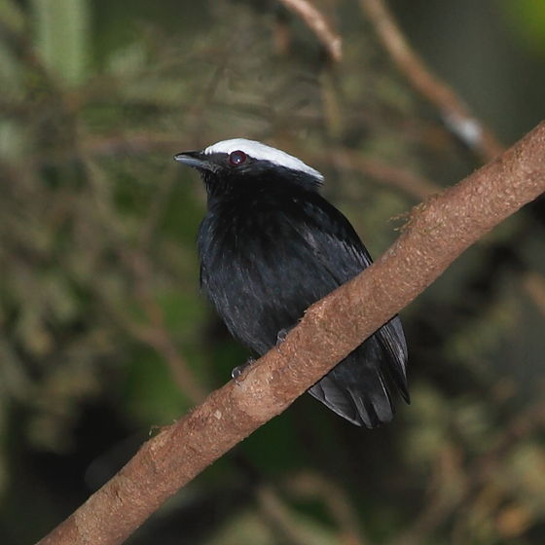
Songs are understood to be physical extensions of the singer’s body. To acquire the song the singer drinks tobacco. After the singer receives the song they fast so that the song will become used to living in her body and not leave her. During this period she has to abstain from sex. In case these precautions are not kept there is even an anon to keep an anon from leaving in case the fast is broken.
New ginger (i.e. new anent)
I have put inside
That which cures anger (i.e., an amen that clams jealousy)
Do not leave me.
I am a woman of good fortune
[the song] recently growing
Have I erred
I am not flirting
It is a lie
Do no leave me
I am a woman of good fortune
Do not leave me.
Michael F. Brown, Tsewa’s Gift: Magic and Meaning in an Amazonian Society. Smithsonian Institution Press. 1986, 77

Slide 11
The songs that are integrated into the singer’s body include “third party” relationships that mediate the singer’s relation to the target audience of the song. In this case the song increases the intimacy between the hunter and the game by connecting him to the wisham, a bird that seems to consistently attract animals. The wisham is a bird that travels with the spider monkeys as they forage.- a bird that is considered their friend or relative. Taking the song into the singer’s body would also mean that the singer must from now on live in a relation of particular respect to the wisham bird. In this song the singer sings in the first person “I am your wisham.” The wisham is call “gathering wisham.” This is a technical term that attribute to the wisham the ability to attract (gather) many different species through its charisma. And it is this gathering charisma that the singer takes into herself in taking the song.
I am your wisham
Friend wiisham
Wiisham that loves
Friend Wisham
Your wisham
Wisham of the curassow
unerring wisham (with darts that cannot miss)
Spider monkey wish
Your wisham
Friend wisham
Wiisham that loves
I do not err with spider monkey
Friend Wisham
Your wisham

Slide 12
Gatherer wiisham [four times]
Wiisham that loves curassow
Wiisham that loves curassow
Gathering, gathering wiisham
Gathering, gathering wiisham
Wiisham that loves game
Wiisham that loves game
Wiisham that loves deer
Wiisham that loves tinamou
Michael F. Brown, Tsewa’s Gift: Magic and Meaning in an Amazonian Society. Smithsonian Institution Press. 1986, 77

Slide 13
Relation to monkeys mediated by husband/wife relationship
The song “I Befriend the Widow” is supposed to be performed when hunting in the company of a new wife, suggesting that the animals are attracted by the erotic tension between the hunter and his wife.
The Aguaruna were a warrior society where young women were often left widows. When this happened an older sister often took the widowed younger sister into her home where she would become a second wife or co-wife.
The man might go out hunting with the new wife where they might have a romantic encounter. The idea of this song is that the attractiveness of the young widow Kakuí, or perhaps the erotic tension between Kakuí and her new husband will attract spider monkey who will be killed as food.
Hence the hunter’s relationship to the spider monkeys is mediated (enhanced) by his relation to his new wife Kakui. His relation to Kakuí is also mediated by the spider monkeys. He is hunting the spider monkeys in order to give them to her and he is with Kakuí in the forest only because they are hunting spider monkeys.
I Befriend the Widow
I befriend the widow
I befriend the widow
With the friend I join
Unerring with spider monkey
Attractive Kakuí
I befriend, I befriend
Attractive Kakuí
I befriend, I befriend
(Tsewa’s Gift 77).

Slide 14
The Garden’s Children
Aguaruna gardeners understand the manioc plants as people with families who include the gardener in their family as a mother. If she does not treat the manioc plants with empathy they will withdraw from her and not produce food.
“Alto Mayo women reason that since manioc plants are “people,” there must be both male and female plants, as well as adults and children.” Brown, Tsewa’s Gift 110-111.
Women “leave a few of the largest plants unharvested so that these will “call” new plants to replace the ones just uprooted”. According to one woman Brown interviewed “The large plants.... sing to the replanted stems to make them grow well.”
Brown found that Aguaruna treat the manioc tubers as babies. For this reason “not even the tiniest tuber should be left behind lest this “baby” begin to cry because it has been abandoned:
“The other manioc plants come to console the baby tuber saying, “Why did our mother leave you behind? If she does this, how will the manioc grow so that she can make beer for our father?” To avoid this, you must always collect every tuber when digging up a plant.” Michael Brown quoting an Aguaruna informant, Tsewa’s Gift, 106.

Slide 15
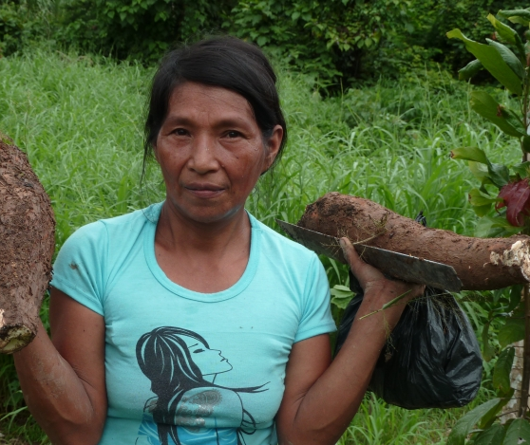
The Manioc People (Brown, Tsewa’s Gift, 105)
Long ago people did not make gardens as we do today. Instead of waiting until the entire garden was cleared of brush and large trees, women began to plant manioc as soon as a small part of the garden was cleared. [Presumably this was because the forest clearance was much slower before the introduction of steel tools.] Thus the manioc was sometimes mature in some parts of the garden before the entire garden had been cleared.One day a man who was clearing a garden said to his wife, “If I cut down this big tree it might fall on the manioc that is already growing. Should I leave it standing or cut it down?” He decided to cut it down and instructed his wife to make manioc beer so that he could invite his kinsmen to come and help him.

Slide 16
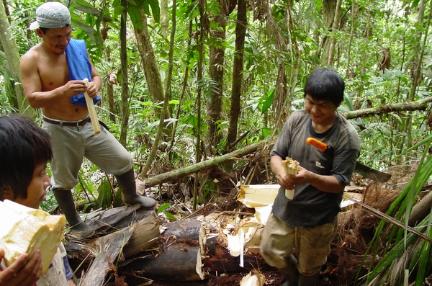
A few days later the men came, and after drinking manioc beer they began to chop down the large tree. Suddenly the souls of the manioc plants arose; they were people, lots of people. The manioc people said, we will help cut the tree so that it won’t fall in our direction.” When the manioc people arose, all of the men fell asleep.

Slide 17
Some of the manioc people began to pull a vine growing on the tree, while others cut the tree with axes. They pulled the tree so that it would fall away from them. As they pulled, the old manioc people sang, “Sons, pull hard so that the tree won’t crush our children. When we are done we will eat the head of a spider monkey.”
When the tree had been felled, the manioc people disappeared. Among the sleeping men, the man who had called the work party could hear songs of the manioc people in his sleep. Because of this we know that manioc has a soul, that is has people.
The intent of the following story is to make the listener empathize with the manioc plants as people who have families and who worry about their children like humans do. Increasing the empathy of the gardener will make the manioc plants respond to the gardener by producing food.

Slide 18
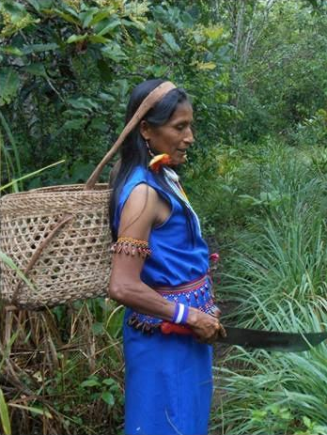
According to Brown many anen are intended to make the plants animals or earth feel compassion, pity or empathy for the singer. How would the words of the following song make Nughui (the earth or garden mother) feel compassion for the singer?
In worn-out soil
I make a garden
In the thicket of the bird chuchumpiú
I make a garden
Mother Nugkui, mother Nugkui
Let me know your manioc
I am an orphan among enemies
Almost dying I live
In worn-out soil
I make a garden
In the thicket of the bird chuchumpiú
I make a garden
Mother Nugkui, mother Nugkui

Slide 19
“Emphasis on the suffering of the singer seems to be a characteristic shared by many supplicatory songs known to the Aguaruna....” ....songs used to...recruit Nugkui’s assistance in the garden attempt to manipulate powerful beings by stressing the wretchedness of the supplicant.” Tsewa’s Gift 110-111.
Mother Nugkui, mother Nugkui
the child of others cry like birds’ offspring
“Chianana” they cry, suffering
My child does not do this
Mother Nugkui, mother Nugkui
Let me know your manioc

Slide 20
Amazonian people believe that the food craving of a pregnant woman is really the craving of the child in the womb. If the food craving is not satisfied the woman may have a miscarriage. In one of the anen recorded by Brown the singer infers that his pregnant wife's desire for meat is so strong that it will cause a miscarriage. The song is intended to elicit compassion for the hunter’s pregnant wife and unborn child
I will have a miscarriage for curassow
To the Nugkui woman [i.e. singer’s wife}
I will give a miscarriage for curassow
Make me find deer
Tsewa, Tsewa
Make me find spider monkey
I will have a miscarriage for spider monkey…
Hawk, hawk
Attract the spider monkey
Make me find currassow
Make me find guan
Attract game

Slide 21
Michael Brown, Tsewa’s Gift: Magic and Meaning in an Amazonian Society
Andean/Amazonian society saw itself as a body of relatives held together by empathy.
Michael Brown’s book Tsewa’s gift:
extends the scope of the convivial society to show that of relatives to include social relationships to plants and animals.
makes a clear case that the relationships to plants and animals are not merely a disposable addition to the circle of human relatives. Rather, plants and animals mediate the relations to human relatives and human relatives mediate the social relation to animals and plants.
presents an innovative theory of what rituals do. The purpose of ritual songs is to increase “affinity” or emotional closeness between humans and the plant and animal world

Slide 22
What do I need to know for the test?
The articles by Michael Brown are from his book Tsewa’s Gift. The book is about magical songs called anen.
Who is Tsewa? What is Tsewa’s Gift?
What does Brown mean by the word magic in relation to these songs?
Know the meaning of the word anen in relation to related words from the same stem.
What is the purpose of singing an anen?
How does and anen work?

