Slide 1
The Morpheme -wa has the following meanings:
1. -wa apended to a noun means “with.”
2. -wa diminutive; often indicating intimacy (one’s own)
3. -wa apended to a non ending in a vowel may be a possessive. Examples: paiwa (his, hers, its); yayawa (fathers); Mariawa (Maria’s).
4. -wa as a verbal suffix increases transitivity directing the action of the verb toward the speaker. In so doing it often causes the action to appear more intense, either as a more personal favor or as a more personal offense.

Slide 2
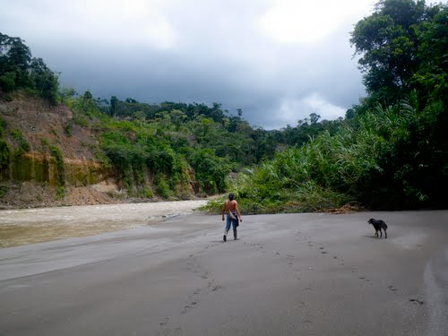
Allkuwa puriun.

Slide 3
He is walks with a dog.

Slide 4
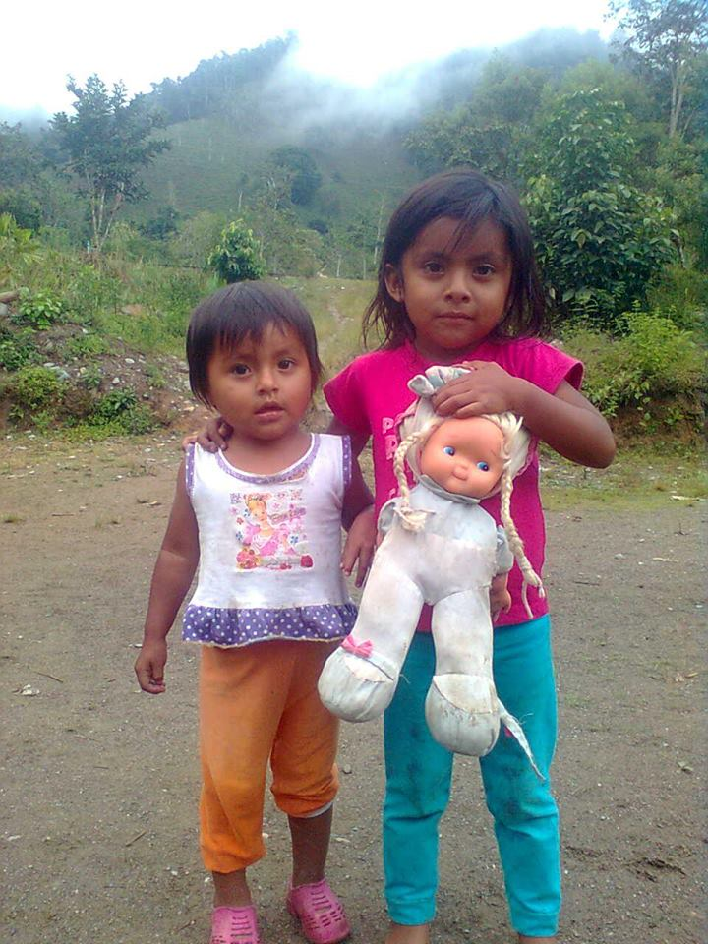
Muñecawa pugllaunchi.

Slide 5
We play with a doll.

Slide 6
Gaunteswa apini.

Slide 7
apina = grasp
guantes = gloves
I am grasping it with gloves.

Slide 8
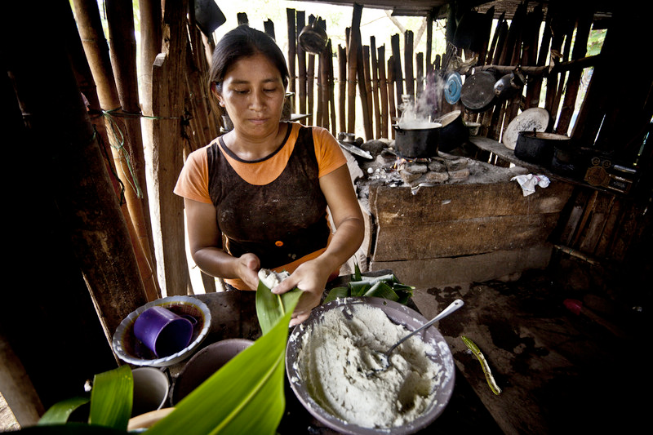
Ima panga-wa maitungui?
sara = corn
panga = leaf
maituna = to wrap
What leaf are your wrapping (it) with?
With a corn leaf.

Slide 9
Ima panga-wa maitungui?
sara = corn
panga = leaf
maituna = to wrap
Ima pangawa maitungui?
Sara pangawa.

Slide 10
Ima panga-wa maitungui?
What are you making chicha with?
sara = corn
I make chicha with corn.

Slide 11
Ima panga-wa maitungui?
Imawa aswara rangui?
sara = corn
Sarawa aswara rani.

Slide 12
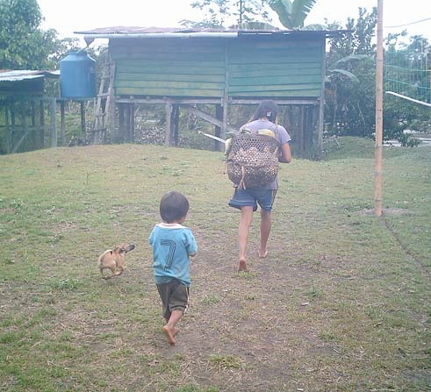
Who is this child walking with? With his mother.

Slide 13
Kai wawa piwa puriun? Paiwa mamawa.

Slide 14
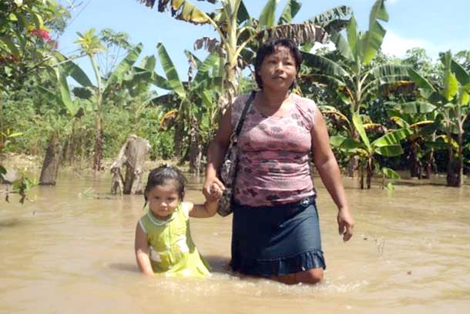
Piwa puriun? Paywa ushiwa puriun

Slide 15
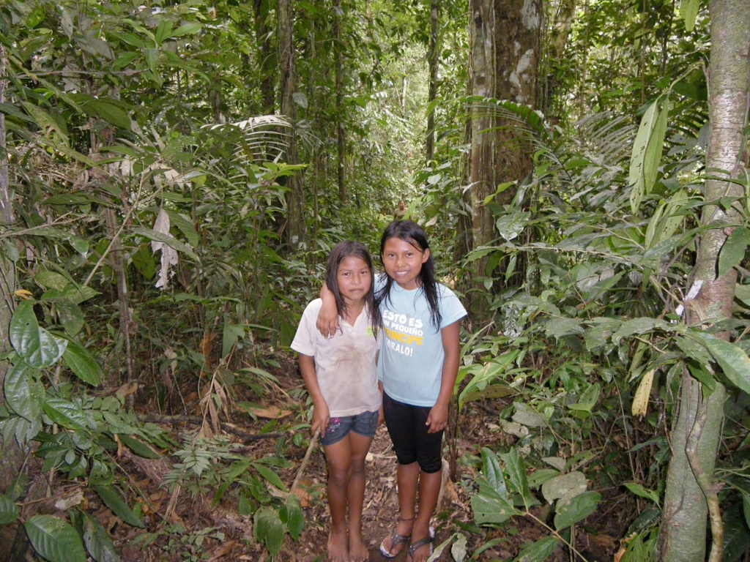
I am standing with my sister.

Slide 16
Ñuka ñañawa shayauni.

Slide 17
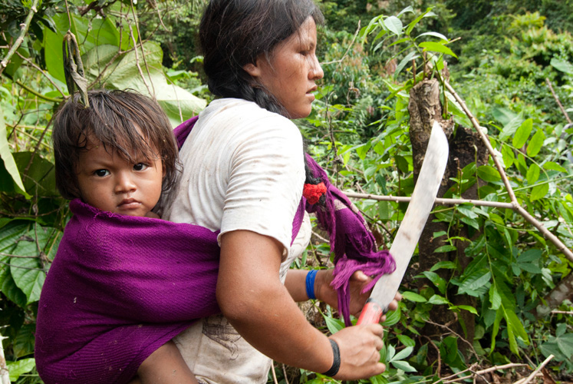
Ima panga-wa maitungui?
Imarawa rarkangui aswara?
My mother is working with a machete.
sara = corn
Sarawa asuarkani.

Slide 18
Ima panga-wa maitungui?
Ñuka mama sauliwa tarabaun.
Sarawa asuarkani.

Slide 19
Ima panga-wa maitungui?
Imarawa rarkangui aswara?
Ñuka shuj punzha computadorawa tarabasha maikan oficinais.
sara = corn
Sarawa asuarkani.

Slide 20
Ima panga-wa maitungui?
Some day I am going to work in an office with a computer.
sara = corn
Sarawa asuarkani.

Slide 21
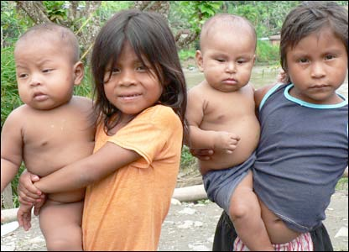
Ima panga-wa maitungui?
Who are you playing with?
Instead of playing with dolls we are playing with bald headed kids.
Sara pangawa.

Slide 22
Ima panga-wa maitungui?
Piwa pugllianguichi?
Sara pangawa.
Muñeca randi llushti uma wawaunawa puglliaunchi.

Slide 23
Malkira palawa awai apauni tarpungaj.

Slide 24
Malkira palawa awai apauni tarpungaj.

Slide 25
As a verbal suffix -wa directs the action of the speaker. In so doing in enhances transitivity so that the action done to the speaker often appears more intense either as a more personal favor or as a more personal offense.

Slide 26
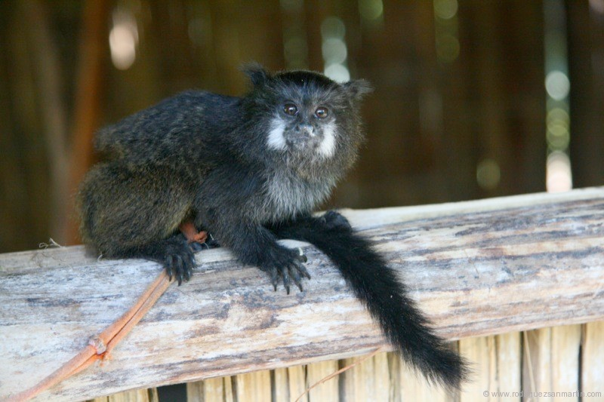
Please feed me.

Slide 27
Kara-wa-i.

Slide 28
Don’t eat me.

Slide 29
Ama miku-wa-ngui.

Slide 30
When I eat wild fruit my stomach hurts me.

Slide 31
Sacha muyura mikujpi iksa nanawan.

Slide 32
My mother told me about it.

Slide 33
Ñuka mama kwintawaka.

Slide 34
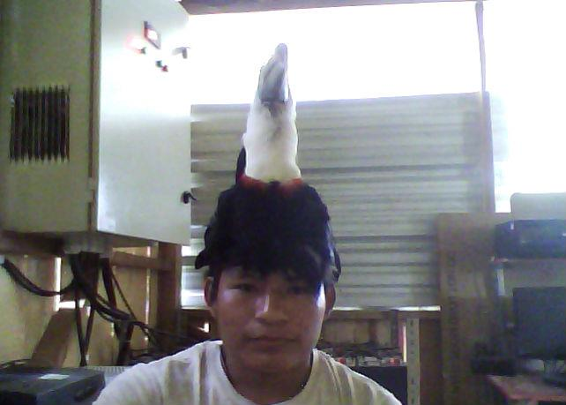
The shot me when I was not paying attention.

Slide 35
Ñuka mana riparashkai illapawaka.

Slide 36
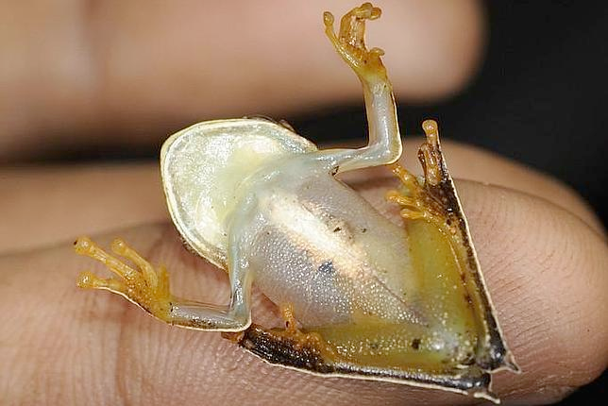
Let me go!

Slide 37
Kachariwai!

Slide 38
Ñukara mana tapuwaka.

Slide 39
They didn’t even ask me.

Slide 40
Ñukara Itsingama vultiachiwaka.

Slide 41
They turned me upside down.

Slide 42
As a suffix appended to a noun -wa works as a diminutive often conveying the idea of intensified relationship. For example “Ñuka kariwa" means “my own dear husband.”

Slide 43
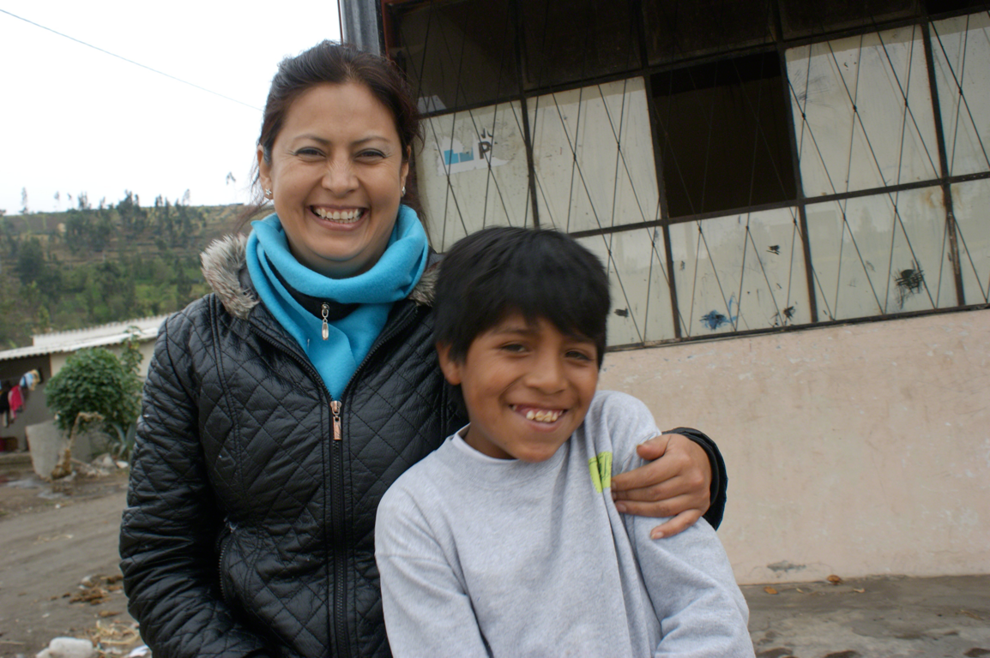
Ñuka churiwa.
Ñuka mamitawa.

Slide 44
My own dear son.
My own dear mother.

Slide 45
Paimi ñuka warmiwa.
Ñuka kariwa man. pai.

Slide 46
She is my own wife.
He is my own husband. pai.

Slide 47
Paiwa kikin allkuwawa puriun.

Slide 48
He is walking with his own dog.

Slide 49
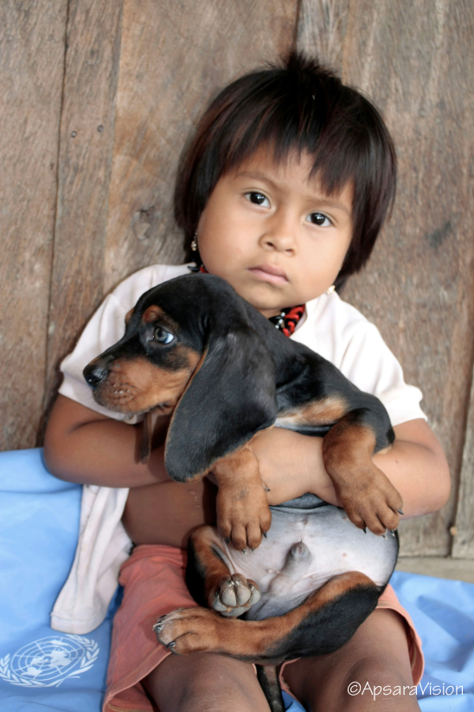
I am hugging my own dog.

Slide 50
Ñuka kikin allkuwara ugllariuni.

Slide 51
I stand hugging my own sister on the forest path.

Slide 52
Ñuka ñañawara ugllarisha shayauni sacha ñambii.

Slide 53
Ñukanchi (kikin) muñecawawa pugllaunchi.

Slide 54
We are playing with our own doll.

Slide 55
When appended to nouns ending in a vowel -wa may function as a possessive marker as follows:.

Slide 56
Ishki kachunguna upichinun (paywa waukiunawa warmiuna).
He is my cousin’s husband.

Slide 57
Ishki kachunguna upichinun (paywa waukiunawa warmiuna).
Ñuka primawa kari pay.

Slide 58
He is following his mother.

Slide 59
Paiwa mamara katiun.

Slide 60
Kai warmi paywa ushushiwa makira apisha yakui puriun.
Piwa puriun? Paywa ushiwa puriun

Slide 61
He is walking with his dog on the sand.

Slide 62
Paywa allkuwa puriun tsatsai.

Slide 63
Paywa ñañara ugllariun.

Slide 64
She is hugging her sister.

