Slide 1
Ishki Kandurumi,
Gabriel Andi T.
Kwillurguna. Orr and Huddleson 1971:88.
Atun yaku umai ishki atun rumi tiyak aka. Paiwa shuti Candurumi. Kai ishki rumiuna anauka kari Candurumi, warmi Candurumi.
Kai ishki rumiuna munanauka shu punzha lamarma ringaj. Shina rimashka shimira charinauka shinallara: “Shu punzha yaku ashkara undakpi rina manchi lamarma tiyangaj.” Kasna chapasha kawsanawka unai wataunara.
Kai rumiuna kawsajkuna aj aka 300 metros tupu karui yakumanda. Shina asha paiguna ashka yaku undachu nisha chapajkuna aj aka.
Kasna paiguna chapasha kawsaushkai shu punzha ashka llandu puyulla tukuka. Indima rikurika, puyulla tukuka, manzhanaita ñaka tuta kwinta. Punzha kasna tukujpi ashka runauna manzharinauka, “wañungajmi raunchi!” nisha.
Ña chishi mayanda yaku umama uyarika urku tularishka kwinta tululululuu. Kai uyarijga yaku tucllamusha uyarishka aka. Ña tutayaka. Kasna tutayajpis uyarinanga uyarisha katiuka mas mas shinzhira. Ña mas unailla tutai yaku taparingaj kallarika. Runauna kaita rikusha-llara mana sikanauka urkuunama, paiguna iyanaushka ansallara undamungaraun nisha. Yaku ña paktaka chi rumiuna sirishkama. Kari rumi yaku partima sirij aka, warmi rumi mas sacha purama. Kasna ashka. Yaku pactajpi kari Candurumi ña ringaj kallarika yaku uraira. Chi rumii bila rikurika, campana uyarika, shinallara kaparishkas. Chi rumi mana yanga rumichu aka randi astaun supaiguna wasimi aka. Chi raigu pai riushkai bila, campana, kaparishkas uyarika.
Kari rumilla uraira rika yaku apashka lamarma pactanagama. Randi warmi rumi mana ushaka kari rumiwa parijo ringaj yaku paiwajma mana pajtashka raigumanda. Chibi chara chapasha kawsan sakirij warmi rumi, shina ajllaira kunagama yaku mana chi tupura tujyan. Chi Candurumi riushka uras ashka runauna wañujkuna aj aka, yaku mayanda kawsajkuna.
Chillai tukurin kai kwintana.

Slide 2
The Two Kandu Stones
Gabriel Andi T. In Kwillurguna. Orr and Huddleson 1971:88.
Translated from Kichua by Tod Swanson
At the head of the Atunyacu (the Napo) there used to be two boulders (or rock cliffs). Their names were Candu Stone. These two rocks were Male Candu Stone and Female Candu Stone. These two stones wanted to go to the sea one day. These two stones wanted to go to the sea some day. They had talked it over in that way and had an agreement: “one day when the water rises high we are to go to be in the sea.” Waiting like that they lived for many years.
Those stones lived about 300 meters distant from the water. Because that is how it was, they lived waiting, desiring that the river should flood greatly. As they were living waiting that way, one day the sky darkened with clouds. The sun did not appear, the sky turned to clouds, frighteningly [dark] almost like night. When the day turned like that many people were afraid. "We are going to die," they said. Toward afternoon you could hear a sound like mountains caving in up river, "Tulululululuu." That sound was the sound of water exploding over its banks. When it began to become night, when it was almost already night the noise kept getting louder and louder. Then late in the night the water began to cover things up. Seeing this the people did not climb the mountains because they thought the water would rise only a little.
But the water reached that place were that stone was lying, the male stone who lay closer to the water. The female stone was farther back in the forest. When the high water reached him the male stone started to go down river [burning] candles appeared in that stone, the sound of bells and cries came from there. That stone was not an ordinary stone but the house of spirits. Just the male stone went down river until he reached the sea.
The female stone could not go as a pair with the male stone because the water never reached her. So that female stone lives waiting, lying there till now because the water does not rise to the place where she is. In that time of the Candu stones many people who lived by the river died.

Slide 3
Constructions from this story to discuss:
Phrases with unai.
Kasna chapasha kawsanauka unai wataunara.
Ña mas unailla tutai yaku taparingaj kallarika.
Phrase with mana- chu randi -mi
Chi rumi mana yanga rumichu aka randi astaun supaiguna wasimi aka.

Slide 4
Distance between downriver and upriver: Marker of terrestrial space.
The most important directions in the Amazonian region are:
urama “downriver” (east) upriver
anakma “upriver” (west) .
The end point of these directions are the headwaters and the sea at the mouth of the rivers.
Downriver and upriver marked distance between relatives
This is a distance that separated women from the men they loved.
Women stayed at upriver with children and manioc gardens and home.
Men travelled downriver to hunt, trade, or work in the oil fields.
This separation by distance downriver was a part of life. Sometimes it lasted for days at a time and sometimes for months.
Since Amazonian women were married into communities farther upriver or downriver from where they were born distance on the river is also what separated them from their families and home communities.
The river was also the line of communication between relatives who were apart.
In a time without telephones women sang magical songs on the river bank so that the water would carry their message to those they loved.
The story of the Two Kandu Stones can be read as myth that accounts for the origin and meaning of the space we need to live in. It is not a story widely known by all Amazonian Kichwa people. Rather it is part of the meaning of the local geography.
The geography of the indigenous world is comprised of male and female pairs: kari-warmindi.
Marking the upriver (western) endpoint of this distance is a single female boulder.
She is paired with a male boulder that lies at the opposite pole of habitable space: far downriver at the mouth of the Amazon.
As a result of the events narrated in the story the end points of the upriver and down river directions are marked by stones who love each other but who are permanently separated.
The longing between these stones is the tension that maintains the space people live in.

Slide 5
Stones
Stones are a great image for the permanence of this longing because a stones cannot move.
In Andean/Amazonian tradition the disorderly society of the characterized the world before this one was turned to stone in order to make room for the present world to emerge.
Petrification could be seen as a containment of destructive imposible desire (killa).
The separation of the Male and female Kandu stones is a second act in the creation drama that creates habitable space.
It is perhaps for this reason that passion contained in the male stone expresses its longing as it is washed downriver.
“When the high water reached him the male stone started to go down river [burning] candles appeared in that stone, the sound of bells and cries came from there. That stone was not an ordinary stone but the house of spirits.”
Llakichina
Like most Kichwa stories the effect on the audience is llakichina. We feel the sorrow and longing of the stones. It is not a longing which will go away unless the distance between upriver and downriver, west and east goes away. And if that distance collapses the world will end.
In feeling this llakichina for the stones the listener feels it for themselves and their relatives because the space that separates the stones is the space the space that also separates the listener from her relatives.
The river and the stones that are measures of distance in the Kichwa world feel the same pathos of separation that humans feel because they too are alive.
This sorrow is not something temporary. Rather it is a necessary component of the time and space that make the world habitable. This pathos is how the poignant reserve that mature people keep between themselves and the relatives they respect is experienced emotionally. It is the llaki (sorrow and love) inherent in the distance necessary to create the space relatives need if they are to live together.
Just as physical space would collapse if the headwaters of the Amazon moved to the mouth of the river so also the emotional space needed to sustain relations will collapse if relatives are too lazy to endure the difficult emotional work of enduring distance.
Stones are a great image for the permanence of this longing because a stones cannot move.

Slide 6
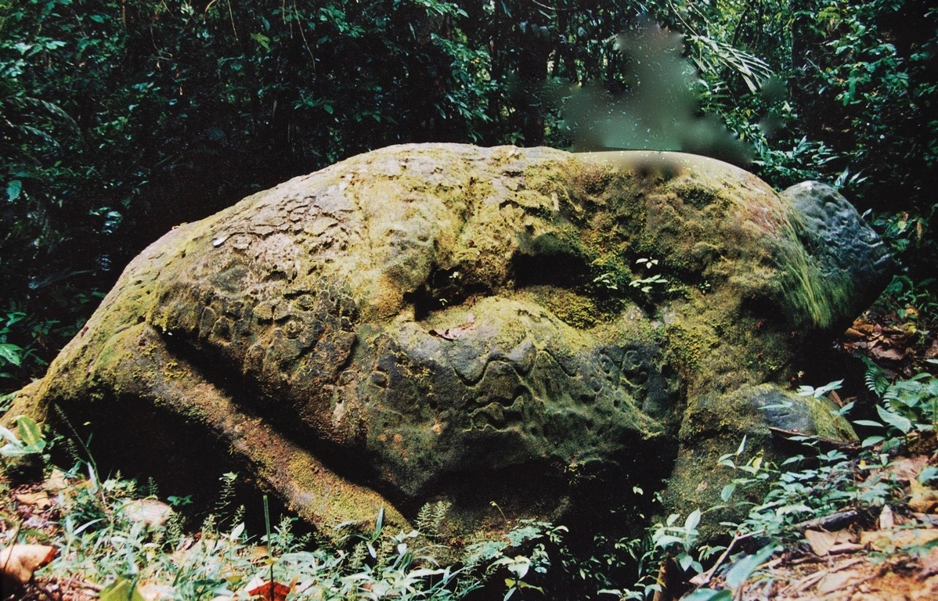
Chibi chara chapasha kawsan sakirij warmi rumi.

Slide 7
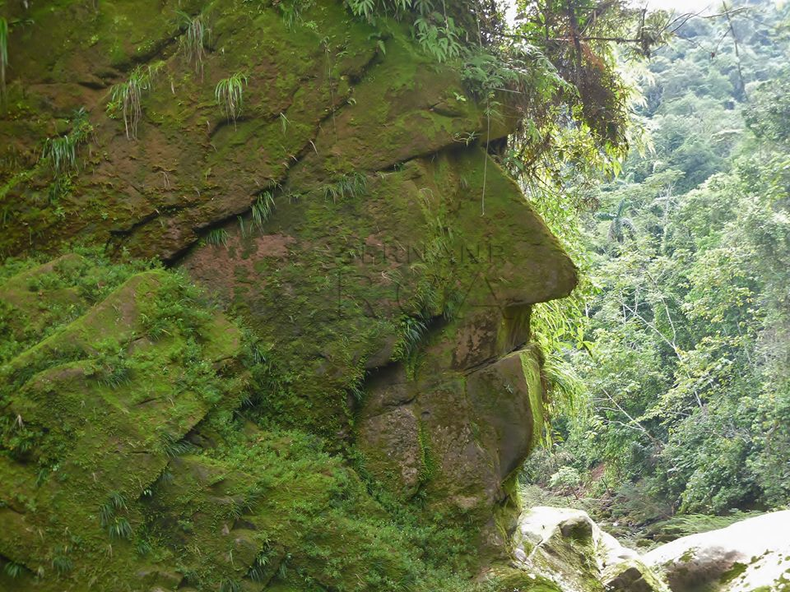

Slide 8
