Slide 1
Order: Kichwa-English
Review of past tense
shamu-ka-ni
shamu-ka-ngi
Shamu-ka
Shamu-ka-nchi
Shamu-ka-nguichi
Shamu-nau-ka

Slide 2
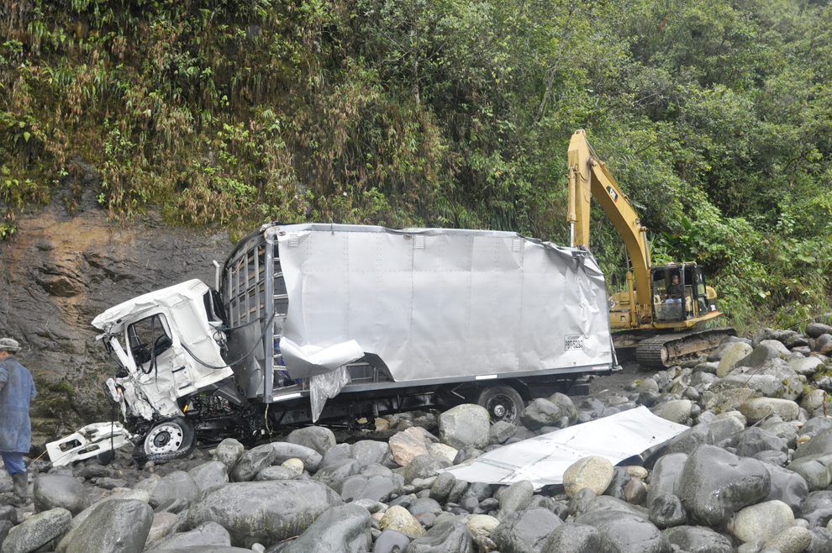
“Shuk camion yanga waykuma urmaka/ A truck fell into the canyon for no reason.”
A dialogue for practicing the Kichwa past tense.
Note: This dialogue slide sequence appears below in two versions. In the first, the order of slides is Kichwa/ English. The second is English/Kichwa. The keynote version for Mac has sound. The PDF does not.

Slide 3
Order: Kichwa-English
Kay camion yanga yakupata-ma urma-ka.
shamu-ka-ni
shamukangi
Shamuka(n)
Shamukanchi
Shamukanguichi
Shamunauka

Slide 4
This truck fell to the river bank for no good reason.

Slide 5
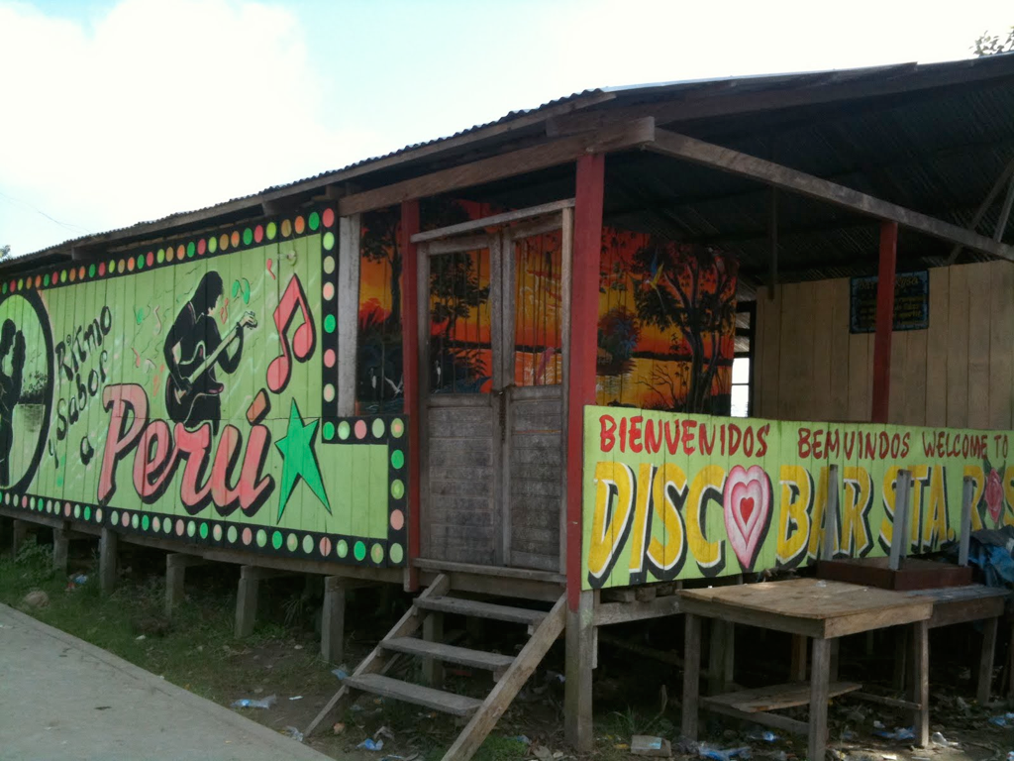
Kayna tuta ansa upikani ñuka waukigunawa.

Slide 6
Last night I drank a little with my brothers.

Slide 7
Kuna ñambimanda urma-ka-ni waykuma.

Slide 8
Now I fell from the road into the canyon.

Slide 9
Apu ñukawa piñarika.

Slide 10
The boss got mad at me.

Slide 11
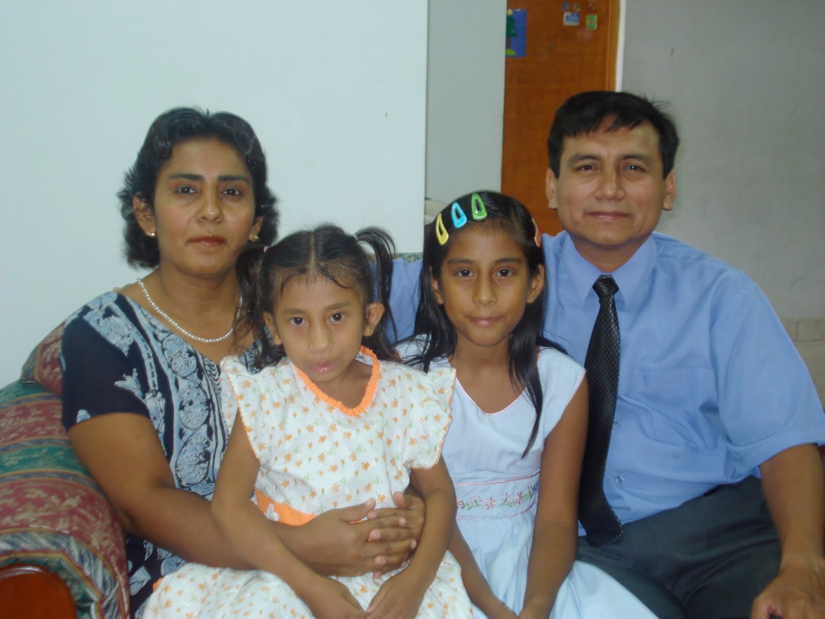
Chi camion = ñuka yayakmi. Ña rimakani choferda.

Slide 12
That truck that fell is my father’s.
I already told that to the driver.

Slide 13
“Ama upinguichu,” nikani. Ñukara mana uyaka.

Slide 14
I told him not to drink. He did not listen to me.

Slide 15
Ñukas rimakani ama shina machanguichichu.

Slide 16
I also told him not to get drunk like that.

Slide 17
Kutiwan kutiwan rima-sha kacha-ka-ni.

Slide 18
I told him that again and again.

Slide 19
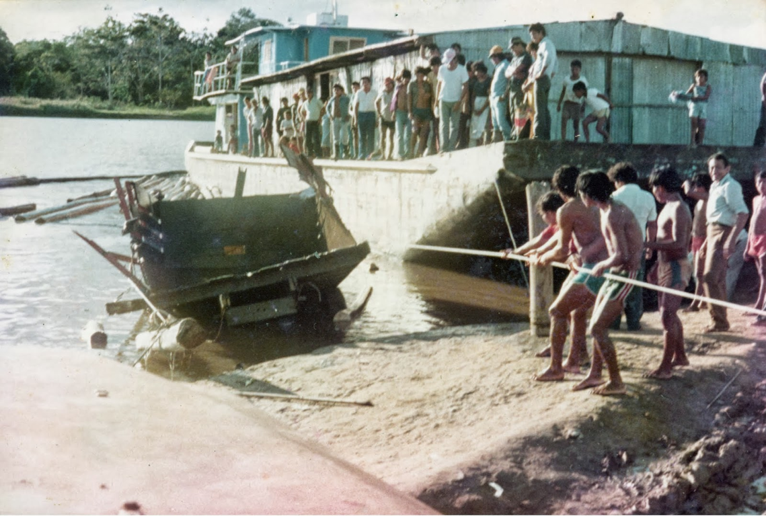
Ñuka wawki randi yakuma urmaka.

Slide 20
My brother on the other hand fell into the river.

Slide 21
Kuna paiwa camionda aisanun yakumanda.

Slide 22
Now they are pulling his truck out of the water.

Slide 23
Ching! Machai-kara-una chi-ta-mi munanun.

Slide 24
See (ideophone)! That is what the drunks want!

Slide 26
Order: English-Kichwa.
This truck fell to the river bank for no good reason.

Slide 27
Kay camion yanga yaku patama urmaka.

Slide 28
Last night I drank a little with my brothers.

Slide 29
Kaina tuta ansa upikani ñuka waukigunawa.

Slide 30
Now I fell from the road into the canyon.

Slide 31
Kuna ñambimanda urmarkani waikuma.

Slide 32
The boss got mad at me.

Slide 33
Apu ñukawa piñarika.

Slide 34
That truck is my father’s.
I already told that to the driver.

Slide 35
Chi camion ñuka yayajmi. Ña rimakani choferda

Slide 36
I told him not to drink. He did not listen to me.

Slide 37
“Ama upinguichu,” nikani. Ñukara mana uyaka.

Slide 38
I also told him not to get drunk like that.

Slide 39
Ñukas rimakani ama shina machanguichichu.

Slide 40
I told him that again and again.

Slide 41
Kutiwan kutiwan rimasha kachakani.

Slide 42
My brother on the other hand fell into the river.

Slide 43
Ñuka wawki randi yakuma urmaka.

Slide 44
Now they are pulling his truck out of the water.

Slide 45
Kuna paiwa camionda aisanun yakumanda.

Slide 46
See (ideophone)! That is what the drunks want!

Slide 47
Ching! Machaikarauna chitami munanun.

