Slide 2
Sumak Takik- “Apatikas”
English translation
Tukuy añangu kuynta tarbak runakunama kay sumak takita kuyanchi
Mashi Patricio Alvarado runa orquesta Archidonamanda
Tukuy paju tuta
We dedicate this song to all the people who work like ants.
From Archidona, Mashi Patricio Alvarado’s Kichwa orchestra.
Every stormy night

Slide 3
//Tukuy paju kallariusha rayu tamiya tuklla tukun//
//Kanpa warmi manzharikpi chaki makiwa ukllaringui//
//Every time a storm begins the thunder and rain explodes//
//When your girl gets scared hold her tight with your feet and hands//

Slide 4
//Apatikas kanikpiga chaki pachay tiyan, chaki pachay tiyan aytanguimi//
//Ukumbilla amushitu ukuy wasita paskanguichu//
//When the ants bite, they are under your feet, they are under your feet, (just) step on them.//
//Rainbow boa, master (of ants), have you opened the ant house (yet)? //

Slide 5
Tukuy tarbak runaguna ashka kullkigunarami charinun!
Kay llakta warmiguna sumak tarbak warmikunami!
All the hard-working people have lots of money!
The women of this town are women who work beautifully (like the ants)

Slide 6
//Ishkay puncha washapiga lisan pangata maskanguichi//
//Kupal vilata sindisha ukuy wasima pushanguichi//
//Two days later go look for lisan leaves//
//Light the copal candle and take us to the ant house//

Slide 7
//Apatikas kanikpiga chaki pachay tiyan, chaki pachay tiyan aytanguimi//
Ukumbilla amushitu ukuy wasita pushanguichi
Ukumbilla amushitu ukuy wasita paskanguichu
//When the ants bite, they’re under your feet, they’re under your feet, (just) step on them.//
Rainbow boa, ant master! Lead us to the ant house
Rainbow boa, ant master! Will you open the ant house?

Slide 8
Ukuy kuynta sikira kuyuchisha tushungui!
Tukuy Archidonamanta aylluguna
Cotundo, San Francisco, Porotoyaku, Villano, Tambayaku warmiguna!
Move your hips like the ants when you dance!
[To] all our relatives from Archidona
Cotundo, San Francisco, Porotoyaku, Villano, Tambayaku women!

Slide 9
//Kunan pacha wanbraguna llanzhuta ama mikunguichi//
/Llanzhuigunata mikusha ursa illak tukunguichi//
//Young people today, don’t eat the llanzhu!
//If you eat the llanzhu you all lose your vitality//

Slide 10
//Apatikas kanikpiga chaki pachay tiyan, chaki pachay tiyan aytanguimi//
//Ukumbilla amushitu ukuy wasita paskanguichu//
//If the ants bite, they are under your feet, they are under your feet, (just) step on them.//
//Rainbow boa, master (of ants), have you opened the ant house (yet)? //

Slide 11
Ukuy kuinta wankurisha ñukanchi llanganakunata dzaslla tukuchishun!
Sumak katishkawa, aswata upisha ñukanchi llaktama ñawpakma pushashun!
//Banding together like ants let’s finish our work quickly!//
Following well (the example of our elders) drinking chicha, lets lead our community forward!//

Slide 12
Kanba killa wasimanda allpara allasha pallanguichi
Kawna killa wasimanda allpara allasha pallanguichi
//Pulu mangapi kanzhasha wawakunara karanguichi//
//From your lazy home, dig in the earth and gather (them)//
//(Then) roast them in an old pot full of holes and feed the children.//

Slide 13
//Apatikas canikpiga chaki pacha tiyan, chaki pacha tiyan aytanguimi//
//Ukumbilla amushitu ukuy wasita paskanguichu//
//If the ants bite, they are under your feet, they are under your feet, (just) step on them.//
//Rainbow boa, master (of ants), have you opened the ant house (yet)? //

Slide 14
Napu Yakupuray kausak warmikuna. Sara tarpuk warmikuna
Gustu kushiwa
Kay iyayta sakinchi.
Tukuy mikuna sumak mikunami
Rukuguna kawsayta ama kungarishun
To the women who live near the Napo River.
The women who plan corn
With joy!
We leave you this thought.
Every kind of food is good food!
Let’s not forget the our ancestors’ way of life.

Slide 15
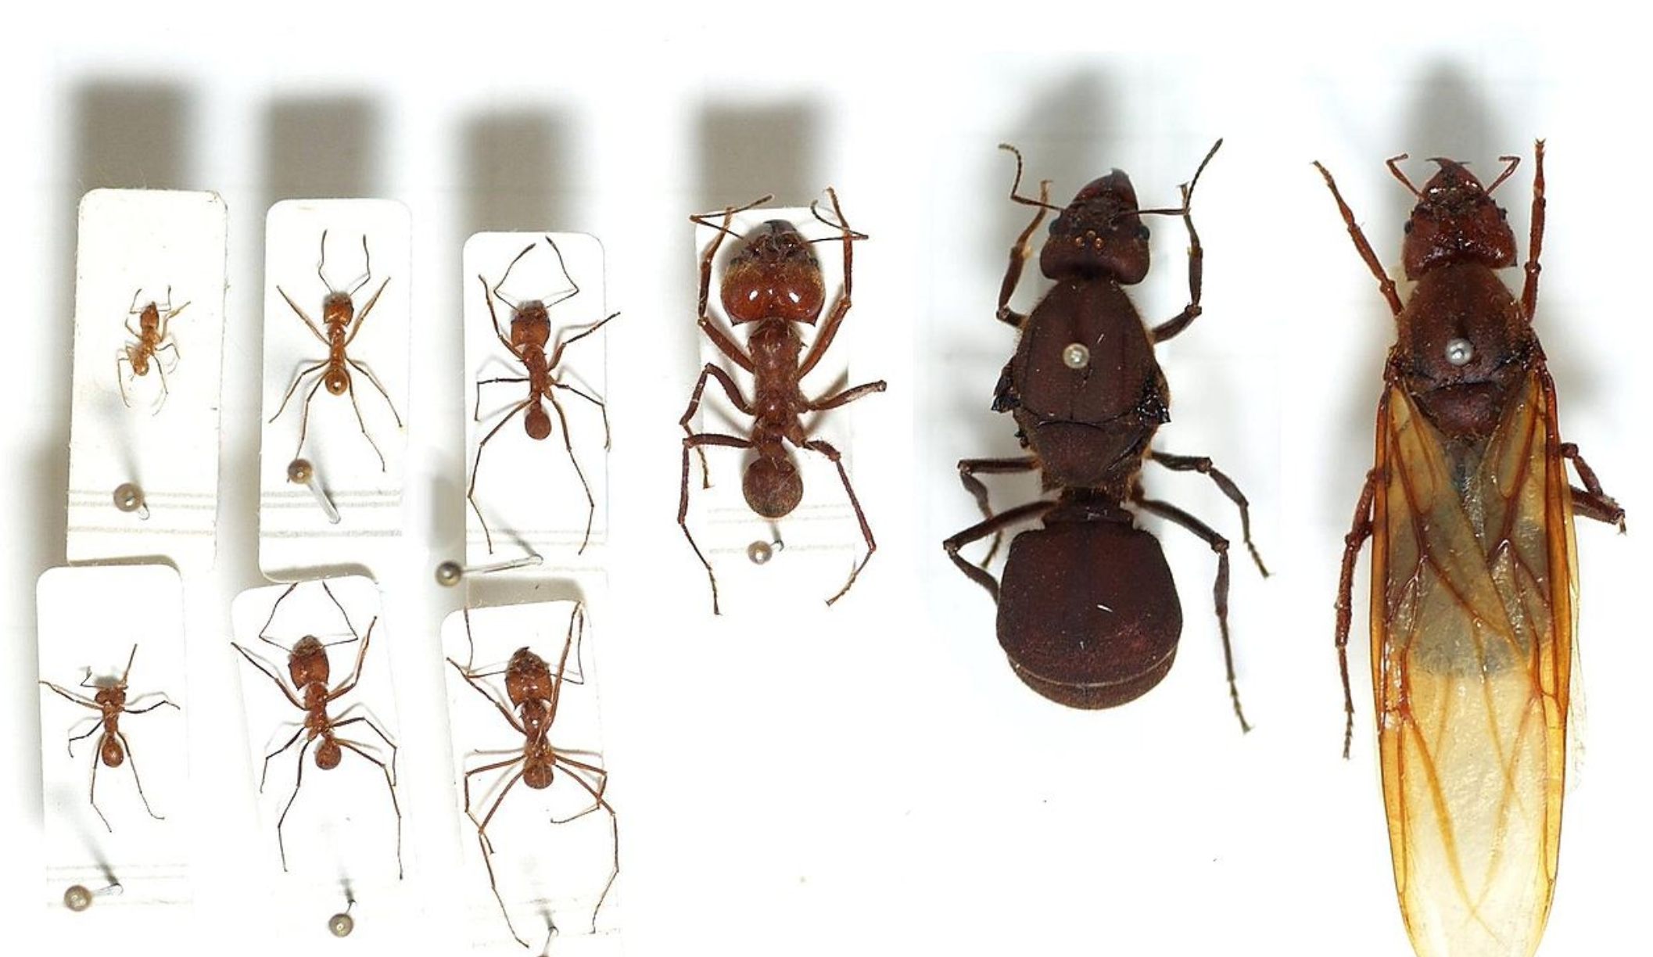
https://askabiologist.asu.edu/leafcutter-castes

Slide 16
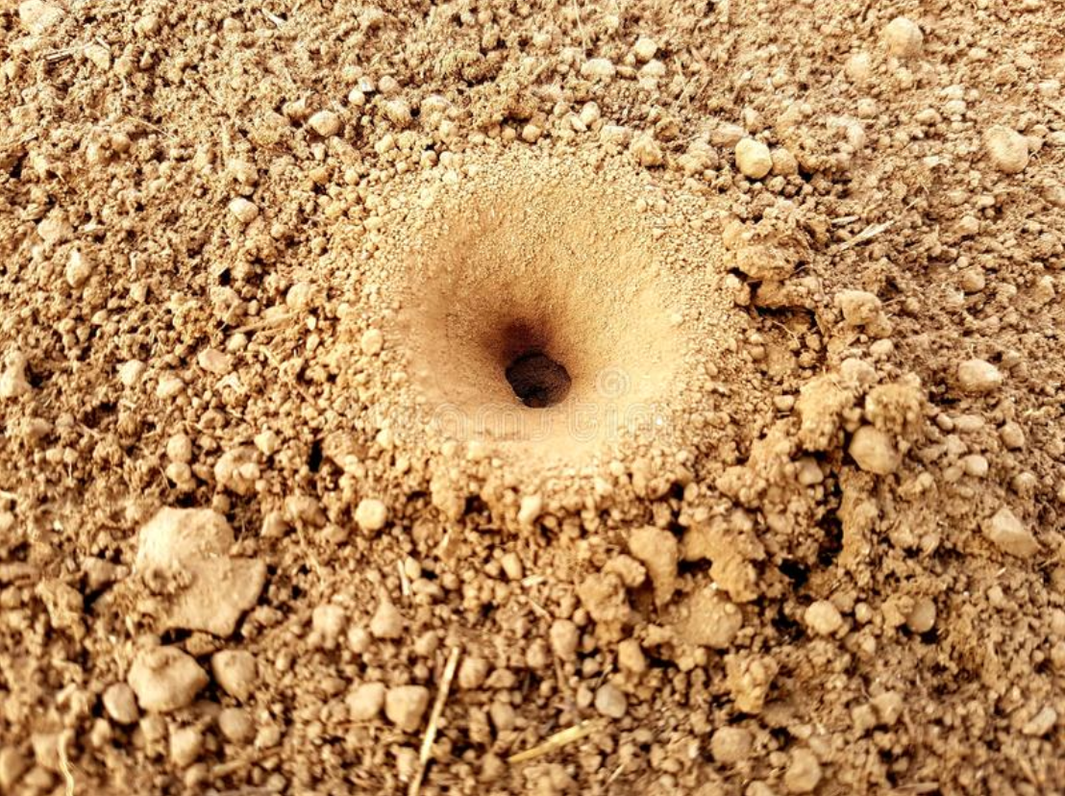
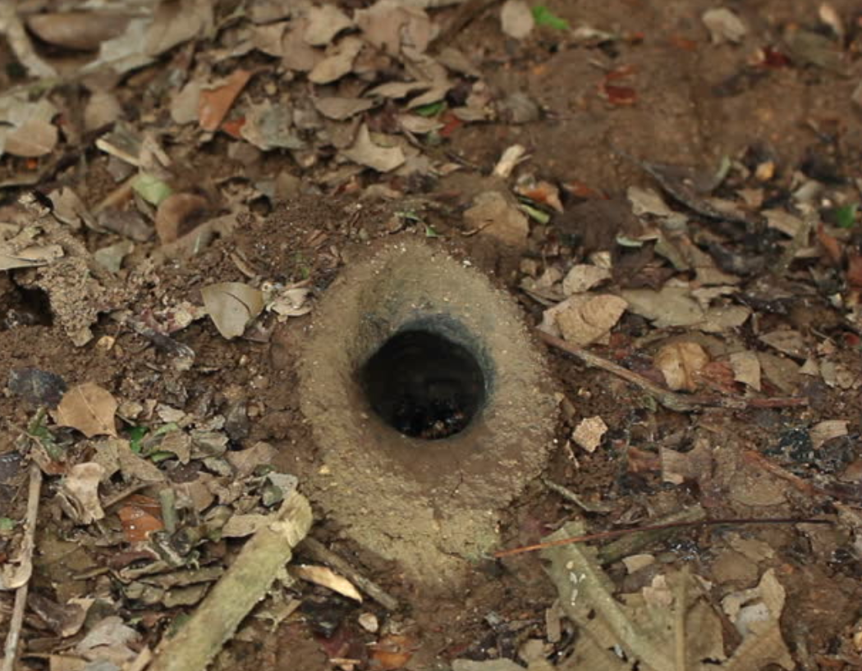
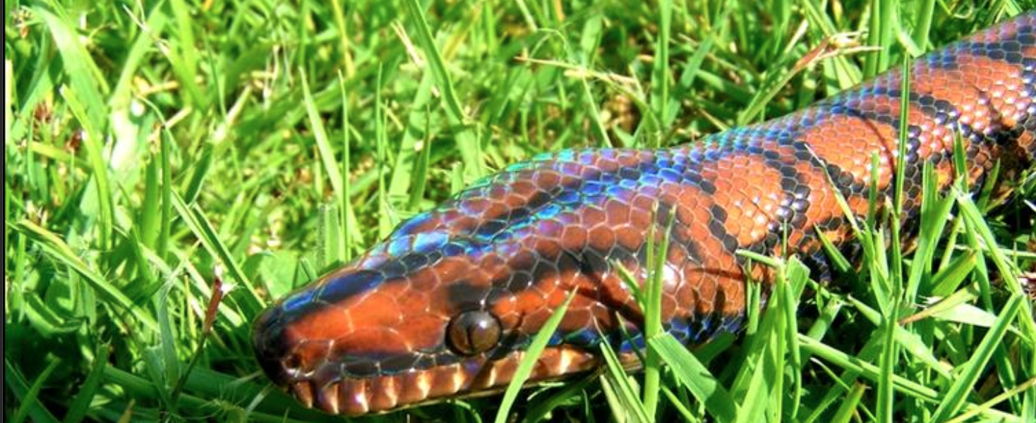
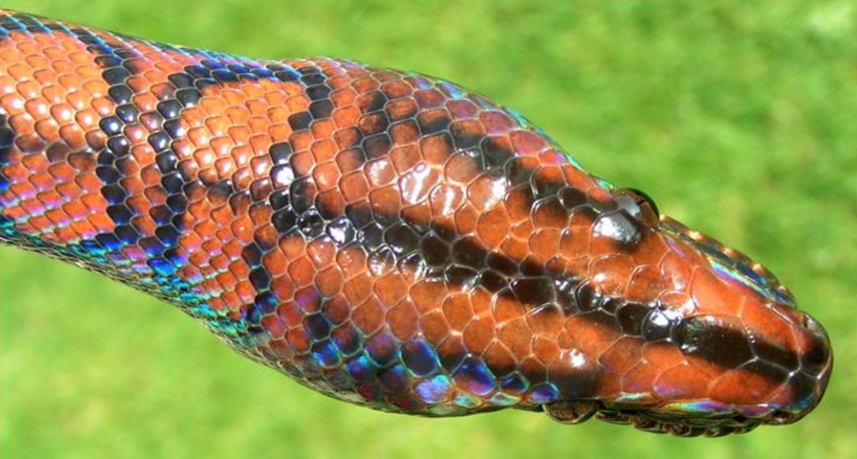
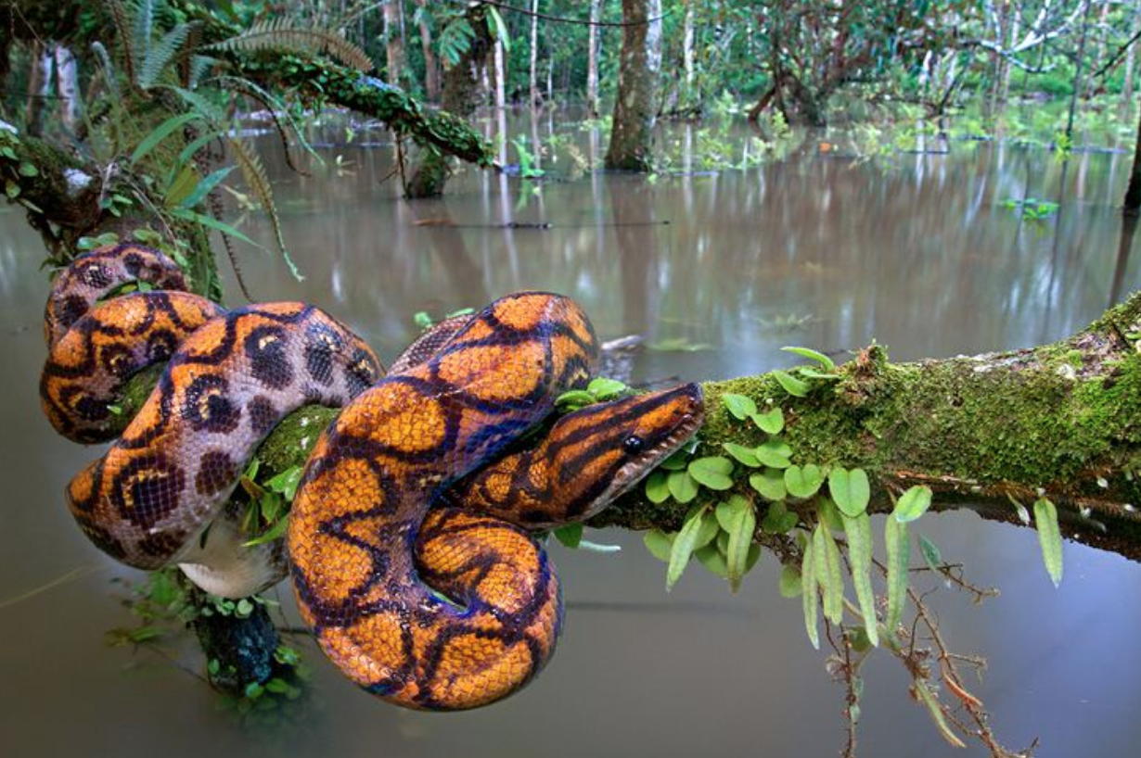
Rainbow boa, master of ants, squeeze open the ant hole so the queens can fly.

