Slide 1
The verbal suffix “chi” is used to increase transitivity. It indicates that the subject is causing someone else to undergo the action of the verb. Learning this one suffix greatly increases your repertoire of verbal vocabulary.
Examples:
rikuna to see
riku-chi-na to show
rikungi you see
rikuchingi. You show
upina To drink
upichina To give someone a drink
upingi. You drink.
upichingi. You give someone a drink
wañuna To die
wañuchina To kill
puñuna To sleep
puñuchina To put a baby or a child to bed

Slide 2
Ñuka-ra chirichin
purina To walk
purichina To make someone walk Allkura purichinara munani.
yachana To know
yachachina To teach
kuyuna To move oneself
kuyuchina To make something move
sakina to leave
sakichina To make someone leave something or entrust (leave) a task
Tukuna To become
Tukuchina To finish something (goes with a transitive verb)
Nuspana To dream
Nuspachina To cause someone else to dream
Ñuka mama ñukara nuspachin. My mother cause me to dream.

Slide 3
The verbal infix –ri decreases transitivity
It often indicates internal states or processes that are not very actively caused. In this sense it is similar to a reflexive but in a manner quite different from different from the familiar reflexive suffix -se in Spanish. In Spanish the suffix -se does not greatly change the meaning of the root verb. In Kichwa however the comparable suffix -ri tends to alter the meaning of the verb to a particular more narrow usage that often must be memorized.

Slide 4
Compare the following pairs:
kushiyana To be happy
kushiyachina To make someone happy
Piñanrina To be angry
Piñachina To anger someone
Llakina To love
Llaki-chi-na To make someone sad
Llakirina To be sad
churana to put
churarina to put on clothes
Churachina to dress someone else. (a child)

Slide 5
Other pairs with –ri
aisana to pull
aisarina for a swelling to go down; for a swollen river to recede
apina to take; to grab
apirina to light or turn on by itself
apichina to light or turn on something else
takana to pound
takarina to bump oneself
kawsana to live
kawsarina to revive
kawsachina to cause some one to revive.

Slide 6
rikuna to see
rikurina to appear
rikuchina to show
sakina to leave
sakirina to stay
tukuna to become; to be transformed into something else
tukurina to run out
tukuchina to finish
llukshina to leave or to emerge
llukshichina to cause to emerge (often used in hunting or fishing). To cause an animal to emerge from its hole.

Slide 7
Match the pairs by drawing a line to the best translation.
Ñambi ricurin
Ñambira ricuchin
Ñambira ricun
Chi sisa wañurin
Chi sisara wañuchin
Chi sisa wañun
Sikura tuku-chi-nawn
Siku tukun
siku tukurin

Slide 8
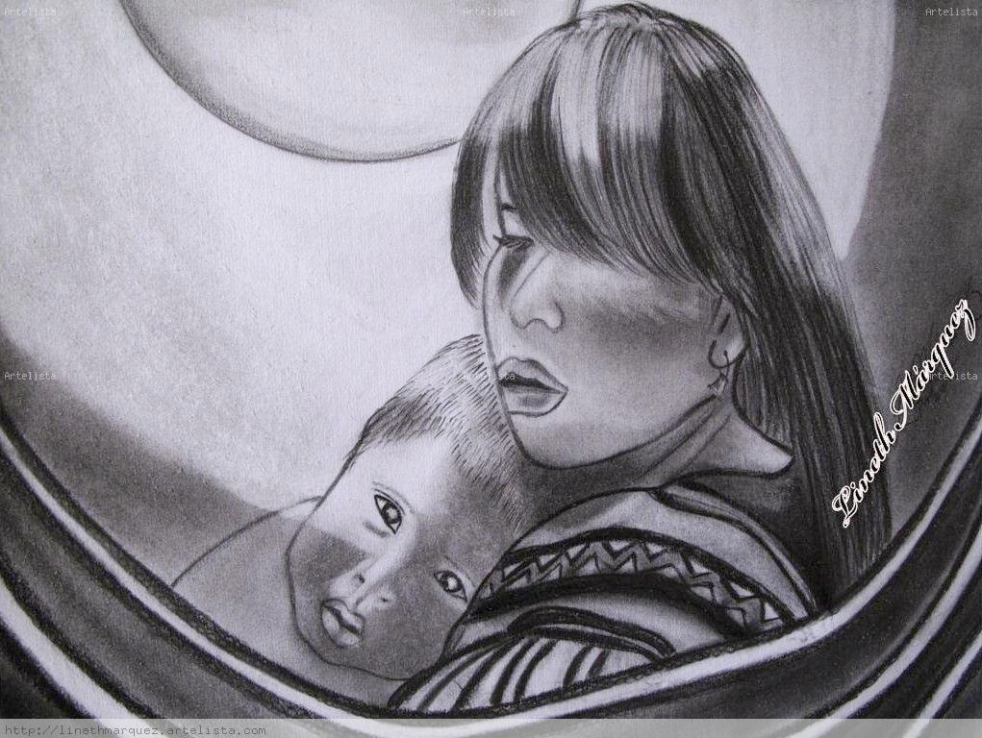
Mama wawa-ra puñuchin
puñuna to sleep
puñuchina to cause someone else to sleep; to put to bed

Slide 9
Pita wawara puñuchin?
Wawara puñu-chi-u-ni.

Slide 10
Pita puñun?
Ñuka

Slide 11
Kanda pita puñunchin?
Ñuka mama

Slide 12
Pita-ra puñuchi-ungui?
Ñuka wawara.

Slide 13
Mama pitara puñunchin?
Ñukara

Slide 14
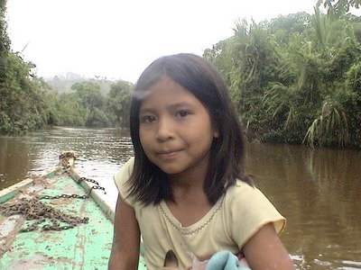
rikuna = to look; to see
Kan-da riku-ni.

Slide 15
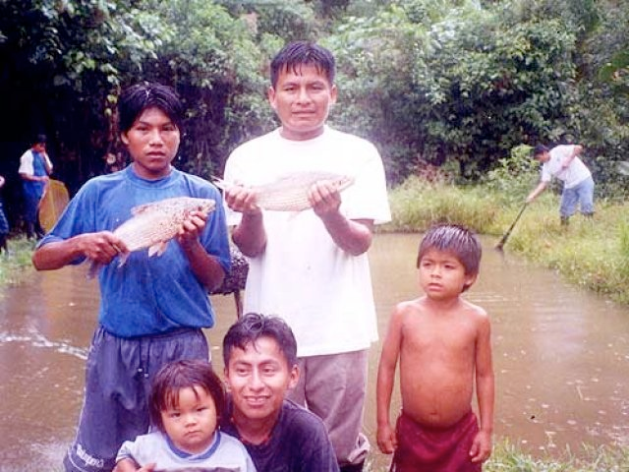
riku-chi-na to show
rikuchinun they show
Aichawa-ra riku-chi-nun. They show fish.

Slide 16
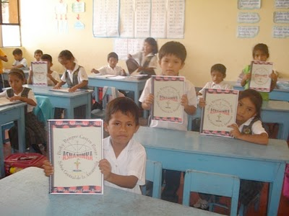
rikuchina = to show
Librura rikuchinun. They show a book.

Slide 17
Cuichij rikurin. A rainbow appears
rikurina= to appear. Kwichik rikurin.

Slide 18
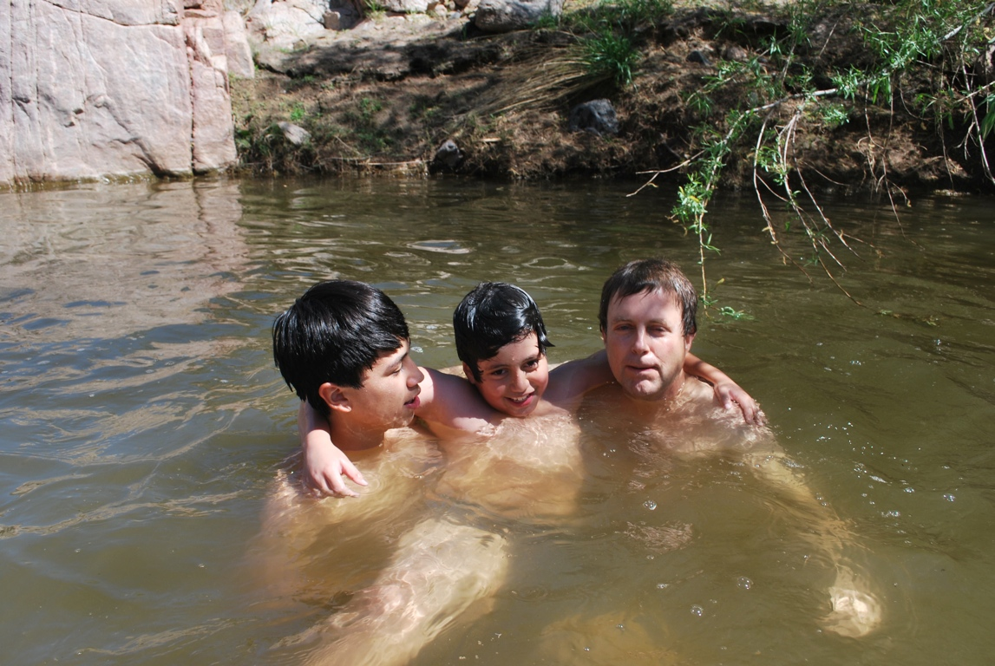
Imararaungui?
Armauni ñuca churigunawa.

Slide 19
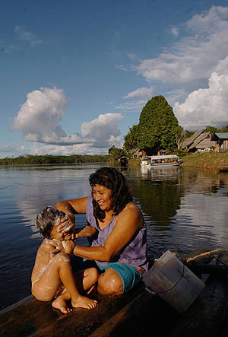
“Sahuan tukun.” “Sahuan huras shamun.”
Kay warmi imara raun?
Paywa churira armachin.
(Not “maillachin”)

Slide 20
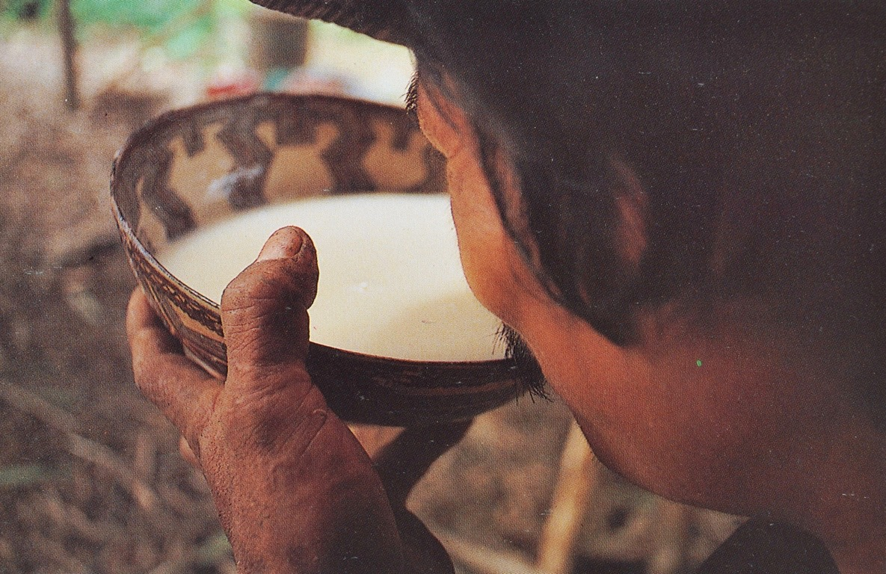
Asuara upin.

Slide 21
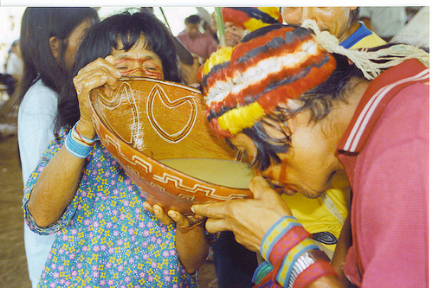
Pay-ta aswa-ra upichiuni.

Slide 22
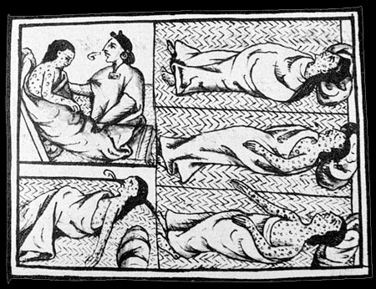
Imara ranun?
Wañunun.

Slide 23
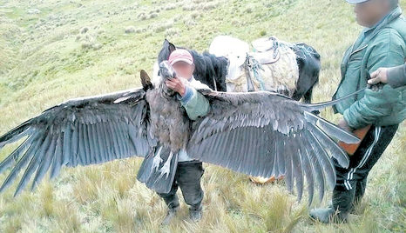
wañuchina to kill
Condorda wañuchin.

Slide 24
wañurina to wilt
wañurin It wilts.

Slide 25
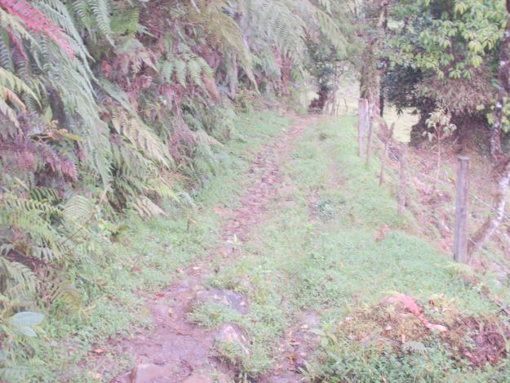
Ñambi chillai tukurin.

Slide 26
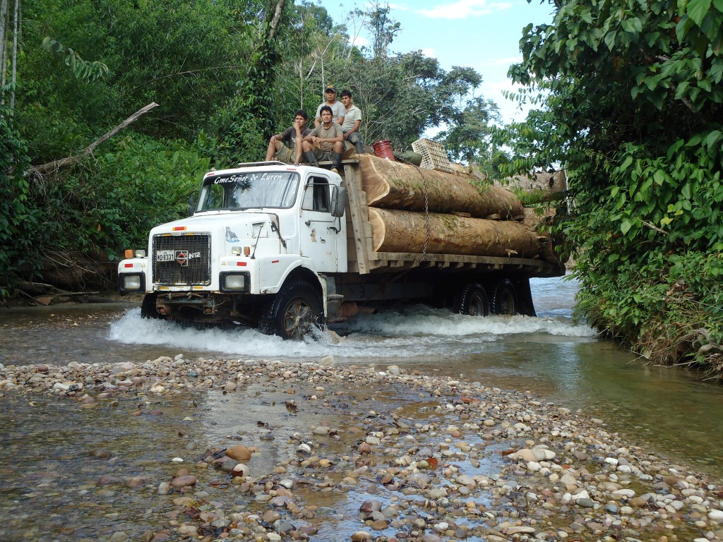
tukuchina = to finish (transitive), to finish off
sachara tukuchinun They finish the forest.

Slide 27
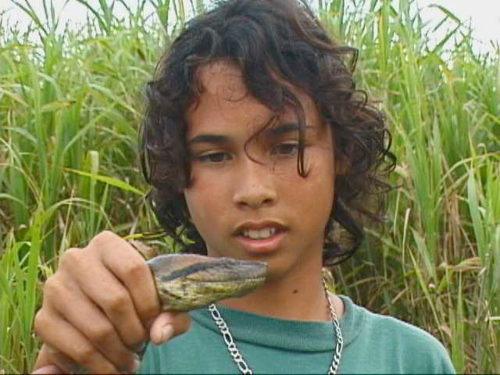
to catch, to grasp
Amarunda apin. He catches a boa.

Slide 28
Radiora apichin.

Slide 29
apirina = to start (intransitive)
nina apirin a fire starts

Slide 30
apichina = to light, to turn on
Ninara apichin. He lights a fire

Slide 31
fotora apichinun.

Slide 32
Aichara pitin.

Slide 33
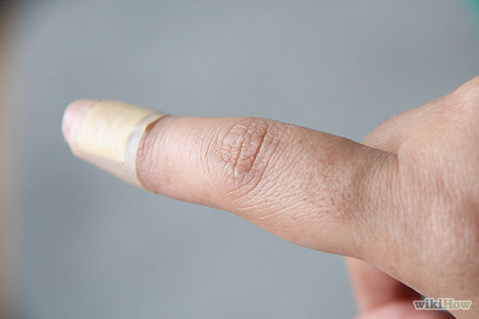
Dirura ansa pitirishca.

Slide 34
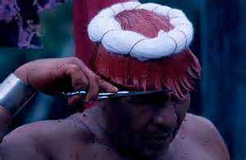
Akchara pitin.

Slide 35
Acchara pitichin

Slide 36
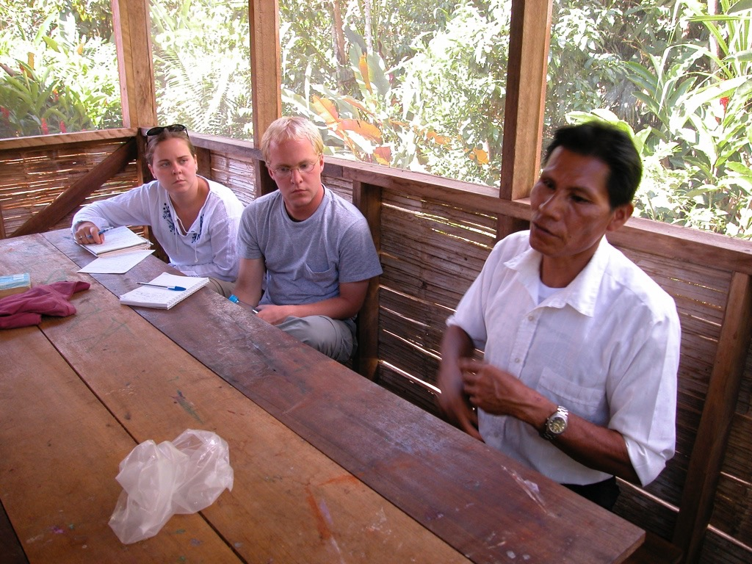
Payguna yachanun.
Pay yachachin.

Slide 37
Botasda churaringuichi.

Slide 38
Yuraj batara churariunchi primera comunionda rangawa!

Slide 39
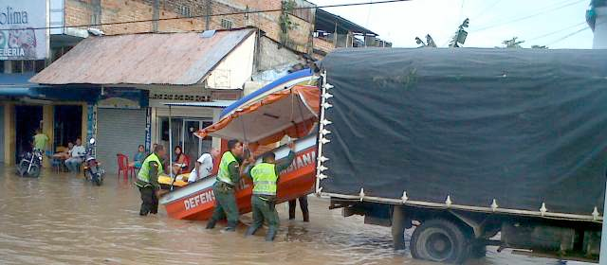
Lancha camionma sikachinun.

Slide 40
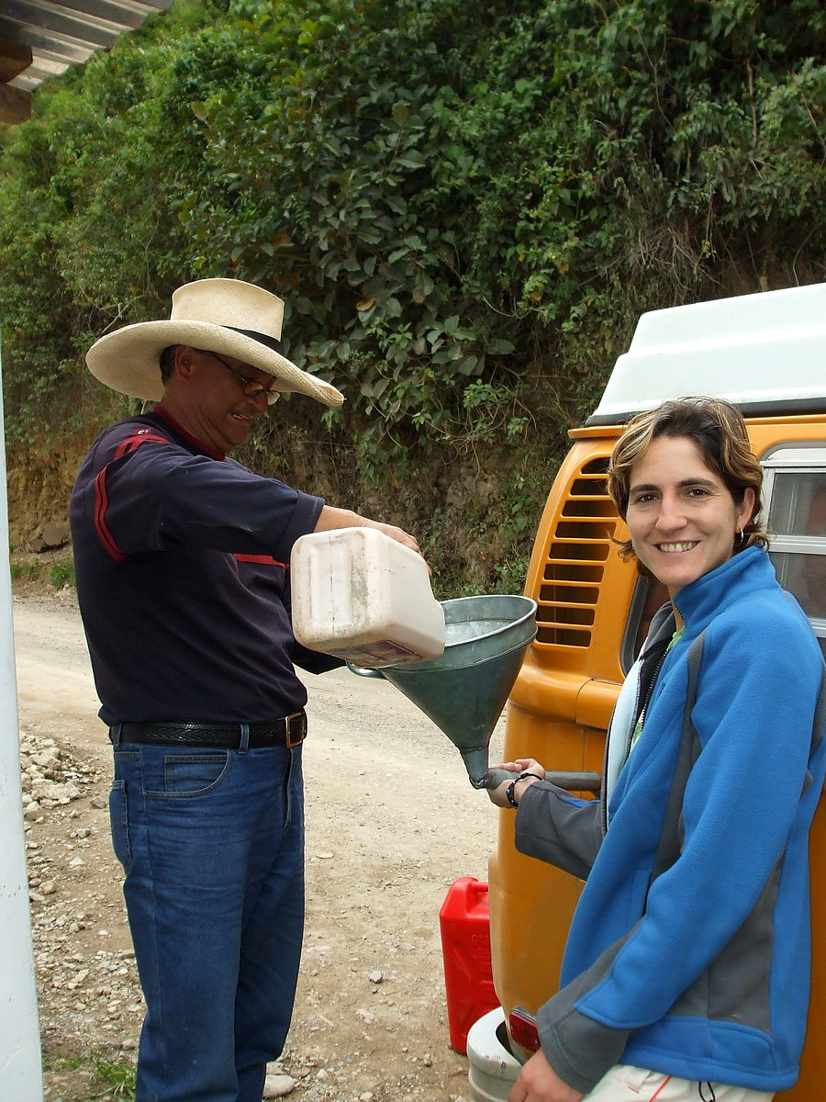
Gasolinara churachiuni.

Slide 41
Paina quiquin shimira rikusha asinun.

Slide 42
Purumanda yakura tallichin.

Slide 43
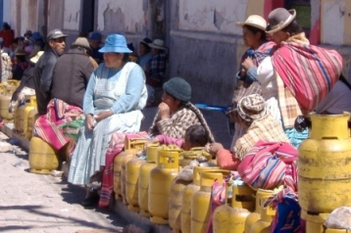
Gas tukurin

Slide 44
Gas tukurin.

Slide 45
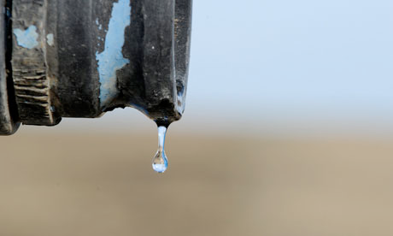
Yaku tukurin.
tukurina = to run out

Slide 46
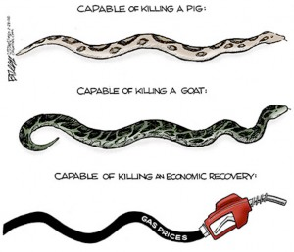
Jesuswa undachingui kamba almara.

Slide 47
Gas tukurijpi waktangaraunchi kamba umara.

Slide 48
Love, Sadness, and Anger
1. llakina = to love
Be able to combine the word llakina with three suffixes
2. -ri- = reflexive suffix which turns the action of the verb inward
3 -chi- = causes the action of the verb to happen to someone else
By combining llakina with these suffixes learn 2 more words:
3. llaki-ri-na = to be sad
4. llaki-chi-na = means both 1) to cause to love; and 2) to cause to be sad. Together these mean “to cause to fell compassion”.
Grammatically the -ri- and -chi- suffixes cannot occur together. If you add -chi- to verb llakirina the -chi- simply “bumps” or replaces the -ri- to yield “llakichina” “to be sad”. Thus llakina (to love) + -ch- = llaki-chi-na (to cause to love) and
llakirina (to be sad) + -chi (to cause)= llaki-chi-na (to cause to love).

Slide 49
In Spanish “amarse” does not narrow the meaning of “amar.” It simply directs the meaning of amar towards the self. In Kichwa however “llakirina” has a narrower meaning than “llakina.” One might be sad when one is loving another person if the beloved is undergoing hard times but not necessarily. However llakirina which may have once meant to love oneself now has a narrower meaning. It means to be sad. To reflect on love or to turn it back on oneself is to be sad. “Llakirina” now has a very particular meaning which has to be learned. It cannot be predicted simply by knowing the meaning of “llakina” + -ri. The same is true of “churana” and “churarina”. In Spanish “ponerse” is as broad in meaning as poner. The -se only directs the action to the self. In Kichwa however “churarina” tends to have the narrower meaning of putting on clothes. Used as a noun “churarina” means clothes.

Slide 50
1) piñarina = to be angry
2) piñachina = to cause anger in someone else
3) yanga piñarina = to be angry for no reason (yanga= for no reason)
Most of the origin stories assigned for this unit are translated from Kichua. Kichua thinking on anger is very similar to what Elvira Belaunde describes for the Airo Pai.
All anger is provoked. Kichua even has a special word for this which is piñachina.
At the same time kichua speaking people also believe that anger at relatives as purposeless. They designate this purposeless anger as yanga piñarina (Similar to Airo Pai goapëine = purposeless anger)

