Slide 1
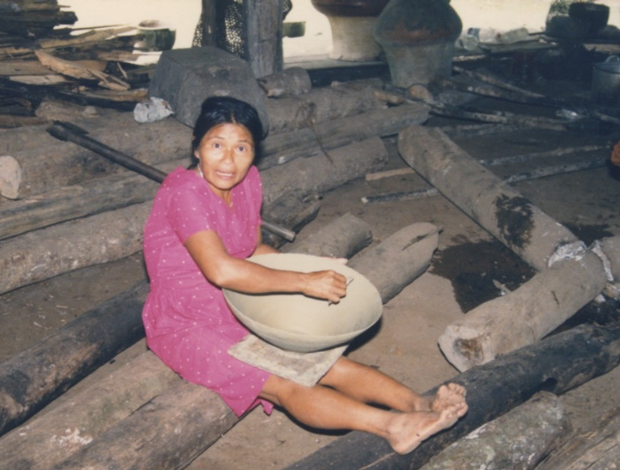
Chapter 13 Durative -u; -k + -ana; -mu, -gri; limitative -gama, -kta; adverbial marker -ta
Aspect
Aspect is a grammatical distinction that encodes the temporal unfolding of actions, events, and processes with respect to their ongoingness or completetiveness. The difference between aspect and tense is that tense relates an action, event, or process to the time of speaking, while aspect is about the ongoingness or completiveness of that action, event, or process
Durative -u.
-k + ana.
Examples:
tinahata awaun
tinahata awak ara

Slide 2
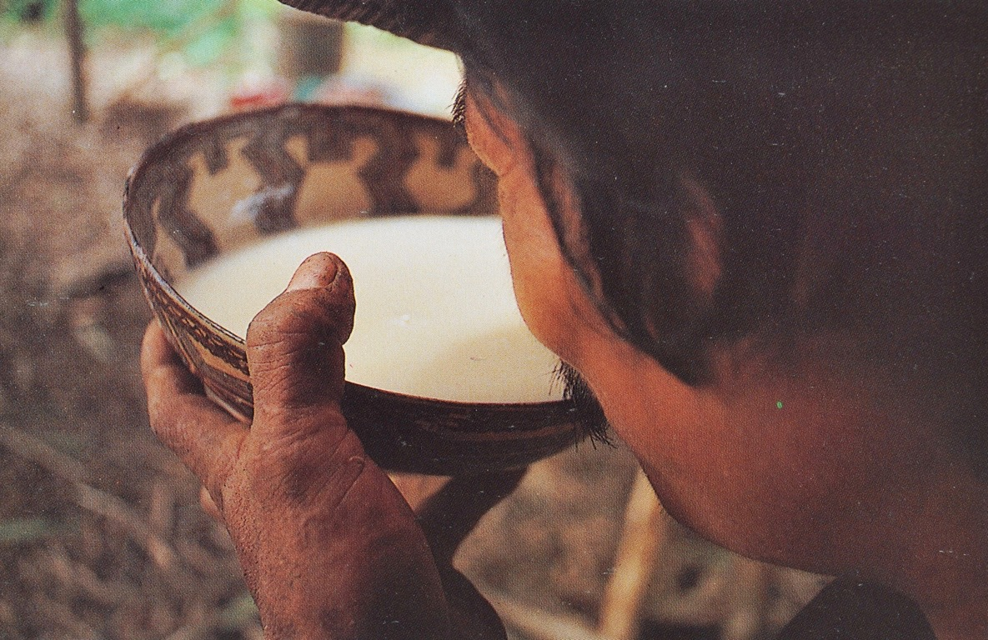
Aspect
To illustrate the difference between aspect and tense in Quichua, consider the following examples. In example 1 below, the drinking of the aswa took place and, with respect to the time of speaking, is over. In example 2, the drinking of aswa is expressed as an habitual, ongoing activity that took place in the past.
1.Aswata upirani. ‘I drank aswa.’
2.Aswa upik arani. ‘I was an aswa drinker/I used to be an aswa drinker/I would drink aswa.’

Slide 3
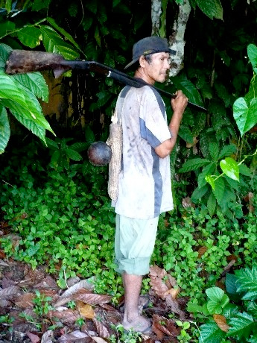
The construction -k + aka indicates habitual action and can be translated as “used to.”
Ñuka yaya sachama purik aka.
My forest used to walk in the forest.

Slide 4
My Dad used to hunt a lot (used to walk in the forest a lot.)

Slide 5
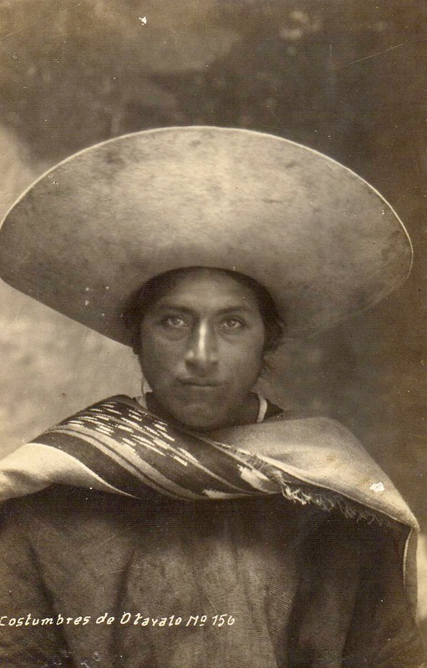
Otavaloguna ñaupa atun sobrerora churarik anauka.

Slide 6
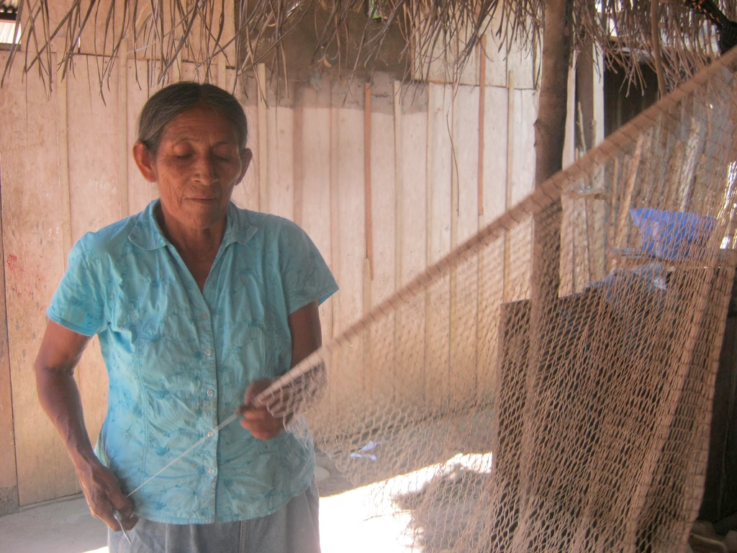
Paiwa ruku mama awak aka.

Slide 7
-mu and -gri/ri
The morphemes –mu- and –gri- are technically known as cislocative and translocative respectively. –Mu- is used to refer to actions that are directed toward the speaker (Compare the terms cislunar “between the earth and the moon”, or cisatlantic “on this side of the Atlantic”).
-Gri- (-ri) is used to refer to an action which is performed by transferring oneself to another location. It can be roughly glossed as “to go and do something, or to go off and do something.” Although –mu- and –gri- are not perfect semantic opposites, they can be contrasted in two ways. –Gri- is usually used to describe actions which move away from the speaker, and –mu- for those moving toward the speaker. They also contrast with respect to their grammatical aspect. Verbs suffixed with –gri- typically refer to punctual, respect to their grammatical aspect. Verbs suffixed with –gri- typically refer to punctual, instantaneous actions and can therefore be used with the sound symbolic adverb dzas. However, they cannot be suffixed with durative –u-. Verbs suffixed with –mu-, however, can either be punctual or durative.

Slide 8
The translocative suffix –rina- or -gri
In Pastaza -ri is added to verb stem-k to form -gri which means to go and do something.
Example (apana= to take) apak + -ri = apagri = go and take. -gri is not conjugated.
In Napo –rina- is suffixed to verb stem + y to mean “go and do something.” As the term “translocative” implies, the action of a verb suffixed with –rina- occurs with a change of location. For example:
apana “to take” > apayrina “to go and take”
randina “to buy” > randyrina “to go and buy.” In this context rina can be conjugated.

Slide 9
Practice suffixing –ri- to each of the following verbs in each person and number.
kuchuna
mañana
mañachina
maskana
tandarina
iyarina
tarabana
waytana
hapina
puñuna
pitina

Slide 10
Suffix –ri- to the verbs in each of the following sentences.
1. Mushuk lyachapata randini.
2. Ñuka kulykiyuk turita rimani.
3. Ñukanchi hatun chagrai tarabanchi.
4. Payguna mikya Lucindawa sawlita mañanchi
5. Alyi alypata maskanawn.
6. Mushuk sawlita mañangichi.
7. Chuchawasata apamungi.
8. Ñukanchi sachama purinchi.
9. Paywa wauki Joaquin kuchara ambin.

Slide 11
The cislocative suffix -mu
The verbal suffix -mu indicates that an action is returning to its point of origin. A possible, but not necessary implication of this meaning is that it include the idea of motion or action toward a speaker. As a specification of verbal motion, it may be thought of as a kind of spatially completed cycle for actions. Just as there is a temporal marking for what has been completed in the past, present, and future, there is also a cyclical retuning to a spatial starting point.

Slide 12
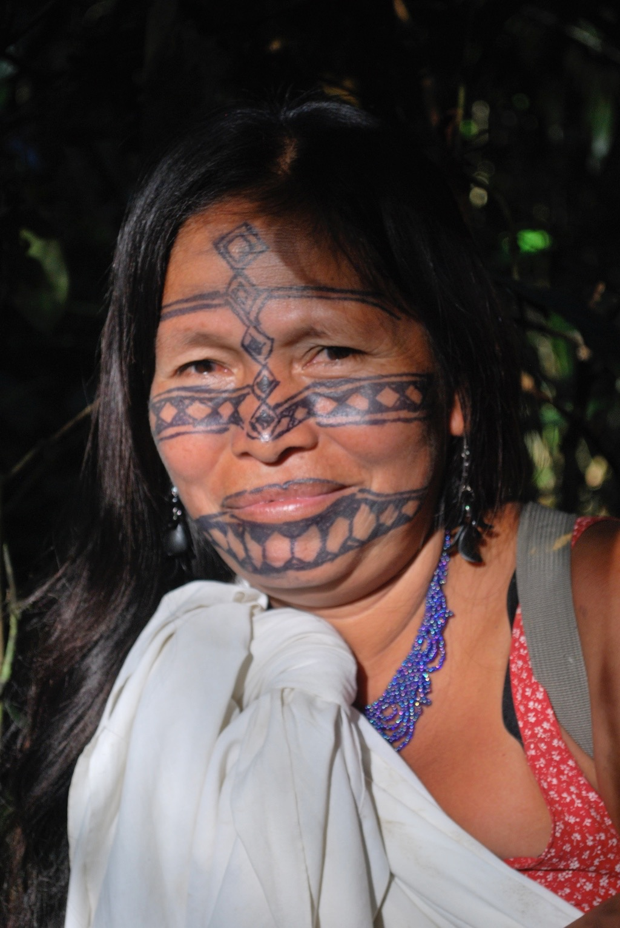
The verbal suifix -mu- signifies the quality of relational movement toward the speaker
apana = to take
apa-mu-na = to bring back
rina = to go
sha-mu-na = to come

Slide 13
Tamia urmamun.
Rain falling towards us.
llucshina= to come out
llucshi-mu-na = Sun rise
ikuna = to enter
Indi ikuna. Sunset
Indi llukshimushkai East
Indi ikushkai. West
The sun rising toward us.
The sun going away from us.
-mu- signifies the quality of relational movement toward the speaker

Slide 14
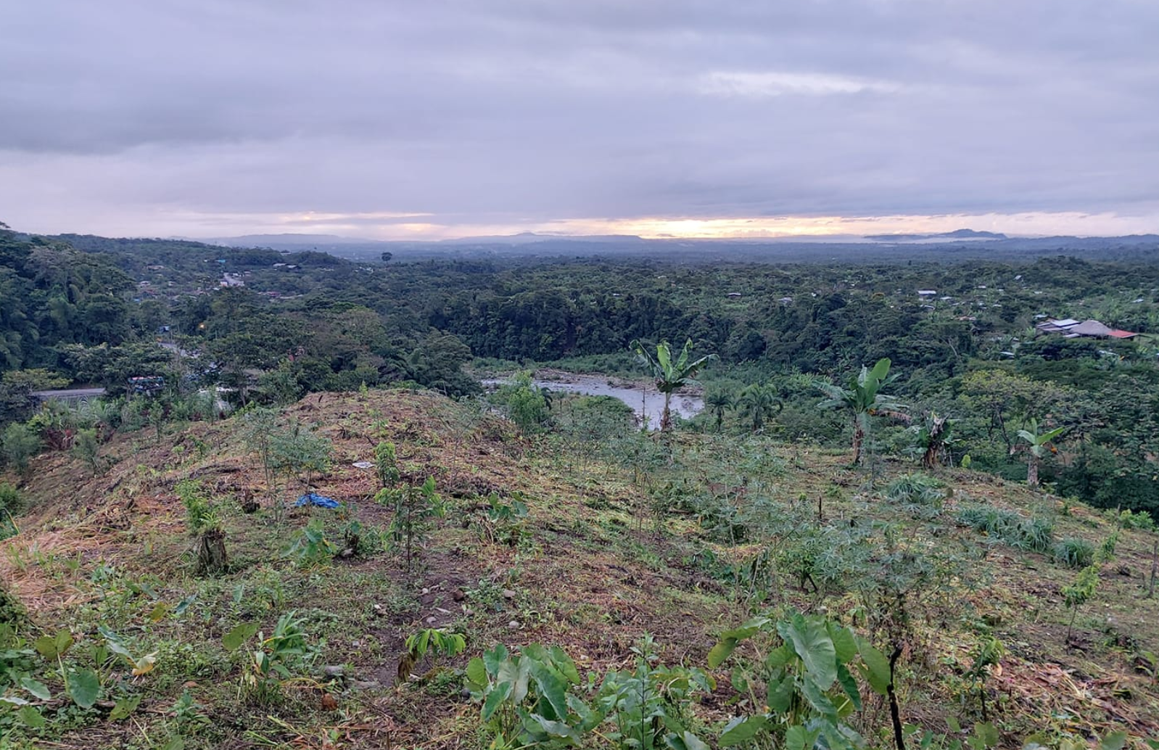
Wasimanda purisha puchukaibi chagrama paktanun.

Slide 15
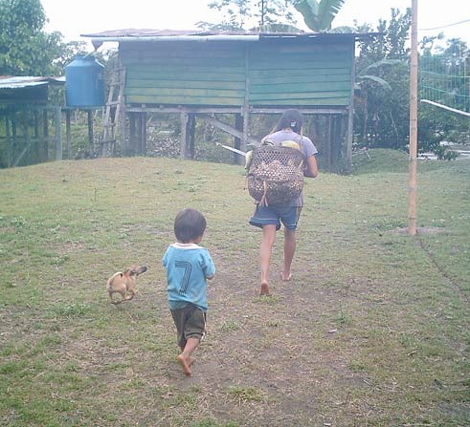
Chiwasha wasima tigramunun.
Chagramanda wasima paktamunun.

Slide 16
Tigra-mu-nguichu?
Ari. Tigra-mu-ni.

Slide 17
The –gama, -kta, and –ta adverbial suffixes
The –gama and -kta suffixes both encode an idea of ‘until’. The suffix –gama is the most unrestricted, as it may attach to any word class to indicate the idea that a spatial or temporal limit has been reached. In the first example below, a spatial limit is demarcated with –gama as the speaker relates how her father used to travel as far as the Marañon River in Peru.
-gama for a spatial limit:
1. Ñuka yaya yapa purik–mi ara Marañon-gama.
‘My father used to travel as far as the Marañon River.
2. In the next example, -gama specifies a temporal limit.
-gama for a temporal limit:
Ñukanchi sakirinchi kayagama.
‘We stay until tomorrow.’

Slide 18
The suffix –kta differs mainly from –gama insofar as it attaches to verbs for the purpose of turning them into adverbs. A verb suffixed with –kta has a completive sense insofar as the verb’s action is now understood as having happened to the complete extent possible. –Gama, by contrast is affixable to nouns, and is more often used when a spatial limit has been reached. Consider how adding –kta to verb roots changes the meanings below:
illana ‘to be lacking’ > illakta ‘until gone’
ismuna ‘to rot’ > ismukta ‘until rotted’
sambayana ‘to become tired’ > sambayakta ‘until tired out’
saksana ‘to be full of food’ > saksakta ‘in a state of having eaten as much as one can’

Slide 19
The final suffix to be discussed, the adverbial –ta, addresses yet another function for this suffix, which we have already met, in the form of the PQ direct object marker -ta, as well as the PQ interrogative -ta for information questions. The adverbial –ta is one suffix that may be used to turn adjectives into adverbs:
ali ‘good’ > alita ‘well’
sindzhi ‘strong’ > sindzhita ‘strongly’
ñañu ‘narrow’ > ñañuta ‘narrowly’
chulla ‘uneven’ > chullata ‘unevenly’
chuya ‘clear, empty, clean’ > chuyata ‘clearly, cleanly’
ichilla ‘little’ > ichillata ‘slightly, incompletely’
iridza ‘ugly > iridzta ‘uglily, scarily, badly’

Slide 20
Written exercise 2
Construct sentences using the following –ta-suffixed adverbs together with the verbs in parentheses.
1.iridzata (muskuna ‘to dream’)
2.alita (allmana ‘to weed’)
3.ichillata (kwintana ‘to speak’)
4.chuyata (sakirina ‘to remain)
5.sindzhita (tarabana ‘to work’)

