Slide 1
Asichina and Llakichina: The Language of Amazonian Quichua Humor
Tod Swanson
Arizona State University
In Amazonian Quichua communities humor plays a key role in creating the empathy needed to hold fragile communities together. Since most Amazonian humor uses the trope of juxtaposing or comparing animal to human behavior I will situate my analysis in the broader context of Amazonian strategies for creating empathy (llaquichina). The use of animal analogies in humor is part of a larger Amazonian strategy of using empathy with animals to mediate empathy between humans.
I will anchor my argument in a group of papers that studied the role of the emotions in holding Amazonian societies together. In her contribution to that work “The fear of Anger among the Airopai” Belaunde showed that anger was feared for its power to turn relatives into enemies tearing a society apart. In his contribution “Helplessness: the precondition of Piro Society” Peter Gow showed how an opposite emotion empathy or compassion society together. In a third paper, “The Efficacy of Laughter” Joanna Overing explores the role of humor in holding an Amazonian society together. (Joanna Overing. “The Efficacy of Laughter: The ludic side of magic within Amazonian sociality.” In The Anthropology of Love and Anger, 65-81.)

Slide 2
Because Amazonian leaders lacked both the coercive power of a police force or the persuasive power of a budget humor loomed large as a tool for dissipating tension and building consensus. It was and still is among the most important tools of Amazonian leadership. Humor was especially important for integrating outsiders into the intimacy of community life. (See Joanna Overing, “The Efficacy of Laughter” In The Anthropology of Love and Anger, 65-81.)
The articles by Belaunde, Gow, and Overing, each study a different emotion in a different language group. Because they base their arguments in the language of the respective groups they study it is difficult to apply their arguments to other language groups or to see the emotions interact. How does the fear of anger lead to importance of empathy studied by Gow or the importance of humor studied by Overing? How does anger as understood in the Airopai language lead to the importance of empathy as understood inthe Piro language or humor. I intend to show how the insights of each work in a similar manner within the Amazonian Kichwa language. By doing so I hope to gain a deeper understanding of how the emotions work together in an Amazonian society. I also hope to show that despite the differences of language there are underlying similarities in the way Amazonian languages work to hold their fragile societies together.

Slide 3
ASICHINA: THE LANGUAGE OF QUICHUA HUMOR
Performative goal: Be able to make humorous small talk
For scholars accustomed to the jaded humor of the urban world Indigenous humor is moving because of its simplicity, its ties to nature, and its constructive quality. The word asichina means to cause laughter. Yet it must be done delicately and with maturity. Foreign students of Kichwa almost by definition fit into the category of visitors to a community who need to be integrated. When they visit Kichwa homes their host will almost certainly use humor to break the ice. The foreign visitor needs to be able to understand the humor and to respond graciously. Thus the use of Kichwa humor is a particularly important linguistic skill for students to acquire. Amazonian communities place a high value on the skill of causing others to laugh.

Slide 4
Across the western Amazon there is a stereotyped female laugh described in the Napo Kichwa ideophone “Ju ju ju juiii! (produced on an ascending scale). This form of laughter is shared across a wide variety of Amazonian language groups. It is the sound of sisters and kachuns bonding, often making jokes together about men. The female sound of asichina is also the sound women engaging men. It is associated with the sound of serving chicha, or women teasing men while serving chicha. Frequently sisters laugh in this fashion while engaging in group teasing of a male visitor
or of a masha, the husband or boyfriend of one of the sisters. It is thus a sound associated with the important Kichwa concept of llaquichina, the creation of feelings of llaquina love and llaquirina (sorrow/empathy) and conviviality. When women hear this sound from afar it is believed to cause them to miss their sisters. When men hear this sound it is believed to make them homesick for the women they love. It thus causes both love and sorrow at the same time which is the meaning of llaquichina.

Slide 5
Since Kichwa humor is so frequently comprised of human animal comparisons it is notable that the very skill of female laughter is believed to be especially embodied in the calls of a bird admired for its skill at conviviality: the russet backed oropendola. The distinctive call of this bird “Cu cu pak-chooo! performed on an ascending scale is believed to be bird women’s form of Ju ju ju juiii! The call of the bird may even be the
original source of the Ju ju ju juiii! that is the sound of conviviality. Because this species builds multiple nests in the same tree the birds seem to get along like sisters who live harmoniously with home side by side.

Slide 6
The common theme that runs through this song is the idea that the oropendola flock are a group of human women whom one can hear laughing together in the distance. The explicit use of the terms “Juuu”, “Juuu ju ju” and “Ju, ju ju juui” mark the birds both as women since it is the sound of distinctively female laughter and as “runa” since it is the laugh that distinguishes Amazonian women from sierra or mestizo women. They are laughing in their chagras-the intimate space where sisters work together--a space that unrelated women cannot enter. The laugh of the birds described as (llaquinalla asisha) laughing with the love/sadness associated with conviviality and the remembering of relatives.
This bird laugh is also associated with the female leadership ability to attract a group of people to come together through her humor and hospitality. The russet backed oropendola is believed to call many other species to travel with it through the use of its humor. This trait is evident in another song to russet backed oropendola sung by Eulodia Dagua.

Slide 7
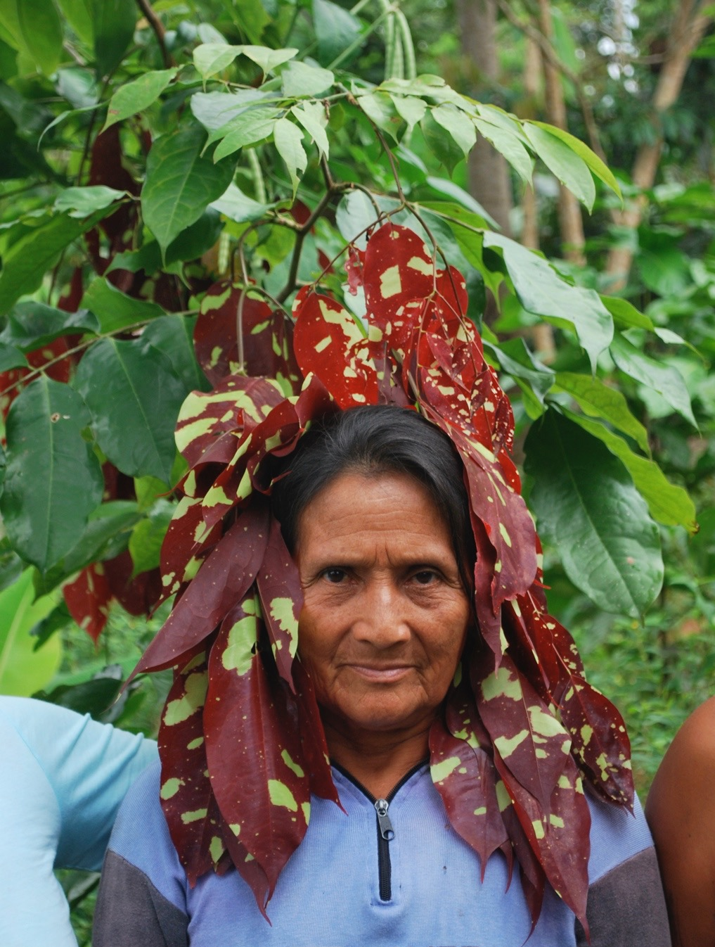
Most Kichwa humor is based on the trope of analogies to the plant and animal world. Although they have very different natures from within those natures they experience their world like we experience ours. Although this is believed to be true it is not at all obvious. Although plants and animals feel like we do they seem to be very different. Kichwa humor seeks to surprise by making these unlikely and unexpected similarities visible.
“But down deep, at the molecular heart of life, the trees and we are essentially identical.” Carl Sagan

Slide 8
One word jokes: Speaking with the name of an animal
The calls and movements of animals evoke llaki because they were once human and are vulnerable like we humans are. Comparing a human to an animal heightens this llaki while causing humor at incongruities within the similarity.
One of the goals of Kichwa humor is subtlety. The goal is to evoke an incongruous comparison without actually spelling it out. One of the most common forms of comparison is to speak the name of an animal at the right moment. Each species is the subject of a body of oral literature that is shared knowledge. Speaking the name of an animal calls to mind these images.

Slide 9
By juxtaposing an animal name with particular instances of human behavior the humorist makes an implicit comparison between the human behavior and the stories associated with that animal.
Wangana (white-lipped peccary) conjures up an image of animals tightly grouped in a pack. It suggests herd activity. But unlike the English metaphor of “sheep” who follow a shepheard wangana seem to rush in a stampede with no known destination.
Chicayu conjures up an image of a mother with too many children all clinging to her body.
Chaja conjures up an image of someone who eats anything.
Pitala- someone with a sharp tongue
Sicuanga-toucan A woman with too much makeup

Slide 10
Chini curu Someone bundled up with too many clothes
Lumu curu A person with very red lips.
Cali cali shimi Someone who chatters continually.
Bula ñawi. Apangura.
Shu shuk ñawi Armallu Some whose eyes look like they are falling asleep. Armallu ichilla ñawira charin.
A comparison of an animal to a human ends in : “runa” rather than in the name of an animal.
Further examples: Ñuca apijpi chutariun. Machacui. If I grab him he stretches. A snake or Ñuca apijpi atunyan. Amarun. If I catch him he stretches. An anaconda.
“Muyura mikusha siki pungundi irayasha purin. Lumucha.” Eating fruits she walks around fattening her rear: Paca
“Aicha” (game animal). Said humorously when someone leaves a muddy foot print coming in the door of the house. The person who hears this joke is supposed to remember hunting a long a creek where game animals come down to drink and then leave the water making wet muddy tracks.
“Yana kallu sikuanga.” Kichwa woman to a man whose tongue is stained with red wine,
Irki changa. Iji.

Slide 11
Machakui. Piñarisha mujllus punguin. “Snake.” Describing a boy comes in angry with his cheeks puffed up
“Iji” grasshopper- someone with skinny legs (Irki changa).
Kukuyu- firefly A bus that comes flashing its lights. Bus shamun punzhan, punzhan, punzhan:
“Tutapishku” (a bat who sleeps upside down).
Response after telling a person with swollen feet to sleep with their feet raised up:
the feeling of lice or ants: shiun shiun shiun

Slide 12
Imarashara kirunlla asisha shayan.
Imarashara ing asisha shayan.
to grin.

Slide 13
Mama Chicayu
conjures up an image of a mother with too many children all clinging to her body.

Slide 14
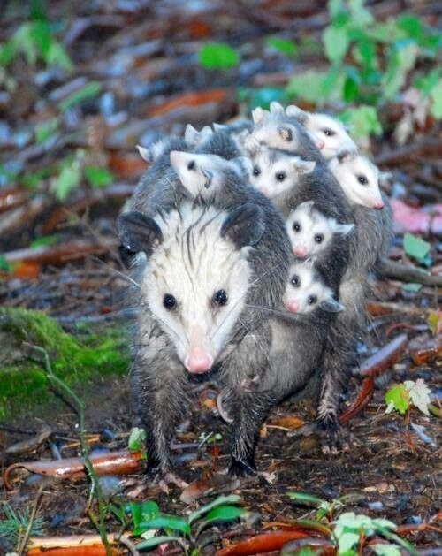
Kan randi chaja mama angui. (Chaja conjures up the image of someone who eats anything; a chicken thief; someone who stinks.)

Slide 15
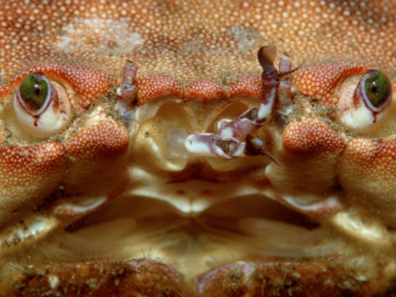
Bula ñawi. Apangura

Slide 16
Maikambi shuj malta warmi paywa ñabi alli pintarisha shamujpi imara ninun?
Sikuanga

Slide 17
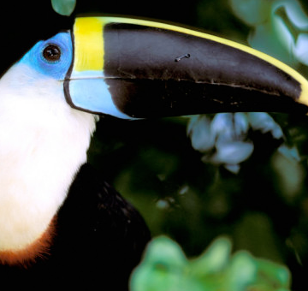
Sikuanga.

Slide 18
Tipuli curu Someone who defecates a lot. Tipuli curu are edible moth caterpillars that feed in large quantities on pacai (Inga edibilis) leaves. When these caterpillars are reaching the stage when they become pupae they all begin to defecate profusely from high in the pacai trees at the same time producing a distinctive sound reminiscent of rain. Runa are attentive to this sound because the caterpillars are a culinary delicacy. Just after they defecate the caterpillars fall to the ground. There is then a window of an hour or so when they can be gathered. When they hear this sound everyone who can rushes out to gather as many caterpillars as possible before someone else gets them. As they gather the caterpillars family members often compete to make jokes about the sound of caterpillar defecation. Since pacai produce a well loved fruit whose seeds are thrown out around the house and grow rapidly into leguminous tree that replennish the soild and are then valued for firewood, most runa houses are surrounded by pacai trees. Hence the sound of the tipuli curu mass defecation is something which everyone hears and knows. Hence the very word “tipuli curu” instantly evokes a universally shared repertoir of scatological humor which does not need to be spelled out.

Slide 19
Sometimes the comparison can be made more subtly by using an ideophone associated with animal behavior. Ideophones are great for subtile humor because they evoke movement or sound without spelling out the meaning to the extent that a word might. For example;

Slide 20
The following suffixes that denote the intensification or exaggeration of a trait are standard features in Kichwa humor.
1. -ruku When the word ruku precedes a noun it means “old” as in “aged”. When it follows the noun it means “big old”.
2. -sapa
Umasapa wawa Bigheaded child
Rinrisapa runa Big eared man
……………… Big bellied man (iksa)
Examples:
Rinri uktu sapa! Uyai pasangui. Someone who overhears too much.
Kallu sapa. A gossip who tells everything.
3 -siki If this suffix is appended to a nominal form of the verb and used as an adjective it means that the person is habitually dedicated to any activity in an excessive manner.
upisiki alcoholic
wakai siki crybaby
tarabaisiki workaholic
4 -kuraga “-chief” works the same way
Wakaikuraga cry-chief (cry-baby)

Slide 21
Similarly there are also a series of diminutives used in humorous
understatement or to exaggerate smallness.
1. -nai, similar to the English suffix -ish.
awa tall
awa-nai tall-ish
Other phrases used frequently in Kichwa humor.
Irusta ricun! Response to someone that is looking at you or staring.
Imara tukun? What is happening?
Imacha tukun!What in the world is happening
Kambas! You too!
Chillara rimani! That is all I am going to say!
Wa!
Kunara atarin (Finally) just now she wakes up!
Kunara riparan. (Finally) just now it dawns on him (or he becomes aware of it).!
Chin! “ I knew it.” “See! I told you so!”
Munai munai warmi mani. Gustu warmi supai mari. Atashailla riki! Kari tunu pugllani!

Slide 22
Expressing similitude. Since humor lies in comparison it will improve your joking skills to learn the Kichwa words for expressing likeness or similarity:
-shina, kasna (kashna), -kwenta….
Examples
Chi warmi wawashinami rimaun. This woman is talking like a baby.
Kasnami lumura ashangai churanaunchi. This is how we put the manioc in the basket.
Ima kuenta tamiaka. It rained incredibly.
Kwinta (shina) ukucha kwinta ; wagra kwinta.
Vocabulary:
Burla shuti
pacha! Too much!
-ruku: Chi runarukuga mana sambayanzhu, purikunllami. That man is not tired, he just keeps walking.
-sapa: iksasapa
-supai: Sachama risha junpisupay shamuni. When I go to the forest, I return sweating a lot.
Wa!
yapajta! too much!

Slide 23
Although most humorous comparisons use animal images references to the customs of other language or ethnic groups is also common.
Eating popcorn in the morning: Awa llacta. or Kungaimanda awallacta tukungui.

