Slide 1
Dialogue for practicing the present tense and pronouns with direct object marker.
Featuring riksina (to know by experience);
pushana (to lead);
katina (to follow)
Begin by translating each slide into English.
\

Slide 2
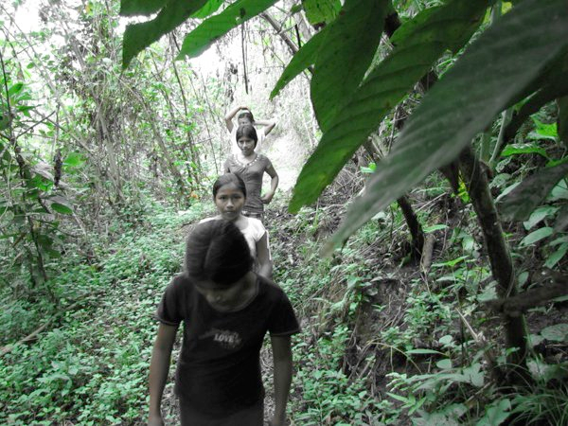
Pita ñambira riksin?

Slide 3
Who knows the path?

Slide 4
Ñambira riksingui?

Slide 5
Do you know the path?

Slide 6
Ari. Ñambira riksini.

Slide 7
Yes. I know the path.

Slide 8
Payta kati-u-nchi.

Slide 9
We are following her.

Slide 10
Paygunara pushauni.

Slide 11
I am leading them.

Slide 12
Ñukara katinun.

Slide 13
They are following me.

Slide 14
Now translate the same slides from English into Kichwa.
\

Slide 15
Who knows the path?

Slide 16
Pita ñambira riksin?

Slide 17
Do you know the path?

Slide 18
Ñambira riksingui?

Slide 19
Yes. I know the path.

Slide 20
Ari. Ñambira riksini.

Slide 21
I am leading them.

Slide 22
Paygunara pushauni.

Slide 23
We are following her.

Slide 24
Payta kati-u-nchi.

Slide 25
They are following me.

Slide 26
Ñukara katinun.

